Slide 1
Suicide and Self Harm – Children and Young People Awareness
Education MH Leads Network Meeting
6th June 2023
Paul Hill Lead Nurse NSFT

Slide 2
Suicide and Self Harm and Young People in Suffolk Local and National Learning
National Confidential Inquiry into Suicide and Safety in Mental Health 2021

Slide 3
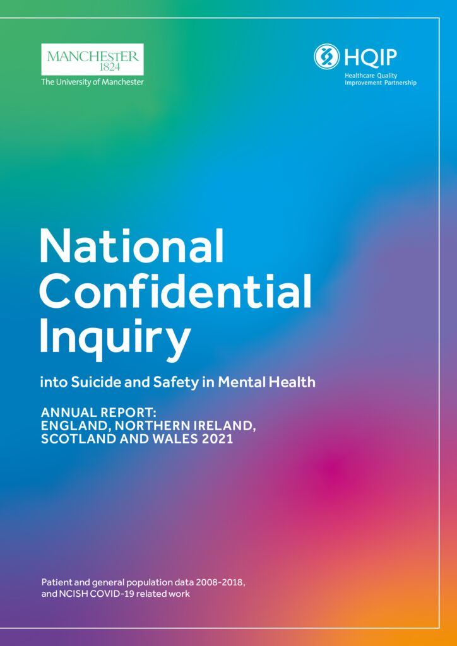
Key Messages At Risk Groups – Under 25s
Report from the national investigation of suicide by children and young people examined suicide by 391 young people aged under 25 in England or Wales
28% had been recently bereaved.
22% were subject to bullying
15% had been abused and or neglected.

Slide 4
Suicide and Under 25s – Themes
1/3 < sought medical help for a physical health condition. The most common conditions were respiratory, like asthma, and dermatological, such as acne.
Many children and young people who died by suicide had not expressed recent suicidal ideas, this accounted for only 27%
24% of Young people under 19 in England who identify as LGBTQ+ and may have fears over their sexual and/or gender identity.
More than a quarter of children and young people who died by suicide, and who were in education, were facing exams or exam results at the time of death.

Slide 5
Suicide and under 25s – Themes
Suicide-related internet use was found in around a quarter of deaths by suicide by children and young people.

Slide 6
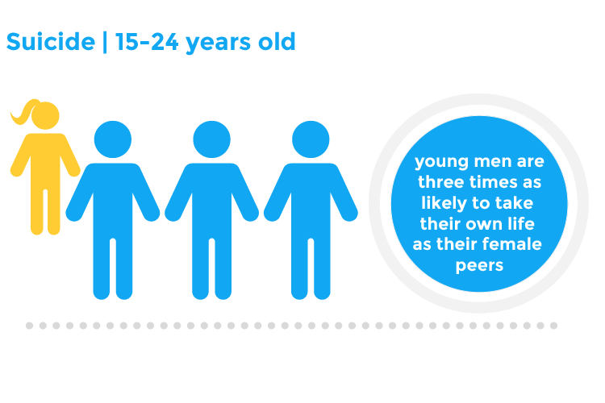
Suicide Prevalence in under 25s
Suicide by young people was rarely caused by one thing and although suicide in all ages is decreasing it is rising in under 20s.
Between 2008 and 2018, the number of young patients who died by suicide increased.
However, the number of suicides in Males is higher than that of females.
Incidents of suicide rises sharply in Young People in their late teens, particularly in those aged 15-17.

Slide 7
Suicide and under 25s – Themes
40% of young people who died by suicide were in recent contact with statutory services.
26% had recent contact with mental health services - and often suicide risk was not recognised.
8% had contact with social care
21% had contact with youth justice

Slide 8
Self Harm
Around half of young people aged under 25 who died by suicide had previously self-harmed
Self-harm in young people was often accompanied with excessive alcohol and illicit drug use.
Self-harm is a crucial indicator of risk and should always be taken seriously, even when the physical harm is minor.

Slide 9
Local Key Themes
Impact of loss of activities/education/work.
Transitions Between Services
THINK Family
Loss of voice of Child and or Parent where one dominates the other.
History of trauma.
Being in an unhappy home.
Parental mental health
The final straw scenario.
Hopelessness and helplessness due to the pandemic and loss of "future".

Slide 10
Local Key Themes – Training
Understanding of neuro development on; risk, impulsivity, fatalism and consequences.
Awareness of physical issues such as puberty and impact of behaviour/risk.
Suicide safety planning: recognising that past behaviour is the best indicator of future behaviour.
Systemic thinking and access to key information about the family and social network.

Slide 11
STORM – Principles

Slide 12
Understanding the person and their story
What do you hear, what do you see, what you do not see and how you feel.
The environment
Empathy
Validation
Asking open questions
Being clear

Slide 13
Assessment process
Twin process with safety planning
Thoughts of suicide
Degree of planning and seriousness of emotional state
The A test
Context
Vulnerability
Notes:
Think about how we ask the question – open/normalising then clarify with a closed question
Degree of planning – where, when, how link to A test
Context – events leading up to the event
Vulnerability – think of the red flags earlier – alcohol, safeguarding, self harm, physical conditions.

Slide 14
Risk Formulation
The 5ps Frame work that helps us understand risk intensity and the different factors that contribute to it.
Problem – Bullying
Precipitating Factors – Exams
Perpetuating Factors – Social Isolation
Predisposing Factors – substance/alcohol misuse
Protective Factors – Supportive family
Notes:
Presenting problem(s): Initial signs, symptoms or other difficulties that are clinically important for the young person. (e.g. low mood)
Predisposing factors: Aspects of the young person’s background that make him/her susceptible to presenting with the given problems (e.g. history of mental illness in family)
Precipitating factors: Immediate issues or events that have caused the young person to present with or experience these problems or symptoms at this time (e.g. recent life experiences/stressors, bullying etc.)
Perpetuating factors: Factors that cause the young person’s symptoms/problems to continue or to progressively get worse (e.g. conflict in home, low social support, poor coping strategies, bullying)
Protective factors: Factors that help to improve the young person’s situation or symptoms (e.g. supportive relationships, friendships and strengths)
We use this to define risk and help us create a safety plan.
We think of who is available to support – family ?
Self help skills
Ensuring safety
Who and how to call for help.
Safe to leave

Slide 15
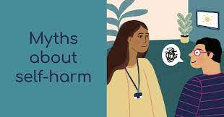
Self Harm – Myths and misconceptions
‘Self-harm is attention-seeking’
Self-harm is a emo/goth thing’
People who self-harm must enjoy it’
Only girls self-harm’
Notes:
MYTH: This is not the case. Many people who self-harm don’t talk to anyone about what they are going through for a long time and it can be very hard for them to find enough courage to ask for help.
MYTH: ‘Self-harm has been stereotyped to be seen as part of youth subcultures such as “goth” or “emo”. While there is some research suggesting a link, there is no conclusive evidence of this with little or no evidence supporting the belief that self-harm is part of any particular subculture.
MYTH: ‘There is no evidence that people who self-harm feel pain differently than anyone else. The harming behaviour often causes people great pain. For some, being depressed has left them numb and they want to feel anything to remind them they are alive, even if it hurts. Pain can also represent self-punishment for some people.
MYTH: ‘It is often assumed that girls are more likely than boys to self-harm, however it isn’t clear if this is true. Boys and girls may engage in different self-harming behaviours or have different reasons for hurting themselves, but this doesn’t make it any less serious.

Slide 16
Self Harm Definitions
Commonly Used Definition:
“Intentional Self Poisoning or self Injury, irrespective of motivation”
Direct Self Harm:
Intentional act of self injury or self poisoning
Non Suicidal Self Injury – specific to self injury
Non fatal safe harm – self injury and self poisoning.
Notes:
The motivation of self-harm may or may not be to end one’s life which can be confusing.
Way to untangle confusion :-
Non-suicidal self-injury – associated with immediate tissue damage. Associated with accumulative damage. Typical motivation to cope with distressing thoughts / feelings rather than ending ones life. BUT does not account for self-poisoning.
NSSI – helpful to understand self-harm as having different motivation; must remember strong correlation between with suicide.
Non-fatal self harm is preferred term – refers to all forms of self-injury and self-poisoning.

Slide 17
Young People who self harm
Tends to begin around 10-14
May prefer to keep this private
Tend to score high on thoughts of hopelessness, depression, anxiety, anger impulsiveness, loneliness
May also have:
Mental Illness
Emotional Difficulties
Personality problems
Eating disorders
Alcohol/drug problems
Notes:
Neurological changes following self-harm have a moderating effect on painful emotions. Mood improves and strong emotions are calmed.
YP in dissociative states – become aware of their being. Beneficial effects are brief, so painful emotions return -> self-harm again.
Beings usually between 10 – 14, and lasts about 10 – 15 years; may continue for decades. More common in females; but other studies suggest equal prevalence.
Many YP prefer to keep SH private. Ice-berg model – at the tip = suicide, middle (above water line) = hospital presenting self-harm, bottom (below water) = commonly occurring self-harm.
SH has a strong correlation with suicide- MUST be taken seriously and considered a ‘red flag’ to future risk. Suicide second leading cause of death for 15 – 29 year olds.

Slide 18
Non Harmful and Harmful Coping Strategies and the link with Suicide
Coping
Health Risk Behaviours
Self Harm
Non Harmful Coping Strategies
Suicidal Thinking
Triggers
Final Straw
Suicide Ambivalence
Notes:
Best seen as a continuum of coping.
Each of us has a set of coping strategies we can draw upon, non-harmful skills (e.g., listening to music) and harmful skills (e.g., smoking, drinking, self-harm).
Strategies are usually effective until they are challenged further and we face increasing emotional pain.
We try to find ways to regulate emotional pain by turning to harmful skills, and away from non-harmful ones.
This usually works. However, if strategies become ineffective, may find ourselves thinking about suicide, or act on thoughts, but with intention to help us to feel better rather than attempt suicide.
Thinking about suicide is point that emotional pain has become unbearable, referred to as ‘psych ache’ – dread, despair, fear, grief, shame, guilt, frustrated love, loneliness, loss.
YP may have suicide thoughts but is ambivalent, even at point of suicide.
Survivors have said that at the moment they attempted to take their own life, they didn’t want to die anymore. This gives us hope that we can help a YP.
I don’t want to die just don’t want to live the life I have

Slide 19
Suicide Prevention
Strategic Measures – National and Local
Prevention
Intervention
Compassion and Engagement
Notes:
Suicide prevention aims to mitigate the risk of a YP ending their life.
Can you think of any strategic measures that are used?
Telephones on bridges
Railings and barriers on high structures.
Reduced pack sizes of paracetamol.
These are effective. Important – link between ambivalence and motivation, by restricting methods, YP distracted enough to change their mind.
BUT YP likely to still feel distressed, even if distracted.
Interventions – key is – be appropriate, accessible, positive experience, listen and act on views of YP, be compassionate and engaging.
Most important of all is how we engage- just knowing someone cares is all we need to change our minds about how we feel. Showing we care can help a YP change their mind about wanting to die. Samaritans

Slide 20
Thank You
Any Questions ?
Paul Hill Lead Nurse Suffolk CFYP and Tier 4 Services

