Slide 1
Seeking pupil views
Kay Breton and Kayleigh Skene
Children's Mental Health Week (childrensmentalhealthweek.org.uk)
https://www.childrensmentalhealthweek.org.uk/media/bb5cdlvn/top-tips-for-schools.pdf
Notes:
KB (KS to monitor chat bar)
Welcome back to all
Taking stock of where we’re at –
Talking through the last few additions to the website and how we’ve come to our plan for the next few sessions (MH event)
Asking people to post a single word / phrase in the chat to capture how they’re feeling about their MH related role in school or college right now.
If you were able now to ask for one topic to cover in our next round of MH topics, what would it be?
Why Pupil Voice? – came as a request via previous survey responses
Children’s MH week.

Slide 2
Session plan
Welcome and introduction
Why should we seek pupil views? A brief discussion of the psychology behind this.
How should we seek pupil views? What do we need to keep in mind to guide us as we do this?
Inviting others to share examples
Some words on the power of being 'deeply listened to' and where this experience sits within relational practice
Talking through some examples of how we have sought pupil views
Sharing resource links
Notes:
KB

Slide 3
What does it mean to seek pupil views?
Gathering CYP’s views and wishes about themselves, their situation, experiences, and their hopes/goals
Using flexible, developmentally-appropriate methods (observation, ask parents, 1:1 conversation, drawing, card-facilitated views)
Really hearing the views they shared and doing something with that (e.g., sharing views more widely, facilitating change in response)
Ideally embedded across school, facilitated by all staff, to be part of ethos :Pupil voice : Mentally Healthy Schools
Notes:
KS
Set ground for rest of the slides e.g., why / what intention and how
+ explain link (whole school approach)
Pupil voice in schools means a whole-school commitment to listening to the views, wishes and experiences of all children and young people. It means placing value on what children and young people tell school staff about their experiences.
Children and young people need to be provided with meaningful opportunities to share their experiences, views and hopes about their school.

Slide 4
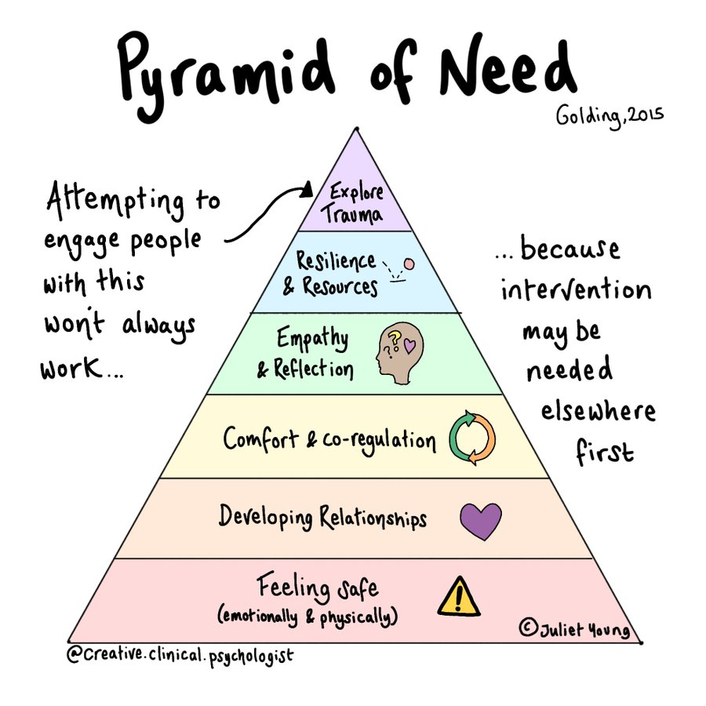
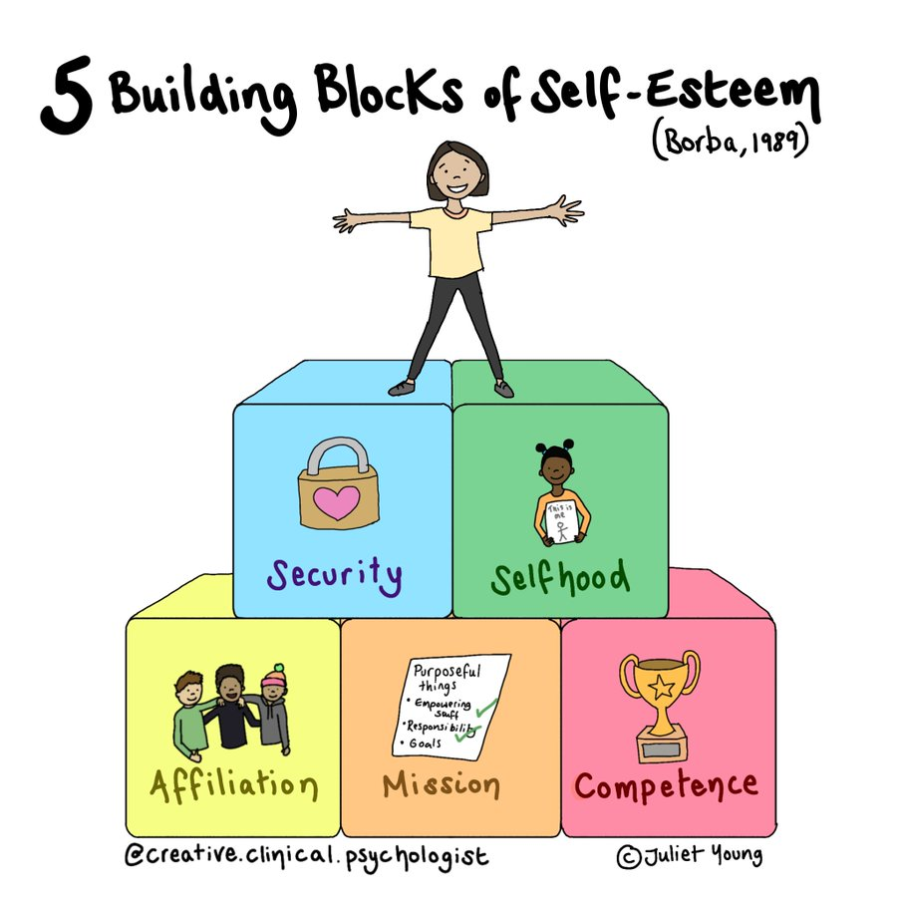
Why should we seek pupil views?
Notes:
KS – intention; feel heard and included; important to wellbeing and motivation...
Thinking about wellbeing specifically – considering psychological theories and some of our basic needs, there's overlap in the importance of feeling safe/developing relationships and belonging with others, feeing sense of agency/autonomy, and getting to feel accomplishment and success – all important for motivation, self-esteem, wellbeing and we know we need to prioritise this to allow access to education.
Important to consider the theory because it can guide both why we should seek pupil views and how we can go about this. If we want to support wellbeing, we need to support connection, feeling heard, and opportunities for success and gathering pupil views provides opportunity to do so....
Relationships/relatedness / connection at heart of all these theories – seeking pupil views gives opportunity to develop relationship through giving space, listening, learning about young person, connection
Sense of agency/autonomy important to wellbeing - feeling choice over what to share / involved in decisions – important for motivation and self-esteem e.g., gathering pupil views gives CYP a chance to feel involved in decisions that may impact them – to make requests for support they need
Importance of competence, experiencing success - Opportunity to recognise and share strengths in pupil views – not only again feed into motivation and self-esteem, but aligns with solution/ positive psychology that recognises ‘doing more of what works’ e.g., if young person/adults can recognise strength for individual, moments of success, maximise these, bring into areas of difficulty.

Slide 5
What aspects of pupil views feel key to consider?
What are we seeking pupil views about? What is the intention?
How does the young person prefer to communicate? (person-centred approach)
Who is the ideal person to facilitate this? (relational-first approach)
What is important for others to know?
Who does this information need to be shared with? How?
Notes:
KS
Considerations before gathering pupil views (to inform the HOW)
Intention – to inform? To understand?
How communicate - HOW (competence, success) using tools that align with YP existing strengths in communication - A child or young person may be very ready to speak whole-heartedly about what they are thinking or feeling, but more probable is that they will find this difficult. Sometimes they may share want they think people want to hear, or the response that they think is most likely to stop further difficult questions being asked. Sometimes they may simply not be able to put into words what they are thinking or feeling.
Relational - HOW (relationship/connection) need to think about who already has good relationship with young person or is relationship building first needed? If a child is going to feel willing and able to let others know what they think and feel, then they must feel able to trust the person they are sharing their views with, and to understand how their views are going to be captured, shared and used. - context of rapport building and feeling safe
What shared- HOW (autonomy) also important to respect their agency e.g., who does this info need sharing with? And aid their voice to be heard e.g., show action (relationship)

Slide 6
Gathering pupil views
When and why are you gaining the voice of CYP within your setting?
What good practice have you / your team found for gathering their views?
Notes:
KS
Hand up or chat options – activities from childrens mental health week to share/feedback?

Slide 7
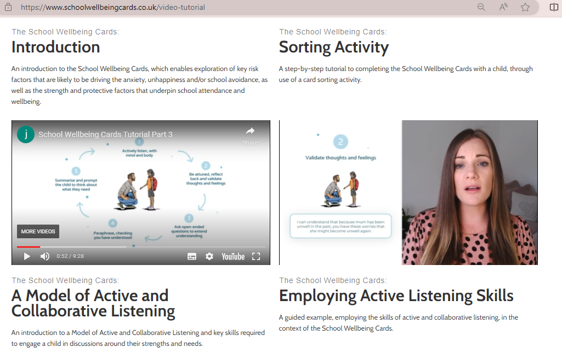
The importance of active listening
“Every interaction is an intervention” (Dr. Karen Treisman)
The principles outlined below can help create a space for a rich conversation. These are based on some of the active listening principles explained by Dr. Jerricah Holder, outlined in her ‘School wellbeing cards’ resource
(https://www.schoolwellbeingcards.co.uk/video-tutorial).
Be
Be self-aware - try to notice your own thoughts, feelings and behaviours as the child or young person is speaking and be mindful of what they may convey or how they might shape and impact your listening.
Be judgement free - try to leave judgements aside during your discussion as these will inevitably be felt even if they are not named.
Keep an open mind, be genuinely curious and ask open questions
Validate the child or young person’s thoughts and feelings
Paraphrase and Clarify to further check your understanding
Reflect back - check that what you think you’ve heard is in fact accurate and as intended (ideally using their own words).
Summarise and prompt the child or young person to think about what they need.
Notes:
KB to talk through
Emphasising that listening is more important than the tool that facilitates it…

Slide 8
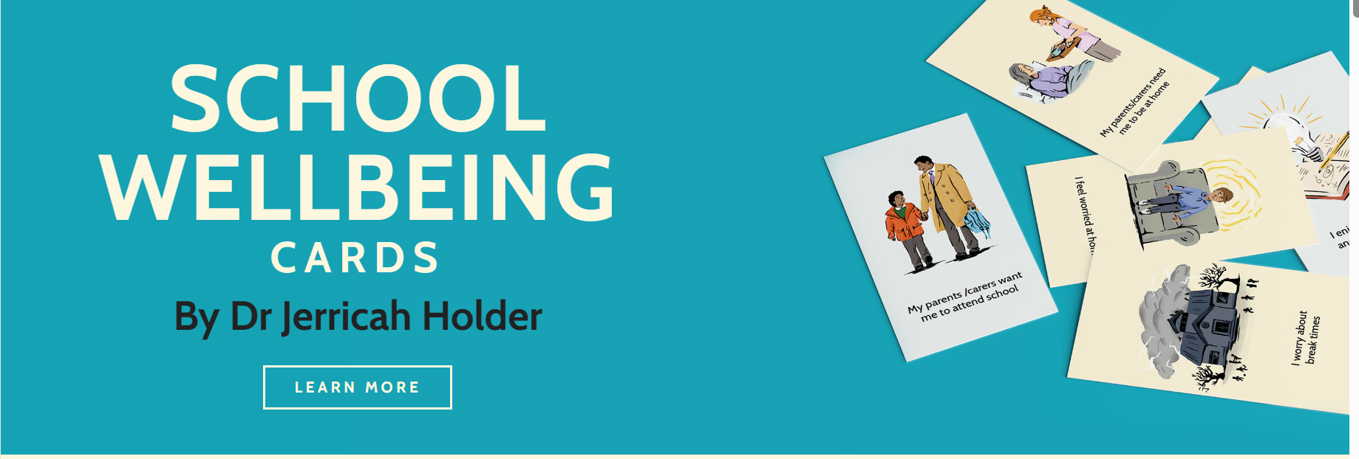
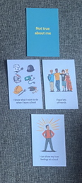
Example : school wellbeing cards
Why were pupil views gathered?
How did the young person prefer to communicate?
What did this look like?
What felt important for others to know and how was this shared?
Action planning tool
Notes:
KS to talk through
Why: Year 6; ASC; school attendance low and masking a lot at school with emotion expressed at home through physical behaviour; EHC needs assessment
How : decided from info I had + flexible response to young person in situation: Verbally but with visual prompting to aid understanding; With familiar adult present in a quiet space; processing time
What involve: school wellbeing cards – EBSNA – sort resilience and risk cards into 'true' and 'not true' about me – push and pull factors – able to ask curious questions e.g., why, tell me more, which is most important?
What share and how? Lots of individual factors of what the YP needed but also wider themes to share e.g., he wanted to fit in with others and feel understood (belonging) and he was generally self-critical throughout (Self-esteem) but was able to recognise lots of strengths too (celebrate these) - shared with SENCo and used in his EHC needs assessment advice for informing provision – could have also used action planning tool

Slide 9
Example : the incredible 5-point scale
Why were pupil views gathered?
How did the young person prefer to communicate?
What did this look like?
What felt important for others to know and how was this shared?
Notes:
KS talk through
Why: Year 9 pupil; finding it hard to emotionally regulate in busy high school and so expressing through behaviour and at risk of exclusion; EHC needs assessment
How: Verbally but with a resource to focus on to aid attention and short bursts of discussion, 1:1 in a dimly lit room
What involve: adhoc – were discussing verbally but young person said "I get angry a lot" so drew visual to explore this; Flexible use of tool, developing use with the discussion – 5 point scale great resource and can be used flexibly for understanding and communicating emotions, interpreting social behaviours.
What share and how: Young person's views on what he wanted/needed to prevent and manage 'anger'; shared in EHC needs assessment, recommended using 5 point scale to facilitate conversations and SEMH interventions with young person

Slide 10
KS1 example(s)
NB: A lot of pupil view seeking activities in the younger years necessitate a basic understanding of what it means to feel happy / sad – so in order to engage pupils in work of this nature in a meaningful way, you might need to do some ground-work first.
Activities:
Sorting and scaling (e.g. using Children’s exploratory drawings )
Using stories to explore how different characters feel in different situations and making comparisons with own experiences
Using small world and puppet play to act out different scenarios and explore related feelings / thoughts
ELSA website as a source of ideas: All about me for Early Years - Item 499 - Elsa Support (elsa-support.co.uk)
cmhw-primary-schools-pack-2024-digi.pdf (e.g. incorporating question prompts into familiar games)
Notes:
KB to do

Slide 11
Some additional proformas for gaining pupil views
In Suffolk we aim to be strengths-based, solution focused and person centred in the work that we do, and truly believe that enabling a child to recognise their strengths, positive character traits and contributions are equally as important in terms of engagement, progress and wellbeing, as helping them to identify any areas of difficulty, if not more so.
With this in mind we are including here some suggested strategies and proformas for gaining pupil views:
Capturing concerns and worries – an activity for children or young people to complete with the support of a family member/ trusted adult or independently with the opportunity to share what is worrying them across their school and home contexts and other areas such as health and friendships (see slide 12).
What is going well – with a similar format to the above activity, this resource gives the opportunity for child or young person to share with the support of family or independently what they feel is going well for them at the moment, which can then be useful to inform what can be built upon within further conversations about supporting them back into school (see slide 13)
One page plan - This document is designed to help plan next steps for a child or young person (see slide 14).
A person-centred plan – this is another version of the one page plan which you might prefer (see slide 15).

Slide 12
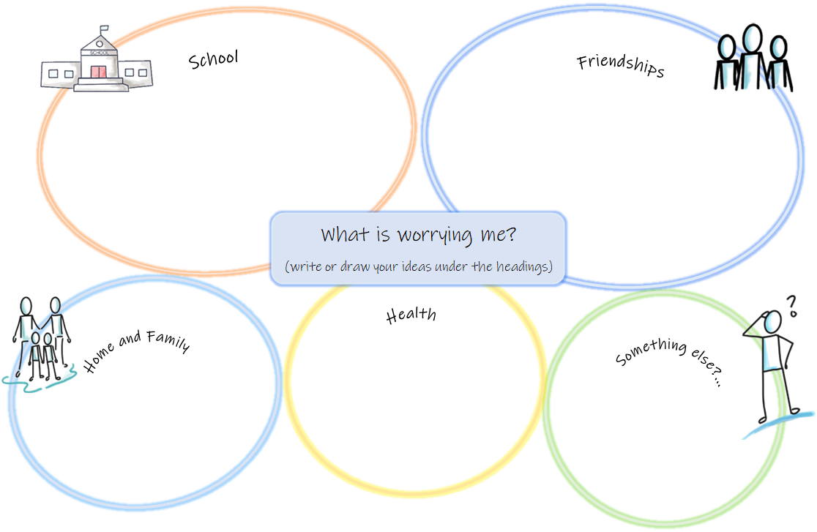

Slide 13
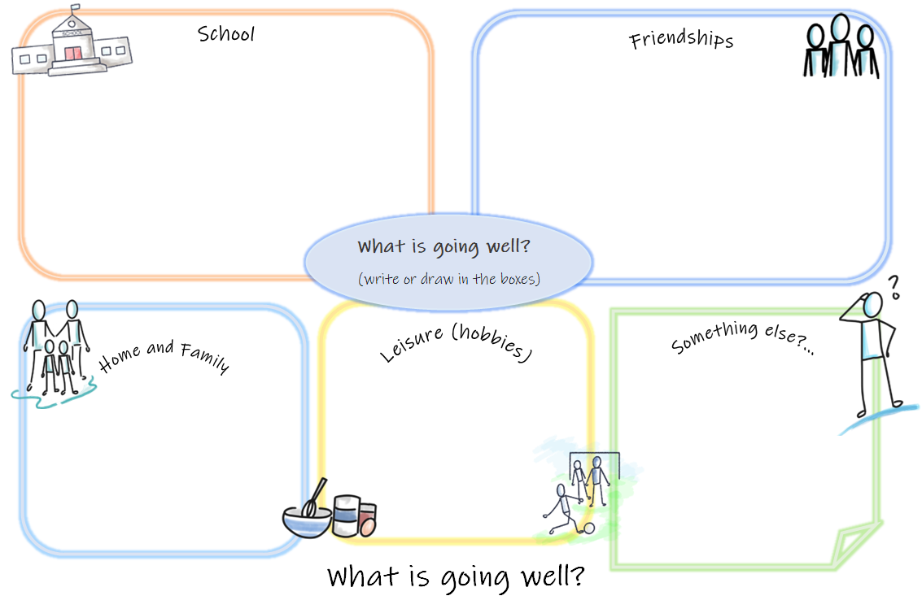

Slide 15
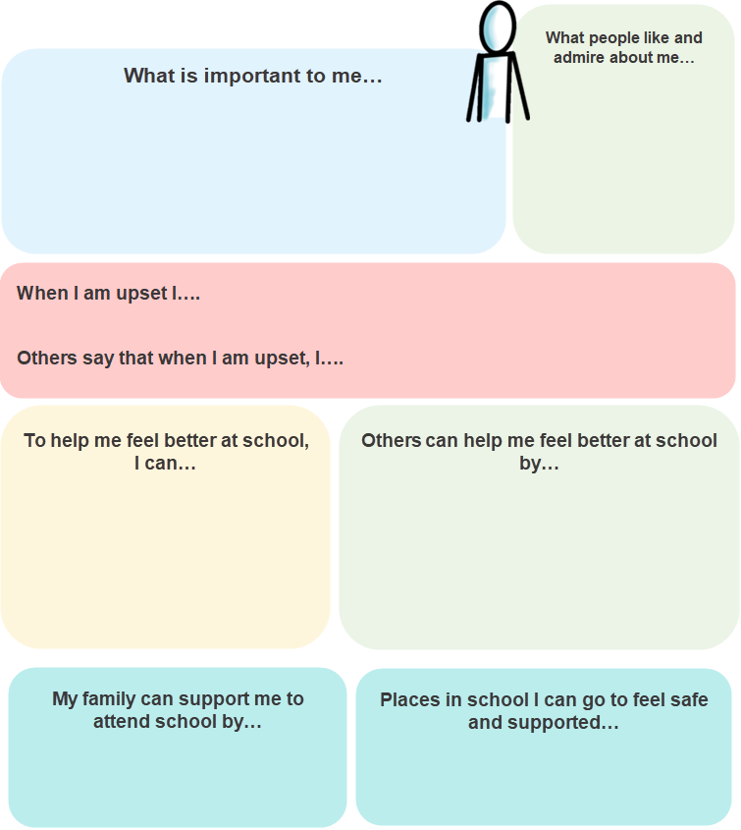

Slide 16
Ideas for collecting pupil voice
Visualising future hopes/goals
Person-centred planning e.g., PATHs (mini-PATH training)
Magic wand / 3 wishes
Card-sorting activities
School wellbeing cards
Strength cards
Externalising discussions (for those who
find talking about themselves trickier)
Blob trees
Children’s exploratory drawings
Visual and creative activities (for those who find talking trickier)
Drawing the ideal school / self / worker
Building the ideal classroom
Photo voice
Incredible 5 point scale / zones of regulation
Supporting / Preventing EBSNA
Co-produced documents (One page profiles, pupil passports)
Mapping landscapes / RAG rating school environment
Drawing the ideal safe school
highland-council-psychological-service-tools-for-gathering-the-views-of-children-and-young-people-may-2020.pdf (education.gov.scot)

Slide 17
Some additional example strategies and proformas for gaining pupil views
Here are some website links to other information gathering activities and proformas that you may be helpful for both gathering pupil views, but also potentially in terms of helping them to consider and plan next steps (please note there are many others freely available and those included here just represent a small sample):
Inclusion Facilitators Free Resources - Suffolk County Council Our Inclusion Facilitator team have produced a wide range of freely available resources to facilitate working with children and young people to gather their views, thoughts and feelings.
Preparing for Adulthood: Person-centred Planning Tools – NDTi Includes a wealth of view gathering ideas (many can also be edited and adapted to enable a more bespoke approach) such as ‘Good day / Bad day’ to help with understanding what is important to and for people to have the life that they want; ‘Perfect Week’ to help us to see what different aspects of living make up a really great week for a person; ‘Working / Not Working’ to help people to sort out what is working from different perspectives; ‘Coping strategies’ to help people to express their anxieties and concerns.
Solution-focused practice toolkit: helping professionals use the approach when working with children and young people (nspcc.org.uk) Includes activity ideas and printable proformas to use for gathering pupil views in a solution focused way.
A Therapeutic Treasure Deck of Sentence Completion and Feelings Cards- Dr Karen Treisman (youtube.com) for an explanation of how Dr. Karen Treisman uses her card deck to elicit views, feelings and strengths.
This is a very simple proforma example to aid the start of conversation: sentence-starters.pdf (mentallyhealthyschools.org.uk)
Another simple questionnaire example that could be sampled to begin a conversation: Me and My Feelings Questionnaire (corc.uk.net)
Emotional-Readiness-Scale.pdf (elsanetwork.org) We would suggest being careful how this tool is used but do think it helpful as a checklist for consideration of pupil strengths and challenges, and of what type of social & emotional skill set is needed to manage school.
student-resilience-survey-1.pdf (corc.uk.net) is a helpful questionnaire to prompt consideration of resiliency factors that can then be developed with support.
The Three Houses templates - Free Social Work Tools and Resources: SocialWorkersToolbox.com Is one example of the ‘3 Houses’ activity (which can be made into 4)

Slide 18
Using questionnaires to gather views:
The accuracy and value of a questionnaire is very much dependent on the mood and communication skill of both the person asking the questions as well as the person answering them.
If they simply become a way of progressing through a list of possible problems and worries in a very problem-focused way, then they cease to be helpful and may even undermine wellbeing rather than contribute to it. We are including some of the best evidence-based links here that will take you to a range of information gathering tools but would advocate care and consideration in their use:
There are many questionnaires and check lists that are widely available that can be used to help gather information about what is going on for a pupil.
Outcome & Experience Measures (corc.uk.net) is a website with links to a wide range of information gathering tools
Wellbeing measurement framework for schools | Anna Freud via this link you will find a range of possible questionnaires to use in primary and secondary schools and colleges to aid information gathering.

Slide 19
How are you feeling about your job role right now as it relates to MH?
What topics would you like covered in our future MH network meetings?
There is always more to be done…
Notes from participants in our meeting on 15th February 2024 – many thanks to all contributors ☺
School avoidance / anxiety
School refusal
Separation anxiety
Lesson avoidance and internal truancy
EBSA
School avoidance and self harm
Finding ways of helping anxiety without indirectly raising it
There is not enough time, or hours in the day
The role is sometimes completely overwhelming
Accessing MH help is still difficult… There is a lot of need and limited opportunity to get external support
Ideas related to pupil voice that were shared:
Seizing an opportunity for a spontaneous chat – Who are your role models?
Having a devoted hour every week in every class for ‘Safe space time’ where pupils get a chance to share their worries / ideas / feelings.
Having a circle time where pupils share their opinions on anything from school uniform to the injustices of this world
Taking pupils on a walk around their local area doing some litter-picking – a great way for gaining a sense of contribution
Creating a ‘Student MH Ambassador’ role and working with pupils to gain feedback on what helps and what hinders MH in a setting (e.g. consider content of toilet door posters)
Creating a “what I would like my teacher to know” box
Having whole class meditation time
Making sure everyone has a One Page Profile
I feel exhausted… feel constantly expected to do more
Note:
There are resources to support schools around toxic masculinity on the Suffolk Schools RSHE Portal - RSHE/PSHE leads and senior leadership in all Suffolk schools should be aware of it. If anyone wants access and their school have not made this known to them, do just email me as it is not limited to subject leads jane.stannard@suffolk.gov.uk
https://www.suffolk.gov.uk/children-families-and-learning/wellbeing-in-education/suffolk-education-mental-health-lead-network

