Slide 1
Welcome
Mental Health Lead Network Event
3rd November 2023

Slide 2
An Introduction to RESTA
Dr Esther Borrett, Brimstone Psychology

Slide 3
What is RESTA?
RESTA is an evidenced based model of intervention and support designed to increase Educational Resilience in young people
Utilises educational setting staff to be able to support students
Follows other models of school support (trained member of staff receiving psychological supervision from Educational Psychologists)
Differs from other models of support (concise, sequential approach untilising evidence from both educational resilience and trauma responsive practice)

Slide 4
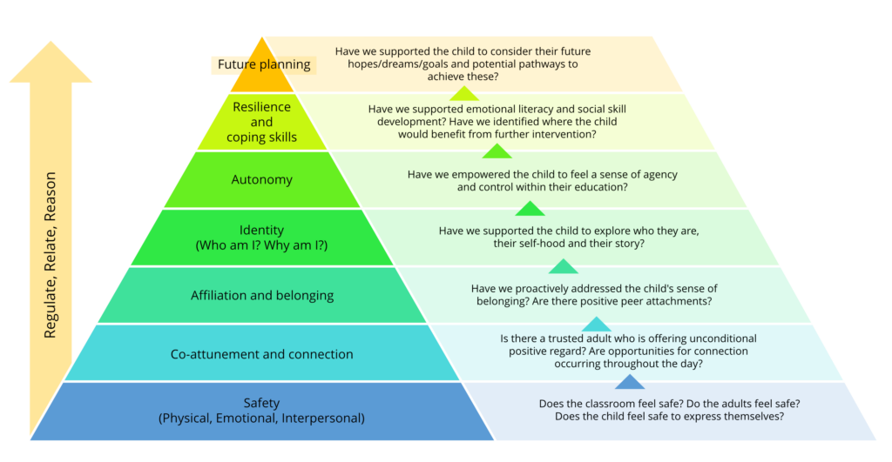
Two Underpinning Models
Protective factors in educational resilience (Borrett, 2019, Borrett & Rowley, 2020; Carter & Borrett, 2023)
Based on research with returners to education- “what helps you to be resilient in education second time around?” Mapped out all education from early years to university level
Connection and support, positive experiences and adaptive skill building
The Applied Trauma Responsive Classroom Model (Carter, 2022, Carter & Borrett, 2023)

Slide 5
Two Underpinning Models
Is structured and sequential
Has evidence based on “what works” – taken from students themselves
Is person centred and responsive to individual need and academic level
Is underpinned by Trauma Responsive practice
Not only gives the practitioner skills to be responsive to trauma but to also how to move an individual on in their journey to increase resilience
Evidence of the programme working (significant increase in educational resilience levels following intervention, increased attendance and improved retention)

Slide 6
What are RESTA protective factors?

Slide 7
RESTA: The Journey so far…
2017/18: Researching Educational Resilience “What works?”
2017/2018: First Educational Resilience Programme
2018/2019: Second Educational Resilience Programme
2019: Findings published – revision of the original programme
2020: COVID – demand outweighed the supply “Is there another way?”
2022: Collaborative meeting between EP, Headteacher, Social Worker – What might RESTA look like?
2022: Pilot Suffolk New College. Dr Carter’s work on the ATRCM
2023: Completion of all resources, checked for validity across levels by students at Suffolk New College
2023: SEND Colleges of excellence input
2023: End of pilot, collaborative review Headteacher, teachers, EP and student – Are we there yet?
2023: Schools – would this work for EBSA?
A special mention and thank you to Trudi Rose-Porter, her team and students at Suffolk New College who have been instrumental to the latest pilot design!

Slide 8
RESTA: What next?
January to March 2024 – Next stage of pilot, first RESTA’s trained (we currently have 10 places left)
March 2024 onwards review of evidence and adaption to programme
Summer 2024 RESTA launch to all
Summer 2024 RESTA handbook, RESTA journals
Up coming projects: Step In, Step Out (NCC). RESTA for EBSA support

Slide 9
NOTICES AND REMINDERS:
Children’s Mental Health Week, 5-11 February 2024 Place2Be have announced the theme for Children’s Mental Health Week 2024: My Voice Matters. Developed with the help of children and young people in Place2Be partner schools, My Voice Matters is about empowering young people to use their voices and share what matters to them – while encouraging those around them to hear their voices. Click here to find out more and see how you can get involved in Children’s Mental Health Week. Mental health lead training from the Department for Education A reminder that the Department for Education (DfE) are offering grants of £1,200 for mental health lead training in your educational setting, and – if you have previously claimed a grant and your mental health lead has moved on from your setting – you can now apply for a second grant to train a new mental health lead. The training will help to: • Better understand wellbeing needs • Achieve the best possible outcomes from your existing in-school provision • Develop approaches aligned with your DSL/SENCO’s work • Develop your universal and targeted support offer • Engage pupils and learners, and work with parents/carers How do I apply? If you haven’t already done so, click here to claim a £1,200 grant and access DfE quality-assured training tailored to the needs of your setting. If you previously claimed a grant and your mental health lead has left your setting, you can apply for a second grant here.

Slide 10
NOTICES AND REMINDERS:
November marks the beginning of Movember, a time to raise awareness of men’s mental health. A recent UK survey showed that 40% of men reported to have never spoken to anyone about their mental health; Movember is the perfect opportunity to shine a light on men’s mental health and get boys and men talking. You can get involved by sharing our "Busting myths for Movember" Kooth podcast, or our "Breaking the stigma" short film around men’s mental health (we recommend this video for ages 17+).
Message from Suffolk Mind: Our new materials relaunch is in February for Children’s Mental Health Week, called the Children and Young People’s Kitbag, but if any schools would like support in the meantime, please direct them to schools@suffolkmind.org.uk and we will be able to help.
Please add any comments to our graphic and / or let us know if you’d like to be part of our MH network steering group or have any requests / ideas for future MH network meetings.

Slide 11
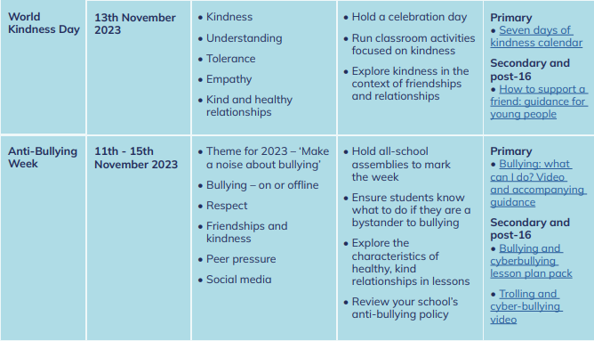
Mental health and wellbeing calendar: autumn term 2023 : Mentally Healthy Schools

