Slide 1
Welcome
Mental Health Lead Network Event
3rd November 2023

Slide 2
Early Intervention CAMHS
Early Intervention CAMHS (NSFT)
Emotional Wellbeing Hub
Under 18s Wellbeing Service
Mental Health Support Teams (MHSTs)
Psychology in Schools Team

Slide 3
The Emotional Wellbeing Hub
Front door triage service for NSFT mental health services for children and young people aged 0-25 years in Suffolk.
Includes referrals to Early Intervention and Specialist CAMHS (under 18) and Youth (YAMHS 18-25) services.
Specialist CAMHS includes Connect (Children in Care or Adopted) and Learning Disabilities (LD CAMHS)
You can contact the Emotional Wellbeing Hub helpline on 0345 600 2090 to make a referral to access specialist mental health support services
Notes:
Front door triage service for NSFT Specialist Mental Health Services for Children and Young people aged 0-25 years in Suffolk.
Includes referrals to Early Intervention and Specialist CAMHS (under 18) and Youth (YAMHS 18-25) services.
Specialist CAMHS includes Connect (Children in Care or Adopted) and Learning Disabilities (LD CAMHS).
Excludes referrals to Eating Disorder and Neuro Developmental Disorder (NDD) services - separate referral routes*
NOT for CRISIS or all emotional wellbeing needs and access to social care and social welfare support services

Slide 4
Under 18s Wellbeing Service
Supports young people and their families with mild to moderate mental health difficulties
Primary Mental Health Workers (PMHW), Child Wellbeing Practitioners (CWP), Psychological Therapists
CBT, IPT, EMDR, systemic therapist, arts therapist
PMHW consultation line 01284 741601
Notes:
PMHW consultation line 01284 741601
Voicemail messages can be left at any time. Duty clinician covers these messages 9-5 Mon, Weds and Fri every week

Slide 5
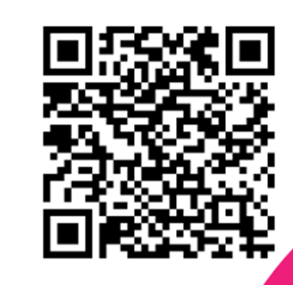
The Psychology in Schools Team
Low mood
School avoidance
Challenging behaviour
OCD
Eating difficulties
Tics and Tourette’s
Anxiety
Self harm
NEW Childhood Neurodiversity programme
These can be found at: https://www.nsft.nhs.uk/parent-workshops or by scanning the QR code.
Notes:
Run parent workshops throughout the year to provide advice and guidance on how parents and carers can support the young people in their lives

Slide 6
Self help techniques
Support available from our services
Support available from other services
Support for children with additional needs
App recommendations
Urgent support information
Notes:
We have a new leaflet all about different services and with some self-help tips for children and young people

Slide 7
Mental Health Support Teams (MHSTs)
An Introduction

Slide 8
Our Service
The MHSTs are new early-intervention services that support young people, their families and school/college communities with mild to moderate mental health difficulties.
Each MHST will be allocated to specific secondary schools/colleges and their feeder primary schools.
We work directly in schools, on site, and in the wider school/college community, both in and out of term time.

Slide 9
Mental Health Support Teams (MHSTs)
Creating a new mental health workforce of community based mental health support teams
To empower mentally healthy communities in schools and colleges
Expanding the workforce
Consultation and Liaison
MENU
Mental Health Training for staff
Psychoeducation for class/year groups
Supervision of specific staff members/groups
Reflective practice for staff
Support/consultation for writing Mental Health Charters and school policies
Support with RSHE/PSHE curriculum
Currently six teams across Suffolk
A new team starting in January 2024
Referrals are predominantly via school/college, but we accept referrals from other professionals and self-referrals. We ALWAYS encourage a conversation about referrals.
Notes:
MHSTs born out of the 2017 Green Paper; Transforming children and young people's mental health provision. MHSTs are teams of trained staff linked to groups of schools and colleges, offering individual and group help to students with mild to moderate mental health issues, including anxiety, low mood & behavioural difficulties. We aim to be embedded in the education setting’s community and to support with a whole school/college approach to mental health and emotional wellbeing. We work with MH leads and provide a link with more specialist mental health services. MHSTs are there to complement and not compete with existing services. Reference Suffolk MHSTs vision.
Expanding workforce – mention EMHP and training in CBT manualised approaches
Explain Suffolk picture (85 education settings covered) and how service is accessed
Discuss 40:60 split between direct and whole school/college approach work
Explain critical role of consultation and liaison with settings to develop a bespoke offer - tailored to the settings needs. Come to us for advise. Bridge to other services. Collaborative and complementary
Capacity – Small team – can't offer everything to everyone but can future plan – utilise a menu to consider planning support

Slide 10
Schools and colleges we support
East Wave 1 | East Wave 2 | West Wave 1 | West Wave 2 | Central Wave 3 | Central Wave 4
Alde Valley Academy | Chantry Academy | Thurston Community College | Samuel Ward Academy | Stowmarket High School | Stoke High School
Saxmundham Primary School | St Mark's Catholic Primary School | Barnham CofE Primary School | Place Farm Primary Academy | Wood Ley Community Primary | Hillside Primary School
Leiston Primary School | Ranelagh Primary School | Honington CEVC Primary School | Burton End Primary Academy | Trinity CEVAP
Benhall St Mary's Primary School | Gusford Community Primary School | Bardwell CofE Primary School | Coupals Primary Academy | Combs Ford Primary
Aldeburgh Primary School | Oaks Primary School | Barningham CEVC Primary School | Wickhambrook Primary Academy |  | East Bergholt High School
Kelsale Primary School | Sprites Primary School | Cockfield Primary School |  |  | Copdock Primary School
Coldfair Green Primary School |  | Elmswell Primary School | Castle Manor Academy | Stowupland High School | Bentley CEVC Primary School
Middleton Primary School | Ormiston Endeavour Academy | Great Barton CofE Primary School | Westfield Primary Academy | Cedars Park Primary
Yoxford and Peasenhall Primary School | Castle Hill Infant School | Hopton CEVC Primary School | Keddington Primary Academy | Mendlesham Community Primary
Snape Primary School | Castle Hill Junior School | Ixworth CofE Primary School | Clements Community Primary | Bacton Primary
 | The Beeches Community Primary School | Norton CEVC Primary School | St Felix Catholic School | Bosmere Community Primary School
Farlingaye High School | Dale Hall Community Primary School | Rattlesden CofE Primary School | New Cangle Community Primary School
Rendlesham Primary School |  | Stanton Community Primary School
Woodbridge Primary School | Westbourne Academy | Thurston CofE Primary Academy
Bawdsey CEVC Primary School | Whitehouse Community Primary School | Walsham Le Willows Primary School | West Suffolk College
Eyke CofE Primary School | Springfields Juniors | Woolpit Community Primary School
Grundisburgh Primary School | Handford Hall Primary School
Hollesley Primary School | Springfields Infants | Mildenhall College Academy
Kyson Primary School |  | Great Heath Academy
Melton Primary School |  | Saint Mary's CofE Academy Mildenhall
Orford CEVA Primary School |  | Beck Row Primary School
Otley Primary School |  | Elveden CofE Primary Academy
Sandlings Primary School |  | Forest Academy
Saint Mary's Woodbridge |  | Glade Primary School
 |  | Lakenheath Primary School
 |  | St Christopher's CEVCP School
 |  | West Row Primary School

Slide 11
The MHST can support with:
Anxiety and/or avoidance
Worry management
Panic management
Mild OCD (Obsessive Compulsive Disorder)
Low mood/depression
Irritability as a symptom of depression
Managing negative thoughts
Thoughts of self-harm and support for alternative coping strategies
Low confidence and low self-esteem
Sleep difficulties
Emotion regulation difficulties

Slide 12
What do the MHST offer?
The Guided Self-Help support offer by the MHST are evidence based and use Cognitive Behavioural Therapy (CBT) approaches to support changes in thinking and actions
The types of support we offer include:
- Individual Guided Self-Help (6-8 sessions)
- Group Guided Self Help support (4-8 sessions)
- One off workshops (e.g. sleep, exam stress, transitions)
- Staff consultations/training
Notes:
Additionally, the MHST draw on additional therapies, as and when needed, with the support and guidance of others in the team with this expertise, such as ACT/DBT/CFT/systemic

Slide 13
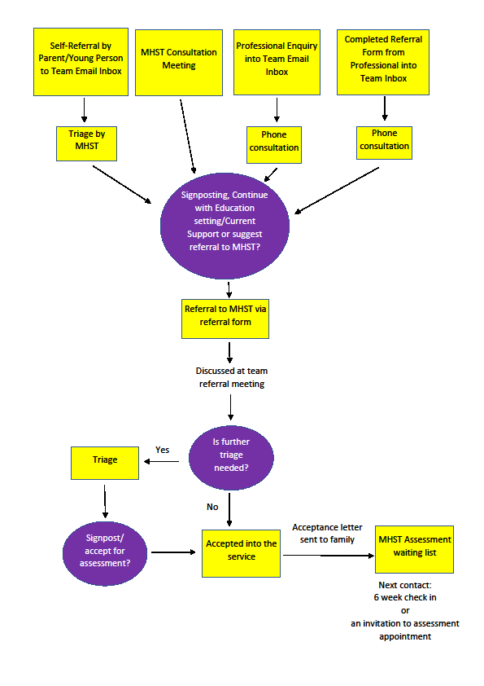
Referral Process

