Slide 1
Welcome
Mental Health Lead Network Event
3rd November 2023

Slide 2
Notes:
The Wellbeing in Education website

Slide 3
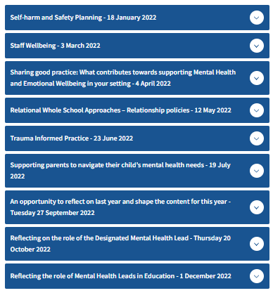
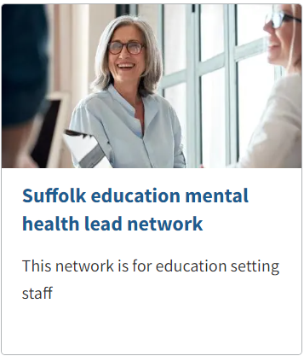
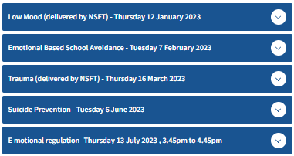
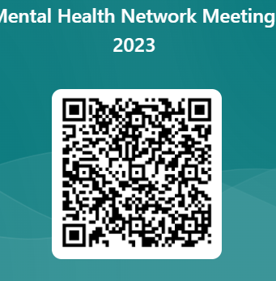
Suffolk education mental health lead network - Suffolk County Council Suffolk Education Mental Health Lead Network
This network is for staff that work within an education setting.
https://forms.office.com/e/j3m30Lktev
is the Microsoft Form link
Notes:
Topics the Lead network has covered to date.
Signposting to our questionnaire: Mental Health Network Meetings 2023 (completing 4 questions to help guide our network planning from January 2024).
Please let one of us know or email the Mental Health Lead email address if you would like to join our steering group to help guide this network going forward.

Slide 4
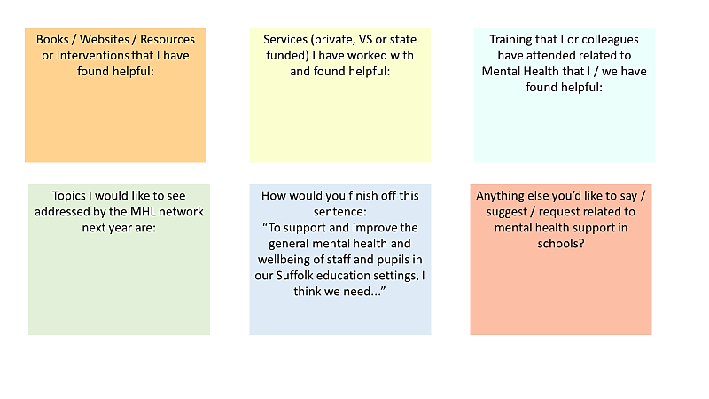
Our I.F. graphic – please use it!
Notes:
Introducing the IF team and explaining their graphic

Slide 5
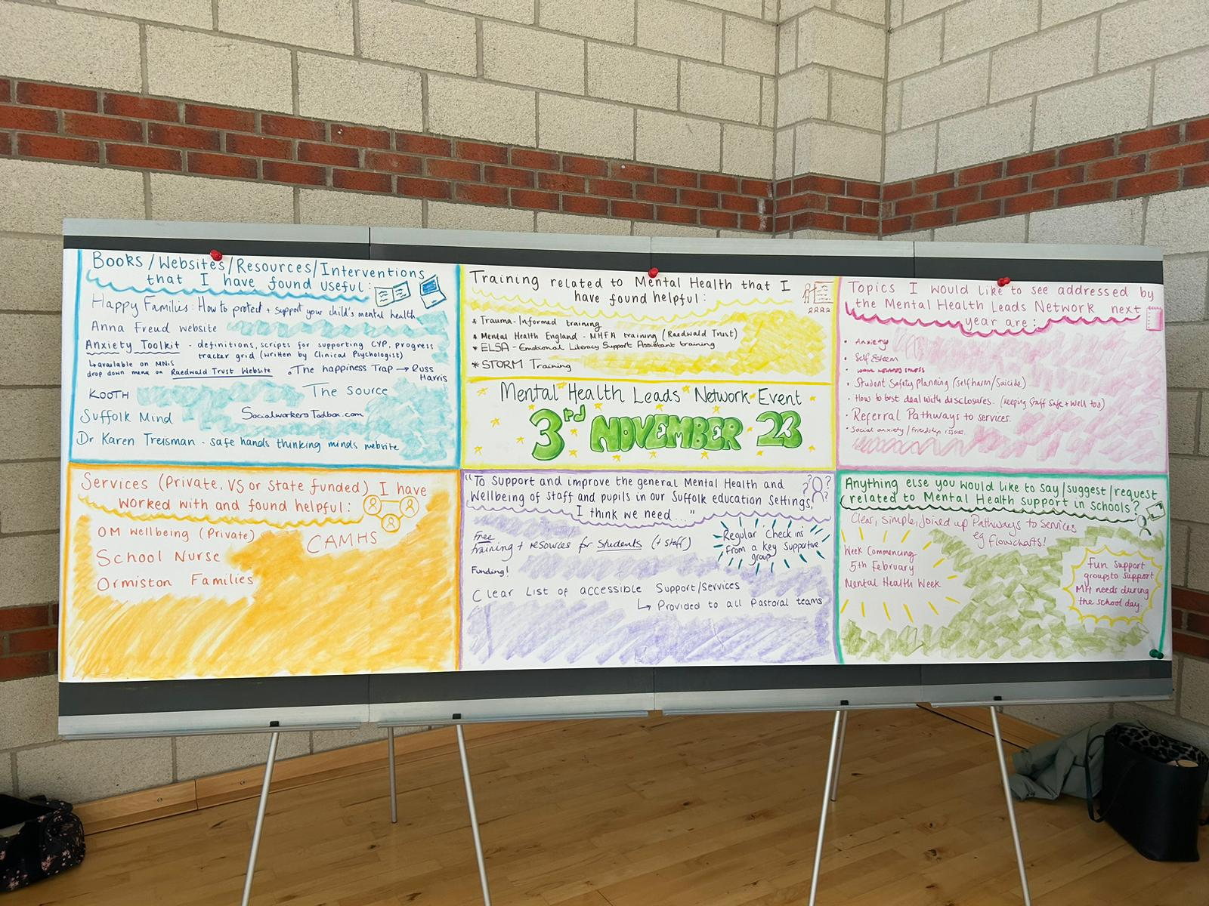
Notes:
This is what our IF graphic looked like at the end of the meeting.

Slide 6
Amy Jefford
Emma Nicholson
Lesa Lee
SEMH Service
Notes:
Amy

Slide 7
Who
are we?
We are a Team of specialist teachers with a wealth of experience in schools.
Amy Jefford - Head of Service: Amy.Jefford@suffolk.gov.uk
SEMH Teachers
Emma Nicholson: Emma.Nicholson@suffolk.gov.uk
Lesa Lee: Lesa.Lee@suffolk.gov.uk
Nikki Prentice: Nikki.Prentice@suffolk.gov.uk
Rae Twelftree: Rae.Twelftree@suffolk.gov.uk
Tony Whitehead: Tony.Whitehead@suffolk.gov.uk
Tracey Pilgrim: Tracey.Pilgrim@suffolk.gov.uk
Notes:
Amy

Slide 8
Specialist Education Services (SES)
Notes:
Amy
Within Specialist Education Services, there are 5 teams of specialist teachers.
Within the graduation response, there are three stages – we sit within stage 2 for early intervention.

Slide 9
What we do (currently) and who do we support
We are a team of specialist teachers who support schools. We are not therapists, counsellors or medical mental health practitioners and whilst we do work with those services when they are involved, we cannot offer this level of specialist support should it be needed.
Children and young people with additional social, emotional and mental health needs may struggle to access or engage with learning.
We work with schools to help them better understand the needs of pupils with additional SEMH needs and how they can be best supported.
Notes:
Emma
It is important to note that our model is changing in the new year, but this information is about what we currently do in our role.
1 - Work with a range of school staff – that might be directly with the class teacher, the teacher assistants, the pastoral team, SenCo or members of SLT. We can work with schools to help put in place strategies, but we don't work on a 1:2:1 basis with a pupil.
2 - We also work with schools who have CYP who are not accessing school/ struggling to come to school – EBSA. We may advise schools on strategies to maintain those important connections between school and home, look at ways that the school can develop, maintain and enhance the learning for a young person struggling to access or engage with their learning. We are a school based service, so we do not work with difficulties experienced in the home. However, we may encourage schools and home to share strategies and use them across both settings. We may signpost to early Help if we feel that there are issues linked to the home. If the issue is purely around attendance and but schools have everything in place, and the pupil has no issues in school, we will signpost to the EWO service.
3 – So our focus is around upskilling, enabling and empowering schools in order that provision for their CYP with SEMH is meeting the needs of the young person. Any work with pupils is generally to model a strategy/ intervention to staff and the pupil may be present. Times we may meet the pupil is to gain their voice and do a very short piece of work.
We work collaboratively with other SES services and outside agencies.
When a pupil is referred into our service, We would look for evidence of at least 2 cycles of ADPR in school, whereby a range of strategies, interventions and provision has been explored already to enable a young person to make progress.

Slide 10
What we do
We develop inclusion plans for schools to use to support the pupil and we do this through a variety of avenues.
We:
Consult with school to explore current strengths and areas of concern
Complete observations in school
Carry out a pupil voice
Provide advice and guidance
Model strategies to school staff
Draw upon the support and guidance from other SES Services
Signpost to other agencies
Notes:
Emma
Currently, following a referral from a school, we would help schools, along with the pupils and their parents/carers (as appropriate) to develop a support plan to enable pupils to successfully attend, access and engage in school fully and safely.
Initially, we would consult with school to unpick a little more around the profile of the pupil, exploring strategies in place, interventions that have worked, what works well, relationships with adults etc..
We might complete observations to see what the learning experience is like for that pupil – making sense of their experience
We might carry out a pupil voice to unpick a little more around their current school experience.
Throughout this all, our focus is upon upskilling, enabling and empowering the school in putting together an inclusive support plan for that pupil based specifically around their individual needs.
We also help the school in unpicking whether the profile of the young person is truly a SEMH, or whether the profile is as a result of other underlying needs. In this instance, we may draw upon the advice and guidance from another SES service.

Slide 11
January 2024
Six Communities of schools
½ termly meetings
Specialist Education Services
Health, Psychology and Therapeutic Services
Whole School Model of support
Whole School Model of support
Whole School Model of support
Whole school support around identified an area of need
Whole school support around identified an area of need
Termly meetings with 2 specialist teachers
Whole school support around identified an area of need
Termly meetings with 2 specialist teachers
Termly meetings with 2 specialist teachers
Bespoke Pupil Work – time limited with an agreed focus
Bespoke Pupil Work – time limited with an agreed focus
Bespoke Pupil Work – time limited with an agreed focus
Notes:
Lesa
From January 2024 – our offer is expanding to include a whole school model of support.
There are 2 ways in which schools can access support, initially through termly meeting with specialist teachers (to be offered to all schools in Suffolk) or school can refer into SES.
We will be providing whole school level of support focussed on the universal and targeted offer and supporting school where required to develop this.
We will continue to provide a bespoke pupil offer which will be accessed by an internal referral systems.

Slide 12
Training Available
ADHD awareness and strategies to support learners with ADHD
Understanding behaviour and strategies for managing behaviour
Supporting Children and Young people to develop resilience
Supporting learners who have experienced ACEs (adverse childhood experiences)
Supporting anxious children
Attachment Disorder awareness and strategies to support learners with Attachment Disorder
Mental health and wellbeing awareness and strategies to support pupils with mental health needs
Foetal Alcohol Syndrome Awareness and how to support learners with FAS
Notes:
Lesa
This is not all of the training – also planning for and managing transitions, supporting learners who display oppositional behaviour, managing meltdowns, using a restorative approach to support children and young people.

Slide 13
Further Training Available
We also offer free half termly training, delivered virtually
Essential strategies for supporting pupils with SEMH needs
and low cost termly targeted training, delivered virtually:
The importance of relationships
Emotional Regulation
Helping pupils with SEMH Needs engage
Notes:
Lesa
Reiterate, happy for team to contact us, ask/ query, etc. Happy to help where we can!

Slide 14
Further Training Available
Further SES training is available – please ask SES Deputy Head:
Sally Blackman sally.blackman@suffolk.gov.uk
Thank you
Notes:
Feedback can be provided by completing the MS Form using link above

