Slide 1






WELCOME
TO

Slide 2



My name is
..........................................
Me!
I come from
..........................................
I speak
..........................................

Slide 3




About me

Slide 4





About our school

Slide 5


Your class
YOU WILL NEED
  Equipment (pens, bag, water, snacks etc)

Slide 6



Your teachers

Slide 7

Places to go in school
(safe spaces)

Slide 8
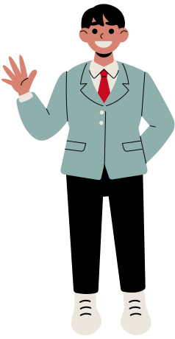



Uniform

Slide 9


School Day
8:00 AM
12:00 PM
3:30 PM
Arrive at school
Lunch Time
School ends

Slide 10


Your Buddy

