Slide 1
Discover Your Future 2021
Interview Preparation
Virtual Work Inspiration Suffolk | April – July 2021

Slide 2

Preparing for a Mock Interview

Slide 3

Preparing for a Mock Interview
Aims of the session:
To understand what types of questions an interviewer might ask you
To prepare personal answers that reflect you in a positive light
To give you some tools to prepare and practice for a job/college/Apprenticeship interview
To increase your confidence and self esteem for an interview
By the end of this lesson students will have some tools to help them perform in a mock virtual interview

Slide 4

Preparing for a Mock Interview
Who has had an interview before?
What was it like?
Was it face to face or virtual?
You will be experiencing a virtual interview – something that is becoming very popular now.

Slide 5

How to perform in an interview

Slide 6



What are the main points from this video?
3
Three things you should do?
Three things you shouldn’t do?
Record them in your workbook

Slide 7
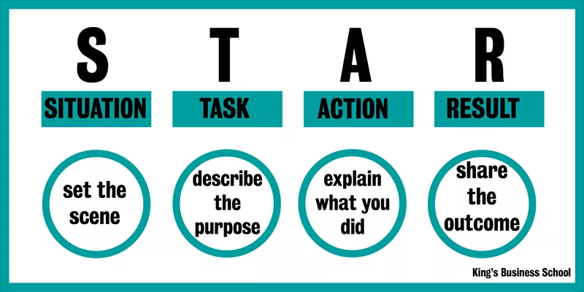
How to answer interview questions

Slide 8
How to answer interview questions
S
Explain the Situation
This situation can be drawn from a work experience, a volunteer position, or any other relevant event. Be as specific as possible.
T
Task
Next, describe your responsibility in that situation. Perhaps you had to help your group complete a project within a tight deadline, resolve a conflict with a co-worker, or use your initiative to solve a problem.
A
Action
You then describe how you completed the task or tried to meet the challenge. Focus on what YOU did, rather than what your team, other students, boss, or co-worker did.
(Tip: Instead of saying, "We did xyx," say "I did xyz.")
R
Result
Finally, explain the outcomes or results generated by the action taken. It may be helpful to emphasize what you accomplished, or what you learned.

Slide 9

Work in pairs or a small group on the example interview questions in your workbook
Create a model answer for at least one question each
Practice being an interviewer and interviewee

Slide 10
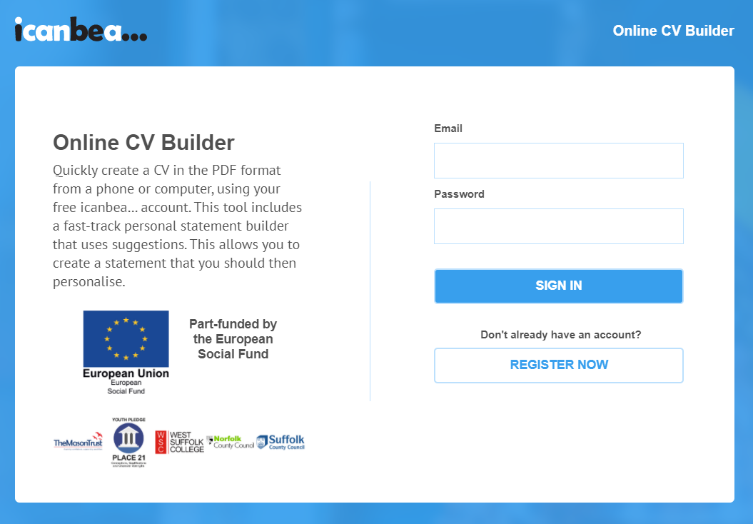
Online CV Builder

Slide 11


Time to reflect…
What have I learnt?
Add your thoughts to your workbook.
Good luck with your interview!

