Slide 1
Discover Your Future 2021 PATHWAYS
Virtual Work Inspiration Suffolk | April – July 2021

Slide 2
PATHWAYS
I will understand what ‘pathways’ means and the opportunities available to me when I leave school.
I will understand and recognise my skills and interests both in and out of school.
I will have mapped out an aspirational plan for my future.
I will understand how I can achieve the education and career goals set in my plan
Notes:
Teacher: Please read and explain the aims for the Pathway’s strand. The focus of this session will be on evaluating our own interests and skills and how they link to our future opportunities and pathways. This is to encourage students to feel motivated by assessing their capabilities based on aspirations and interests.

Slide 3
QUIZ TIME!
Can you guess what these celebrities did before becoming famous?

Slide 4
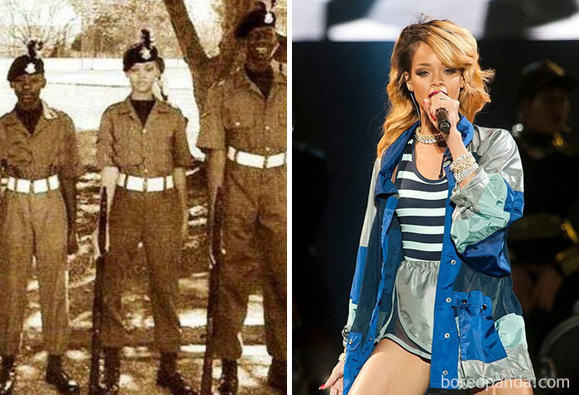
Rihanna…
Rihanna was an army cadet!
Notes:
4

Slide 5
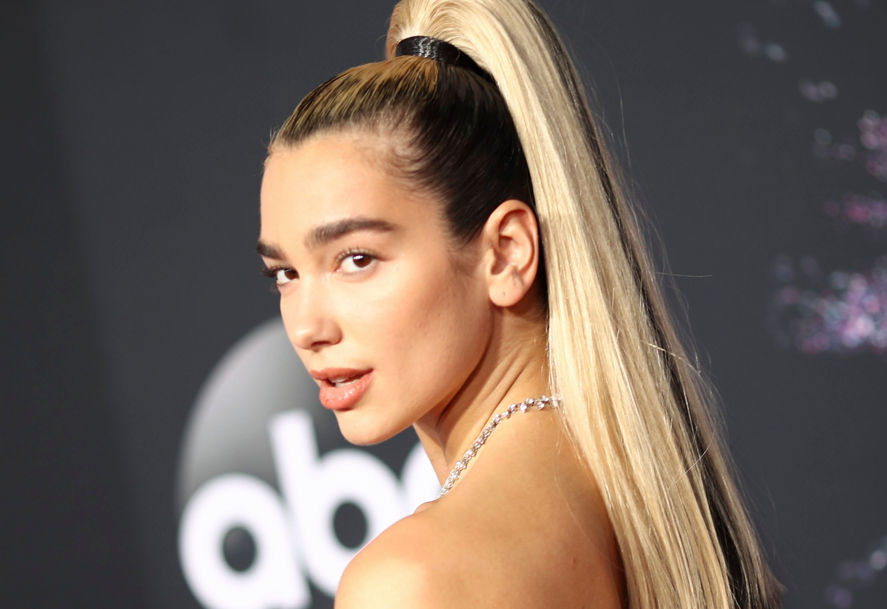
Dua Lipa..
Studied A-Levels at college.
Her first vocal coach said she couldn’t sing!
Notes:
5

Slide 6
Will Ferrell
Studied Sports Information at University of Southern California
Notes:
6

Slide 7
Lady Gaga
Accepted into New York University
Rihanna was an army cadet!
Notes:
7

Slide 8
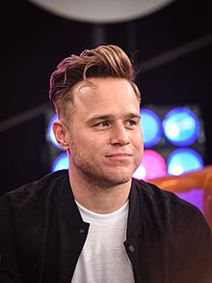
Olly Murs
A-Levels in Politics, Psychology, English and Media.
Her first vocal coach told her she couldn’t sing!
Played football semi-professionally for Witham Town FC and worked as a recruitment consultant.
Notes:
8

Slide 9
What are Pathways?
A Levels & Baccalaureate
GCSEs
BTEC Level 3, OCR & others
BTEC Level 2, OCR & others
BTEC Level 1, OCR and others
Advanced Apprenticeship
Apprenticeship
Level 4+
Level 3
Level 2
Level 1
Which pathway suits you?
Academic pathway
Vocational pathway
Work based pathway
Notes:
Explanation:
Pathways describe the different routes to our future careers that we can take. Pathways include education, work, qualifications, skills and interests.
There are three core pathways: academic, vocational and work based. Everyone suits their own, and not every pathway is the same!
You can mix and match steps to suit you. For example, you might study GCSEs, BTEC level 3 and then do a higher apprenticeship. You could study GCSE & BTEC Level 2, then A-Levels and go to University.
Each pathway has a separate route into Higher education. Could be: Higher/Degree apprenticeship, university study (degree), higher national certificates/diplomas (vocational pathway)

Slide 10
Whereabouts on the Pathway are you now?
Notes:
Split the class into pairs.
• Show each student the blank pathways template in their VWIS booklet. Have the completed one projected on the screen for guidance.
• Ask them to plot where they are now (level 1/2, GCSE/BTEC etc).
• Ask them to reflect on what they have achieved, what is going well and what skills they have learned at this stage in their pathway. Comment in pairs and make notes.

Slide 11
Research Time!
www.icanbea.org.uk
Notes:
Guide the students through the ‘find your career’ tool on the icanbea website.
Show the students the icanbea tool
Ask them to complete the survey tool and to evaluate skills, interests etc.
Ask students to choose as many careers as they like – there is no limit to their possibilities! – but to write down two or three main ones that they would like to know more about.
4. Ask them to fill in the worksheet about their chosen career pathways (inside the VWIS booklet)

Slide 12
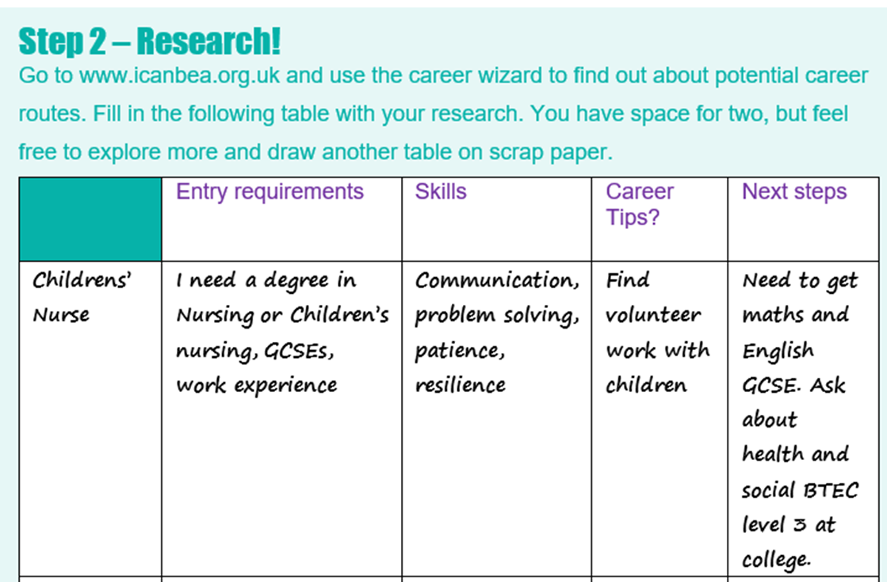
Explore / Labour Market Information
Using the information you’ve just researched, have a go at plotting your own pathway in your workbook
Notes:
• Show each student the blank pathways template in their VWIS booklet. Have the completed one projected on the screen for guidance.
• Ask them to plot where they are now (level 1/2, GCSE/BTEC etc).
• Ask them to reflect on what they have achieved, what is going well and what skills they have learned at this stage in their pathway. Comment in pairs and make notes.

Slide 13
Reflections
After Year 11 you must: Stay in full-time education, get an apprenticeship or a traineeship OR be in employment with training.
Remember: You can cross pathways to learn and work in different ways.
I can use ‘icanbea’ to research careers.
Your future decisions should reflect your values and what matters to you.
I can use my skills and interests to make decisions about my future.
Which pathway would lead me to my ideal career?
Notes:
In your VWIS workbook write down the reflection that you will take away from today.

