Slide 1
Discover Your Future 2021
Enterprise and Entrepreneurship
Virtual Work Inspiration Suffolk | April – July 2021

Slide 2
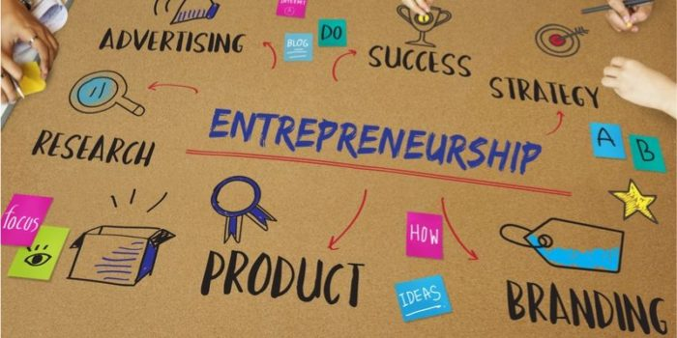
Enterprise and Entrepreneurship | AIMS
To help you identify the skills and attributes needed to be a successful entrepreneur.
To help you explore the different roles and responsibilities involved in running an enterprise.

Slide 3

Feedback on Employer session
Did you learn anything new?

Slide 4

Dragon’s Den- Hope Blooms - student pitch
https://www.youtube.com/watch?v=Ix2rPMz-Tz0
What do you think of their idea?
What skills do you think they used?

Slide 5


Enterprise Challenge
In small teams …
Come up with an idea for a social enterprise
that will make a difference to your community:
it could be health, education, environment….
A product or a service
Then…
  Choose your best idea to present to the class
  What steps will you take to make it happen?
  What challenges might you face?
The best idea from each class goes forward for a prize!

Slide 6


Time to reflect…
What have I learnt?
Add your thoughts to your workbook

Slide 7



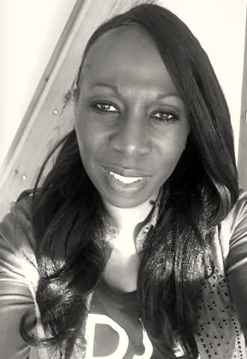
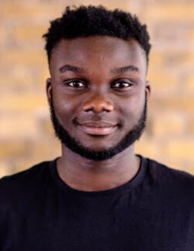

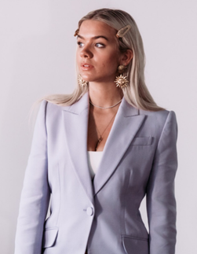




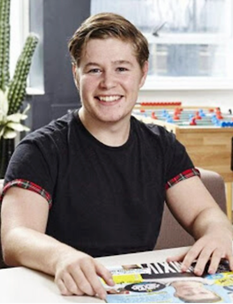
Karen Brady, The Apprentice
Richard Branson, Virgin
Teri Elizabeth Ellington, Ellington Timepiece
Mandy Errington, DJV Boutique Ipswich
Timothy Armoo, CEO and Co-Founder of Fanbytes
Steve Jobs, Apple
Grace Beverley, TALA, SHREDDY and B_ND
Elon Musk, Tesla
Jeff Bezos, Amazon
Jamie Oliver
Oprah Winfrey,
Jack Parsons, The Youth Group
https://justentrepreneurs.co.uk/blog/10-young-entrepreneurs-to-watch-in-2020

Slide 8

https://justentrepreneurs.co.uk/blog/10-young-entrepreneurs-to-watch-in-2020
Timothy Armoo, 25 - CEO and Co-Founder of Fanbytes
Jack Parsons, 26 - The Youth Group
An ambassador for young people who lack formal qualifications and feel let down by the system, Jack Parsons sees improving the odds for young people as his mission
Armoo is the co-founder and CEO of social media marketing company Fanbytes. As a prophet of platform changes, brands approach Armoo when they wish to target content at Gen Z.
Teri Elizabeth Ellington, 23 - Ellington Timepiece
Mental illness can severely impact a person’s wellbeing and productivity. Let 23 year old Teri Elizabeth Ellington be a shining beacon for all those who struggle. She has found strength and purpose in her unique watch line - Ellington Timepiece Ltd.
Grace Beverley, 23 - TALA, SHREDDY and B_ND
Mandy Errington, DJV Boutique Ipswich
My vision from the outset was to provide trend-savvy women in Suffolk somewhere to shop with a distinct difference. My mission is to source and retail ‘individual’ on-trend pieces at an affordable price, to style-conscious women
Ethical and affordable. Those are the two principles that ground Grace Beverley’s business ventures in the fitness industry

