Slide 1
School Air Quality Ambassador Day
11th June 2018
East Suffolk Council

Slide 2
Agenda
10:00am Welcome!
10:05am Introduction: Why is Clean Air Important?
10:15am Lesson 1: Explore and Collect data
11:10am Lesson 2: Design A Clean Air Super Hero
11:45am Pledges
12:00noon Finish & Certificates

Slide 3
Why is clean air important?

Slide 4
Fresh air is good for digestion.
Improves your blood pressure and heart rate.
It makes you happier.
Strengthens your immune system.
Fresh air cleans your lungs.
You will have more energy and sharper mind.

Slide 5
What stops our air being clean?

Slide 7
What can we do to avoid air pollution?

Slide 8
Be physically active
Take low pollution routes and avoid main roads
Avoid sitting in heavy traffic

Slide 9
What can we do to reduce the amount of pollution we produce?

Slide 10
Walk, cycle or scoot instead of taking the car
Switch off engines when not moving

Slide 11
What could we do to reduce air pollution at school?

Slide 12
Lesson 1: Explore and Collect data
You will need:
Your survey sheet
A pencil

Slide 13
Lesson 2: Design A Clean Air Super Hero and write a comic strip.

Slide 14
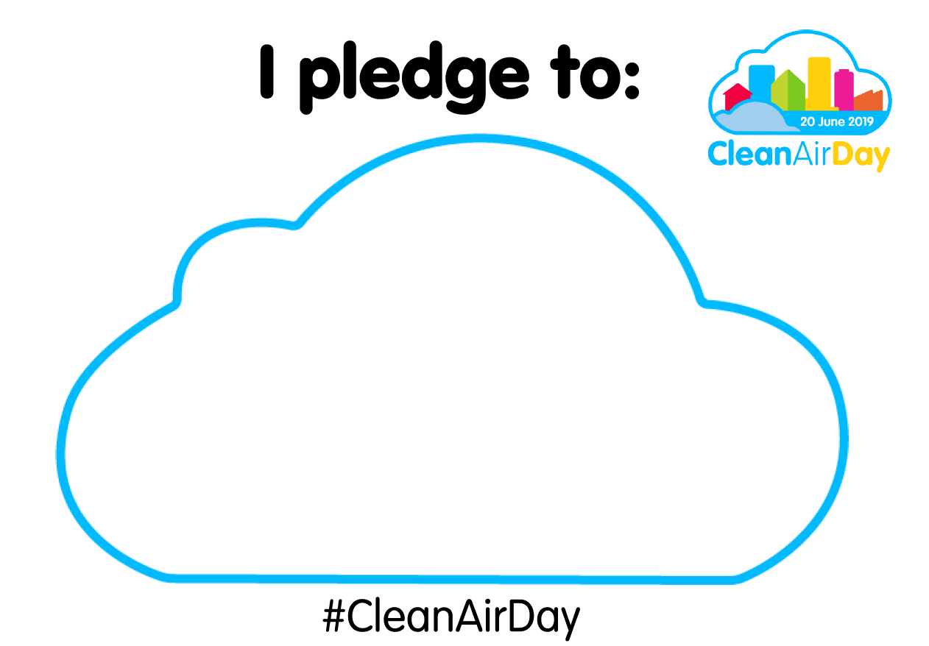
Pledges

Slide 15
Thank You!
You are now Air Quality Ambassadors for the whole of East Suffolk!
Your school will receive all of the resources from today so that you can share this information with your friends on National Clean Air Day on 20th June. #CleanAirDay

Slide 16
Please hang your certificates up at your school, so that visitors know that you care about air.

Slide 17
School Air Quality Ambassador Day
11th June 2018
East Suffolk Council

