Slide 1
Early years needs you!
The benefits of a career in the early years

Slide 2
What are the early years?
The early years refers to children aged 0-5. Working in the early years involves educating and caring for babies and children between 0-5.
Work in the early years could be as a childminder working in the home, an educator working in a private daycare or nursery, in a preschool, in a school nursery or reception class.
A lot of early years providers also run out of school or holiday provision and often need staff for this work too.

Slide 3
Why are early years jobs important?
There are many jobs available in early years settings.
Childcare is vital for our society as it allows people with young children to work.
Work in early years is incredibly rewarding, versatile and fun and gives those that work in it a range of skills and experience which would be applicable across many other fields.

Slide 4
Have you considered a career working with young children?
People can work in early years at many different qualification levels
There is lots of support and options available to gain qualifications, including whilst working
There are lots of ongoing professional development opportunities and courses available for early years practitioners
Some early years settings and out of school clubs will take on volunteers, apprentices or unqualified staff in addition to qualified staff
There will be expectations to attend short courses at regular intervals

Slide 5
The benefits of working in the early years - it really isn’t like other jobs!
Varied – it changes every day.
Flexible – some jobs are part time, term time only or offer flexible working hours. Others are full time. There may well be a working pattern that would suit your needs. Childminders work in the home and can look after their own children at the same time.
Rewarding - doing something worthwhile and making a difference to children. You are experiencing and facilitating children’s developmental milestones.
Opportunities to problem solve – the unpredictable brings challenges and working towards solving them brings a sense of achievement.
Teamwork and support – a strong sense of teamwork, even solo childminders tend to link up for support.

Slide 6
The benefits of working in the early years
Working outdoors – most roles involve supporting learning and development through playful experiences, spending lots of time outdoors as well as inside as early learning occurs everywhere. Few roles are desk based.
Being part of the community and helping families– early years settings are at the heart of the community. Working with young children and their families means you are really making a difference to people’s lives.
Self development - early years jobs involve learning about child development and behaviour and experiencing this first hand. There are plentiful opportunities for continuing professional development and meeting people.
Being creative, playful and having fun – If you like to play, be imaginative and creative, get messy, be outdoors, make things, have varied opportunities, interesting conversations and make lasting relationships then come and work in the early years!

Slide 7
Isn’t it just play?
Play is a vital part of working in the early years and is one of the many ways children learn. Supporting this learning requires in depth understanding and skill. Play is essential for both children and adults as it allows creativity, free expression, opportunities to experiment and problem solve.
“Play is the answer to how anything new comes about”
Jean Piaget
Adults join in with play when working with early years children.

Slide 8
Who can work in the early years?
People of any age enter the sector from school / college leaves to those wanting a career change later in life
A diverse workforce is needed - children, particularly in the early years when their brains are developing rapidly, need to experience and build relationships with people who represent their community and the wider society
The early years sector is keen to recruit more men Calls for more men to work in the early years
Early years staff must have a sufficient standard of spoken and written English to ensure the wellbeing of children in their care
All people working in the early years will need to apply for an enhanced DBS check

Slide 9
Early Years setting managers are looking for these attributes when they interview (EYCS survey 2023)
Knowledge of the EYFS | Able to respond to children’s needs | Able to play and interact with children | Motivated to be proactive and to use your initiative | Good work ethic
Team player | Experience – placements or volunteering | Ideally have a Level 3 | Good timekeeping and absence record | Knowledge of child development
Good communicator / approachable | Understanding of safeguarding | Be confident | Want to do their best for children | Able to plan activities
Notes:
Our survey revealed Suffolk settings want these from new employees
There will be many jobs as the government are expanding funded childcare so you will have lots of opportunities to demonstrate what you know and what you can do.
Different work places and roles mean great flexibility you can work for yourself as a CM, own your own business, work as part of a team term time, all year round, different ages etc. Trying different roles is a great way to get experience and a variety of experience – great for your CV and to talk about when you go for interviews! EY work gives you transferable skills and a great grounding for other roles as it can be so varied due to the families and children you work with and situations which crop up..

Slide 10
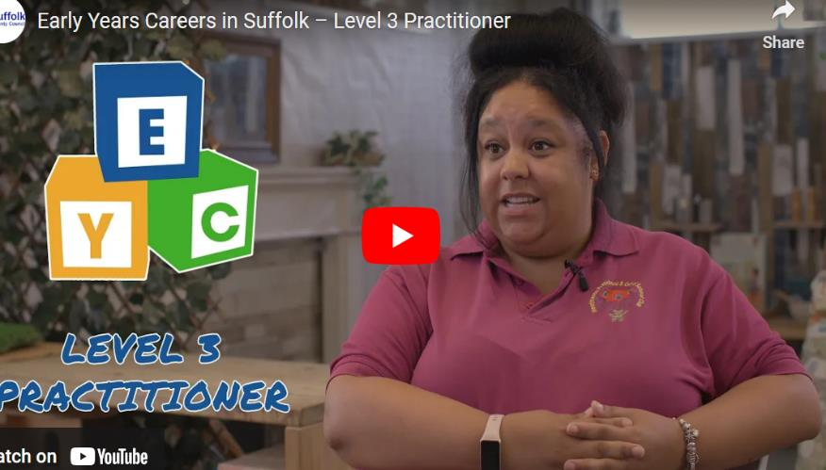
Let’s hear from an early years practitioner
Our web page has information and resources you as job coaches and your claimants may find useful such as leaflets, videos and links
Suffolk childcare careers
Notes:
Please do signpost to our web page and resources. We have Facebook and other social media boosts and radio ads which direct to this page

Slide 11
Other roles in early years settings
With qualifications and experience, there are staff management roles such as room leaders, deputy managers, nursery managers and in larger companies there are roles such as area manager
With training, there are roles for Special Educational Needs and Disability Co-ordinators (SENCo)
Some providers also have administrative assistants or business managers
Most providers spend a lot of time outdoors, for example operating forest school sessions and there may be opportunities to attend training around this to become a forest school leader

Slide 12
Early years career pathway – possible further jobs
Delivering early years training as a tutor, assessor or lecturer
Working for the local authority, for example, in the early years and childcare service, in Family support or inclusion
Training as a school teacher
Working for health, for example in a children’s centre or training as a speech and language therapist
Working in social care, for example training as a social worker
With experience and transferable skills gained in early years provision, there are other job pathways which may be available.
Further qualifications may be required.

Slide 13
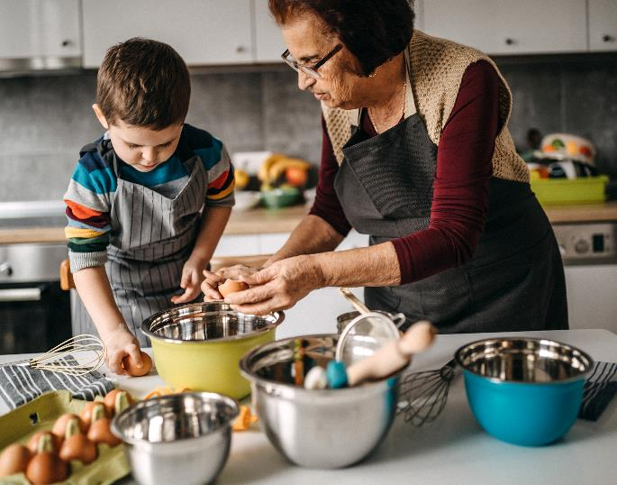
Want to work from home and fit around caring for your own family?
You do not need a qualification to become a childminder though you must gain paediatric 1st aid and safeguarding training before registering.
You must also demonstrate you understand the Early Years Foundation Stage (EYFS),
How to become a registered childminder in Suffolk | Community Directory

Slide 14
I want to become a childminder – start-up costs and requirements
For More Information:
How to register as a childminder and receive a grant worth up to £1,200 – The Education Hub (blog.gov.uk)
Suffolk InfoLink | How to become a registered childminder in Suffolk
DBS Check £38,
Plus, one-off admin fee of approximately £12.00
Health check from GP
£70 - £120
Safeguarding training
£45- (every 3 years)
Ofsted registration fee £35 - £103
per year or childminder agency rate
Pediatric First Aid
£60 - £200
(every 3 years)
Apply for a Childminder
start-up grant
ICO registration £40 (per a year)
Public liability insurance £90
(per year approximately)
Access to a computer/tablet Variable cost
Learning play and safety resources Variable cost
Car insurance with business use

Slide 15
Start up grant for new childminders!
For childminders registering from 15/03/2023 a start up grant of £600 is available
For childminders registering with an agency a grant of £1,200
Apply for a childminder start-up grant - GOV.UK (www.gov.uk)

Slide 16
More about childminding
Childminders can look after their own children whilst caring for other children
There is a need for childminders in many areas of Suffolk
Most childminders operate mainly from their home though can operate for 50% of the time out of their home
Childminders can also employ up to 2 assistants or work alongside another registered childminder

Slide 17
How do I get an early years qualification?
Choosing a training provider – there are a range of training providers both locally and nationally with different learning options, such as classroom or distance learning and with a range of costs
Contact your local college, training provider or Apprenticeships Suffolk for information
There are a range of easily accessible early years qualifications at all levels –
Level 2 & Level 3 qualifications are most popular and take 1 - 2 years to complete. You can also train to degree level and beyond in Early Years.

Slide 18
Gaining a qualification whilst working in the early years
Unqualified jobs - Many early years settings and out of school clubs take on volunteers, apprentices or unqualified staff and it is very beneficial to gain experience before applying for a qualification.
However, most staff must be qualified to provide the legal ratios of trained adults to children. This means qualified positions are the most common roles advertised.
Beware! – Early Years qualifications must be considered full and relevant by the DfE to count in legal ratios Check early years qualifications – GOV.UK (www.gov.uk)

Slide 19
Apprenticeships in Early Years Level 2 & 3
A popular route – many enter the sector this way and it is well supported by employers in the PVI sector and an apprentice wage is earnt whilst working in an early years setting
All Level 2 & 3 apprentices must spend a minimum of 6 hours per week completing paid mandatory off-the-job training which must take place within the apprentice’s normal working hours​
Level 2 Eary Years Practitioner Apprenticeship minimum duration is 12 months and the apprentice must have at least Level 1 functional skills in Maths & English (GCSE grades 1-3 / D-G) and ideally be working towards achieving the Level 2 Functional Skills.
Level 3 Eary Years Educator Apprenticeship usually lasts around 18 months​ and the apprentice must hold or achieve an approved Level 2 functional skills in Maths & English (GCSE grades 4-9/ C-A* at GCSE) in Maths & English before they can successfully complete the apprenticeship. ​
Notes:
Many courses now require someone to have done some volunteer work first
We link up with the major colleges and Apprenticeships Suffolk
T levels and apprenticeships popular routes

Slide 20
Classroom based courses
These are usually run by colleges and students attend many hours of placements in a range of early years as well as regularly attending learning sessions in a college classroom
T Levels – a Level 3 qualification which takes 2 years
Level 2 Diplomas/ Courses which usually take 1 year
Level 3 Diplomas/ Courses which usually take 2 years
There are slight variations in requirements for English and Maths Functional Skills / GCSE dependent upon the college and the course - ask your college directly
The government currently provide free level 3 qualifications dependent upon eligibility
Government guidance on free, Level 3 qualifications
Notes:
Fantastically rewarding work (not so much financially)
A definate career pathway with training and qualification pathway options and many transferable sills and life skills learnt
Benefits
Unless you are a business manager or administrator it is not an office job. In fact you are outside a lot of the time
You have flexibility within the curriculum to really follow children’s needs and interests
You are genuinely making a difference to families

Slide 21
Early Years Skills Bootcamp in Suffolk!
YMCA are delivering an Early Years Skills Bootcamp in Suffolk
Suffolk Early Years Skills Bootcamp
This is free to eligible learners over 19
The bootcamp takes 12 weeks to complete and there is an interview for a role in an early years setting or an out of school club at the end
Participants will also have the opportunity to progress onto an Accelerated Level 3 Early Years Educator Apprenticeship

Slide 22
Already have a degree?
Consider gaining Early Years Initial Teacher Training (EYITT). This usually takes a year and can be done whilst working in an early years setting.
DfE funding means you train for free.
Early Years Initial Teacher Training | Best Practice Network
Early years initial teacher training: 2024 to 2025 funding guidance - GOV.UK (www.gov.uk)

Slide 23
Have young children? Access funded childcare
3&4 year olds
All 3 & 4 year olds are eligible for 570 hours of funded childcare a year (15 hours)
3 & 4 year olds whose parents work* are eligible for 1,140 hours of funded childcare a year (30 hours)
2
year olds
2 year olds whose parents work* are eligible for 570 hours of funded childcare a year (15 hours) and this will extend to 1,140 hours (30 hours) in September 2025
2 year olds whose parents meet criteria around additional government support are eligible for 570 hours of funded childcare a year (15 hours)
9
month
olds
Babies from 9 months whose parents work* will be eligible for 570 hours of funded childcare a year (15 hours) from September 2024 and this will extend to 1,140 hours (30 hours) in September 2025

Slide 24
Eligibility criteria for working families to access funded childcare
To qualify you must earn a minimum of the equivalent of 16 hours a week at the minimum wage and £100,00 a year or less.
This applies to both parents in a couple as well as to single parents.
Use the Gov.uk website to apply –
www.gov.uk/apply-30-hours-free-childcare
If you're approved, you'll receive a code to give to your childcare provider.
For more information, visit Childcare Choices How to apply for 30 hours free childcare | Childcare choices

Slide 25
Many childcare settings allow children to attend where their parent works if there is space. Group settings can claim funding for the eligible children of their staff. NB childminders and childminders’ assistants cannot claim funding for their own child or for another close relative.
Have children?
Childcare choices
Guidance for parents and carers | Suffolk County Council

Slide 26
Early Years & Childcare Service
For more information on working in the early years please visit our website
working in the early years sector

