Slide 1
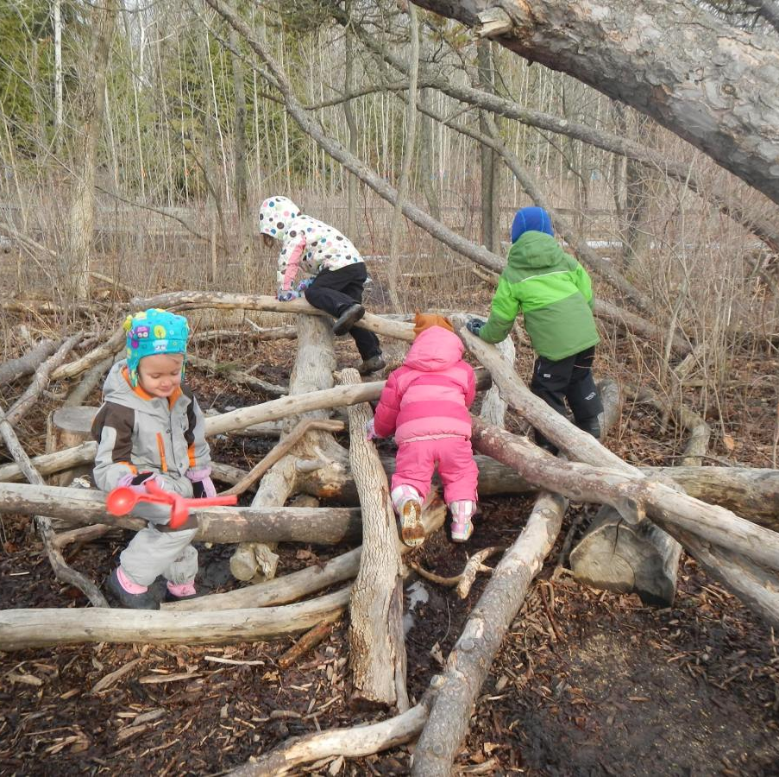
The importance of independent play for children’s wellbeing

Slide 2
What does the research say?
Children are experiencing less freedom / outdoor play (more structured / supervised play)
Consequences of less play
Higher anxiety, less exploration
Reduced creativity / problem solving
What can help support young people’s wellbeing
Connection, motivation, nature
Value of independent play
Problem solving, creativity, negotiation, and social skills
Research evidence is summary from that shared in ‘Stolen focus’ and ‘Lost connections’ books

Slide 3
The Let Grow Programme
Movement in the US to increase children’s independence
Based on the idea that children will grow up to be independent adults and need problem solving opportunities
“independence therapy” - at home intervention (facilitated by school)
“let grow play club” – within school intervention during breaktimes

Slide 5
What next…
Explore let grow resources – free for schools
Look for opportunities to increase play in school (particularly opportunities for independence, problem solving, and low-level risky play)
Get involved in potential research project to try out some of these approaches within school (contact me on Kayleigh.skene@suffolk.gov.uk)

