Slide 1
Resilience Support Teaching Assistant (RESTA)
Dr Esther Borrett – Brimstone Psychology
And Suze Mildenhall- Stowupland High School
With contributions from Jenny Shillito – Herts regional College and Callum Perry City College Norwich

Slide 2
Reminder: What is RESTA?
Members of education setting trained to deliver resilience support to students
Uses a sequential model, relational practice, psychological safety, self-determination theory
Evidence from protective factors research (Borrett, 2019; Borrett & Rowley, 2020)
Protective factors are seen as developing from the system that surrounds the individual
Aim is to enable to students to better ‘bounce back’ when faced with challenges (whilst recognising that the best ideas for change will come from the young person themselves)
Pilot began in January and finished in April

Slide 3
Our first RESTAs
6 in FE
6 in schools
Suffolk, Norfolk, Hertfordshire and Greater Manchester
Some RESTAs are halfway through their first intervention, others are just starting
Feedback from students experiencing the intervention is positive
Gathering data as we go through the programme (visual methods pre and post, Brief Resilience Scale pre and post as well as qualitative data via student reflections)
All RESTAs are working towards licensed practitioner status (dependent on supervision)

Slide 4
Suze Mildinhall – Stowupland High School
Training – sat along side other training nicely (ELSA). Resources for each topic and breakout rooms very useful.
Pilot at SHS – 2 students.
1 Attending school, but lacks resilience, requires a lot of support to maintain attendance.
1 hasn’t attended for a year. Been under MHST and was referred to RESTA via school Psychologist
Implementing in school. Through SENCO or direct to APLs to assess suitability (or MHST)
Challenges – staff not quite grasping what the intervention is and how its different to other psychoeducation provisions; attendance of the students (then discussions how to catch them up), rotating around the timetable for students
Development ideas for September:
Delivering off site if needed/or online
Front loading into an intensive intervention
Whole school approach

Slide 5
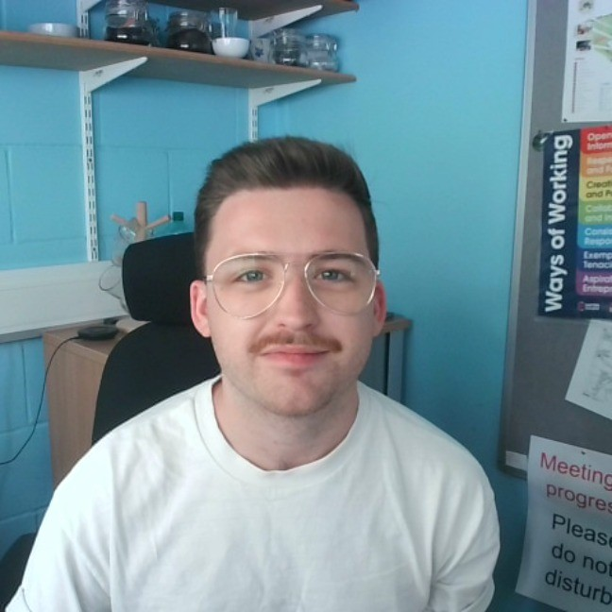
‘The RESTA pilot has been a practical, insightful, and impactful course equipping members of staff at City College Norwich (CCN) with key knowledge and strategies around emotional resilience and wellbeing. The pilot has allowed us, as teaching and teaching support practitioners, to reflect on the challenges that young people in Post-16 face, how we might develop resources around emotional resilience and wellbeing to support them, and how we might begin to implement the ethos of programme of work at CCN. We know that there is a need for these provisions, and we are looking forward to using the support and guidance from the RESTA team to consider future ways of working with young people using the RESTA approach’.
Callum Perry
Course Leader and Lecturer, Inclusive Learning
Team Leader, Curriculum Services
City College Norwich.

Slide 6
Jenny Shillito: Herts Regional College
“It was great for the student to actually see their coping strategies, even allowing us to see how many of those were healthy/unhealthy coping strategies. It gave us an opportunity to really see things we can work on together to better equip her when feeling challenged/unsafe.” – Jenny
“This has been so much better than the counselling I’ve had in the past, it feels more helpful. Just talking about my problems has never helped because I came away not knowing how to change the behaviours that were causing me distress. I feel excited I have the tools to do this myself. I’m not broken or a bad person that bad things happen to.” – Jenny’s student

Slide 7
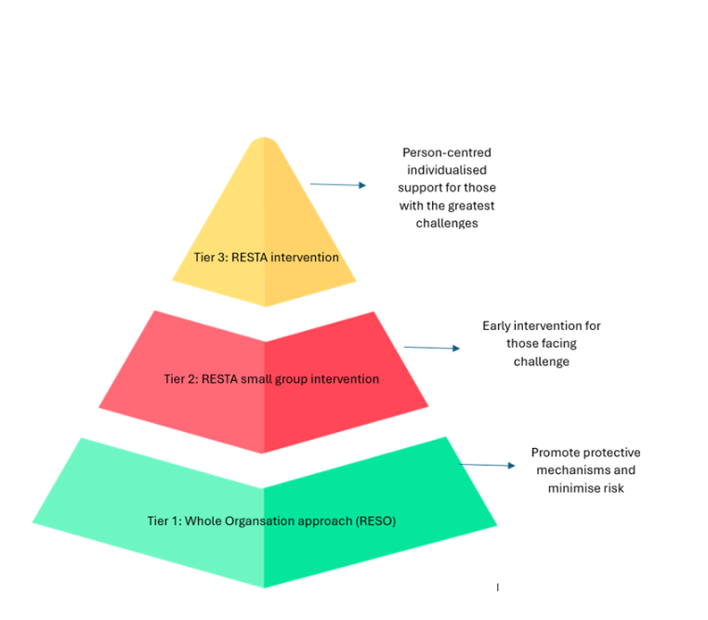
Where to now?
Next stage of RESTAs being trained – book in via the website www.restasupport.co.uk
Disseminating information to Educational Psychologists
Continuing to gather data
Development of wider organisational approach to embed Resilience principles, increase awareness and embed a clear referral system across the organisation
Valuing the role of the RESTA as a conduit between organisation and the RESTA team to embed relational practice
Continuing to work with students to design the most appropriate activities and development of the RESTA student reflection journal

Slide 8
Questions?

