Slide 1
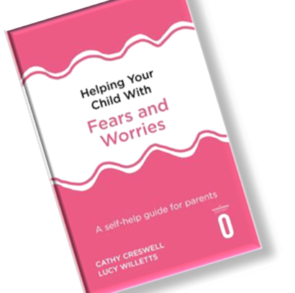
Helping your child with Fears and worries
Dr Zoe Reavill (EP) & Susan Hunter (EP)
Suffolk Psychology and Therapeutic Service

Slide 2
What is the Fears and Worries programme ?
A clinically proven 6-8-week intervention using cognitive behavioural therapy (CBT) techniques to support children aged between 5 and 12 years old.
Parents are guided by an educational psychologist (EP) who work alongside the family to empower them to help their child overcome their fears and worries.
One of the key aims is to increase parental confidence provide them with strategies which support their ability to help their child.
Investment from the family, being involved in the decision around this being an approach they wish to engage with, knowing what to expect and what their role is important.

Slide 3
Benefits
Families retain the skills to support the child, this means they can revisit and use the techniques long after the program completes, saves resources and time
Families use the techniques with other siblings, acts as an early intervention for other children without the need to re-refer
Adults reflect upon their own habits and responses which may unknowingly perpetuate a behaviour, they have the knowledge and skills to change what they do which support the long-term success of the intervention.
Non-judgemental approach seeking to empower via a CBT approach

Slide 4
Case Studies
Pupils struggled to come into school grounds when arriving
Reluctance to leave their parents
Fearful of public spaces
School attendance was becoming a concern
Impacting friendships
Unable to participate in school trips or extra curricula activities
Sleep difficulties

Slide 5
Pre and post evaluation
We have used several measures including;
RCADs
Spences Anxiety Scales
Goal-based outcomes. Baseline score and hoped for score identified at the start, the achieved score given at the end.

Slide 6
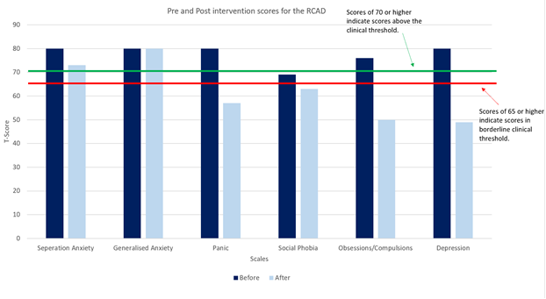

Slide 7
I just had to send you a quick email just to praise yourself and the overcoming programme. We completed the course with you a short while ago and I just wanted to update you!
XXX spent his first sleepover round a friends Friday night in a tent!
I could honestly cry as I never thought this would happen!
We went through the worksheets Thursday night and addressed his worries and XXX then worked on problem solving and solutions. He then had the sleepover and had a wonderful time and is excited to challenge himself now with more things!
Thank you so much without you this would never have happened!

Slide 8
Future plans Family-led CBT
Setting up a family-led CBT intervention whereby schools can support the intervention directly under supervision
The model would be similar to that of an ELSA model, School staff work with parents/carers and receive supervision.
The program can be delivered in small groups or individually depending upon need, and either in person or virtually.
A school-based support model (working on worries, WoW) has been piloted in Norfolk with great success.

Slide 10
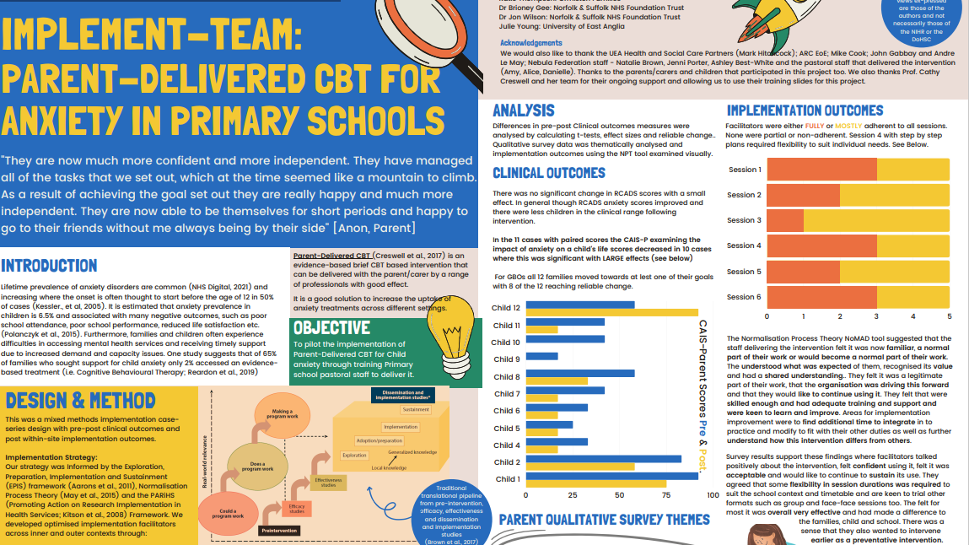

Slide 11
Questions?
Register your interest for family-led CBT delivered by schools
Referrals for the Fears and Worries program
Please get in contact to register your interest and find out more
Zoe.reavill@suffolk.gov.uk
Susan.hunter@suffolk.gov.uk
The link is available on the website

