Slide 1
Supporting Children & Young People’s Mental Health
CYP Engagement Hub
Fran Russo
Emotional Health & Wellbeing Information Officer
James Garden
Information Co-Production Adviser

Slide 2
What is The Source?
A bespoke website for young people in Suffolk
Aimed at young people between the ages of 12-25 years old
Impartial information and advice enabling young people to make the right choices for them
Signposts to support services
The website covers four sections – ‘Future’, ‘Body’, ‘Mind’ and ‘Life’
Watch The Source Walkthrough video –
www.youtube.com/watch?v=r35dN0kjw5Q&t=2s
www.thesource.me.uk

Slide 3
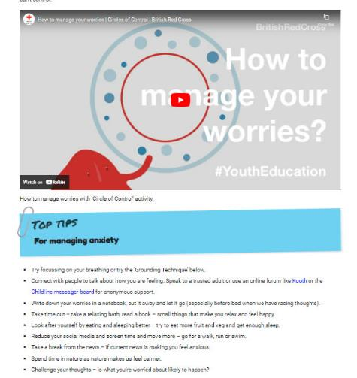
Anxiety Advice for Young People in Suffolk
The Source websites ‘Mind’ section includes information and advice for young people on managing anxiety, and signposts to videos and useful resources.
www.thesource.me.uk/wellbeing

Slide 4
Emotional Wellbeing Posters and Z Card Resources
We have a series of wellbeing z-cards and poster resources available to help schools and settings signpost young people to mental health support services.
We send out our wellbeing resources to schools and settings on request, by emailing: thesource@suffolk.gov.uk
To request our wellbeing resources, go to: www.thesource.me.uk/resources

Slide 5
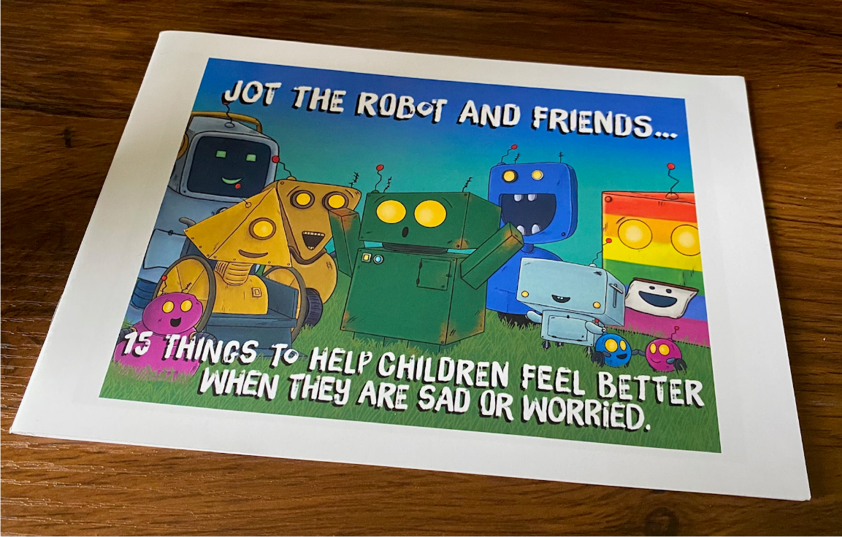
Anxiety support for children – Jot the friendly robot well-being resources…
15 things from Jot the robot to help children feel better when they are sad or worried.

Slide 6
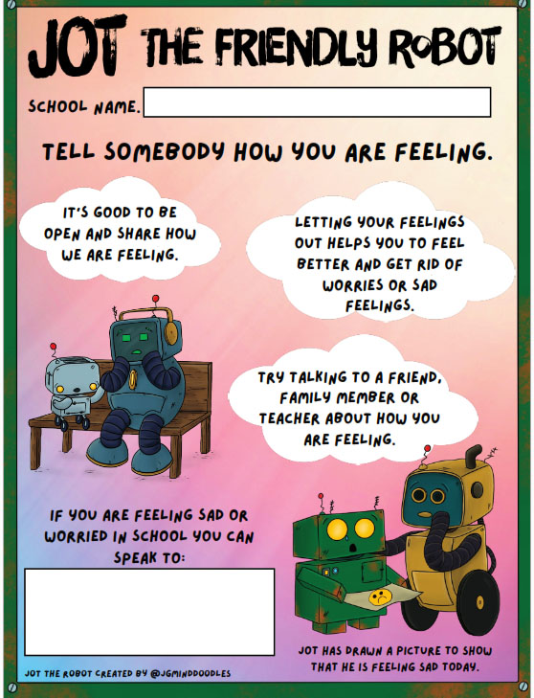
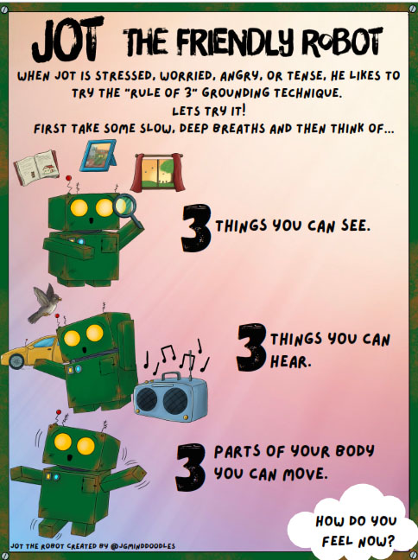
Jot the robot poster resources…
We have the following Jot the robot posters available to schools and educational settings, aimed at children…
Jot the friendly robot - Rule of 3 and Rule of 5 Grounding Technique posters
Tell Somebody How You Are Feeling – teacher to speak to poster
Jot the friendly robot - Sleep Tips poster
These poster resources are available to download from our website or you can request a Jot the robot wellbeing pack by emailing: thesource@suffolk.gov.uk
www.suffolk.gov.uk/jot

Slide 7
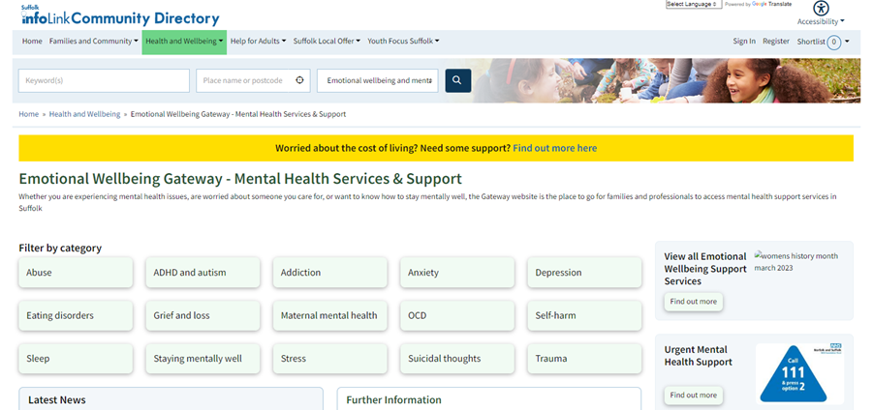
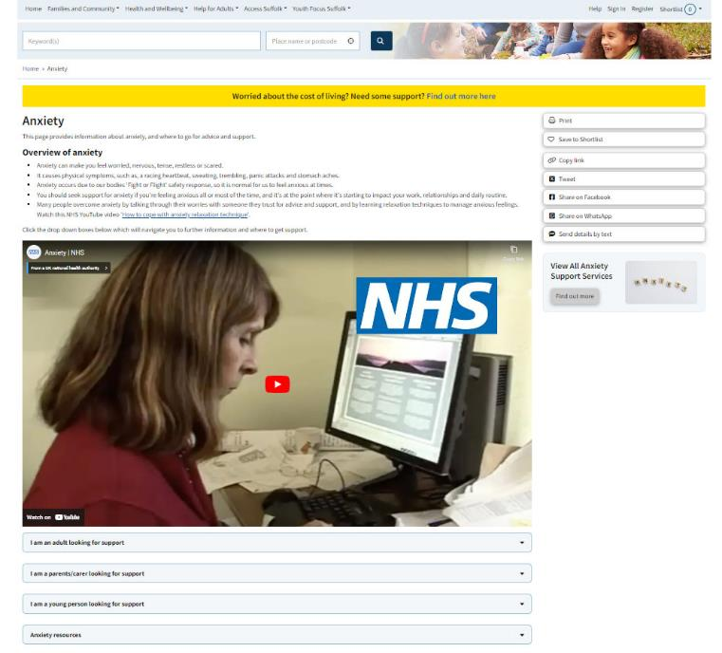
Anxiety Advice for Families Emotional Wellbeing Gateway Website (Suffolk InfoLink)
www.emotionalwellbeinggateway.org.uk

Slide 8
Our contact details…
Please like and share our social media:
Twitter: @sourcesuffolk
Facebook: @thesourcewebsite
Instagram: @ehub_
Engagement Hub enquiries: thesource@suffolk.gov.uk

