Slide 1
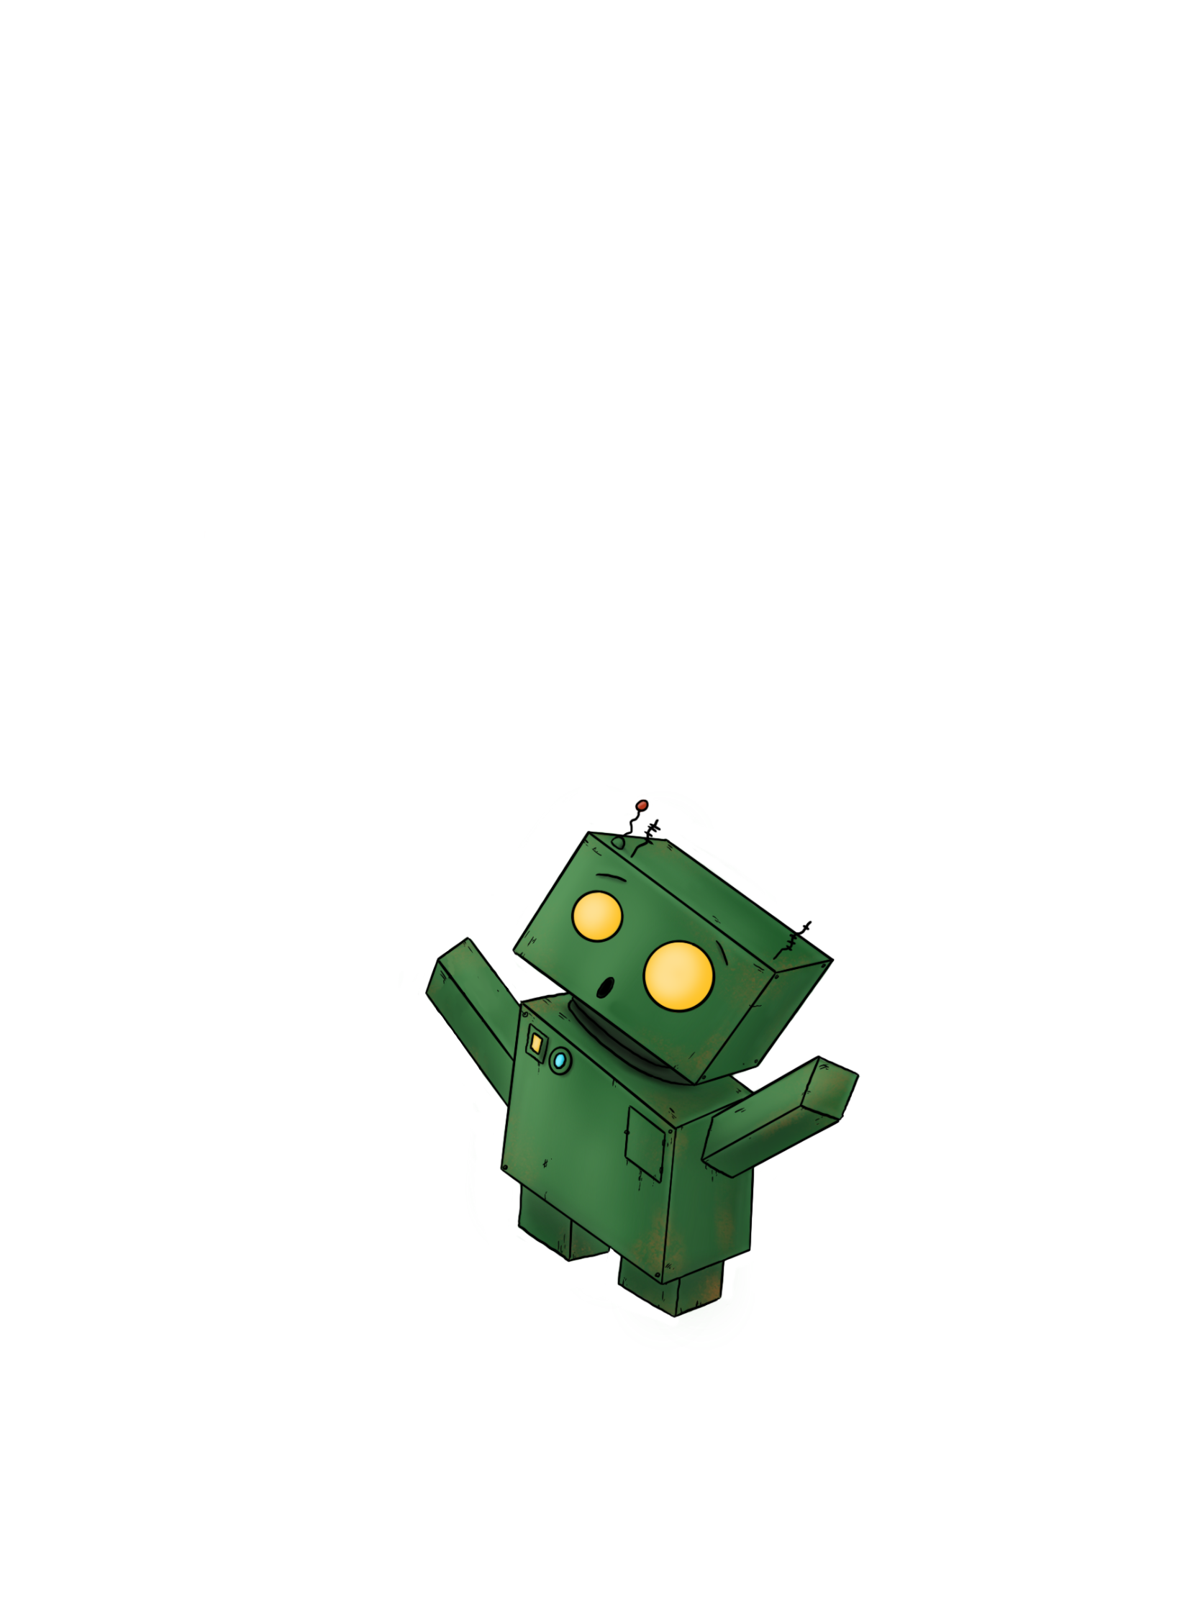
Children & Young People’s Engagement Hub
Suffolk County Council’s
Fran Russo
Emotional Health & Wellbeing Information Officer
Notes:
Hi my name is Fran. I am an EH& Wellbing Info Officer from the CYP Engagement Hub team. My team is a small team based in the children and young people’s directorate at Suffolk County Council.
I (Fran) work in partnership with Suffolk and North East Essex ICB to help to promote service updates and support around CYP mental health transformation work in East and West Suffolk.

Slide 2
What we do in The Engagement Hub?
Listen Communicate Help make change
We support opportunities for Suffolk children & young people to have a voice, shape services, learn new skills and influence the world around them.
Notes:
Our team works with children and young people, enabling their voices and opinions to be heard by decision makers and service providers. We do this via co-production and engagement opportunities, where we gather the voices of young people to put to service providers to help improve support for young people in Suffolk.

Slide 3
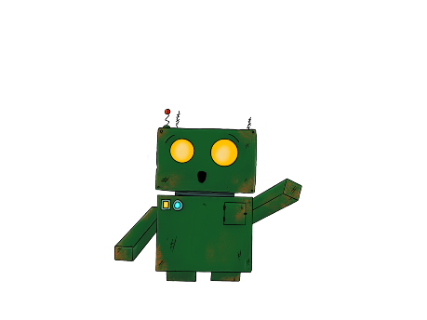
How we work with children & young people…
Recruitment of CYP staff
Children in Care Councils and Care Leavers
Our e-newsletter
Our website for young people in Suffolk
www.thesource.me.uk
Jot the Friendly Robot
Mental Health Transformation work in partnership Suffolk & North East Essex
Integrated Care Board (SNEE ICB)
SEND young people
Suffolk Members of Youth Parliament and Suffolk Youth Forum
UASC – Unaccompanied Asylum-Seeking Children
Notes:
Information and advice on a variety of subjects that impact young people in Suffolk via The Source website www.thesource.me.uk
We work with various groups of young people in schools and colleges to gather their voices and support events, activities and opportunities for young people. Our team supports opportunities for Suffolk children & young people to have a voice, shape services, learn new skills and influence the world around them.
The E-hub is a very small team but we are involved in a lot of work to support young people in Suffolk, we:
Put out a monthly newsletter – called the Suffolk Assembly of Youth (SAY) aimed at keeping people in touch with opportunities, activities and services for young people in Suffolk.
We provide a young person’s panel to allow young people the opportunity to be part of the recruitment and selection process of staff joining the Councils CYP staff workforce who will be taking active roles to support young people in Suffolk.
We work with various groups of young people in schools and colleges and with youth support groups, to carry out co-production work where we gather young people’s voices. Our groups include:
working with children in care councils and care leavers,
Our young person’s SEND Network groups within schools and colleges,
Working with members of youth parliament and supporting them with their Suffolk Youth Forum to gather views from young people for their campaigns.
We have recently created a new UASC group to provide a safe and empowered space for unaccompanied asylum-seeking children to share their experiences and be heard.
We work with SNEE ICB to provide mental health resources for CYP – via our TheSource website and our Jot the robot wellbeing campaign.
We are involved with the SEND Strategy transformation work.
Most people are aware of our team through The Source website (we are also known as The Source Team) The Source is a website that our to team manages to support young people and schools in Suffolk.

Slide 4
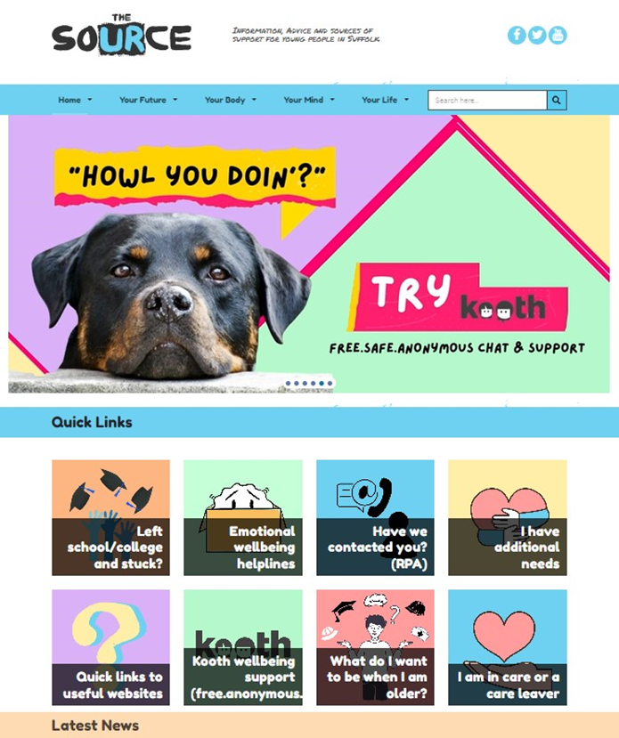
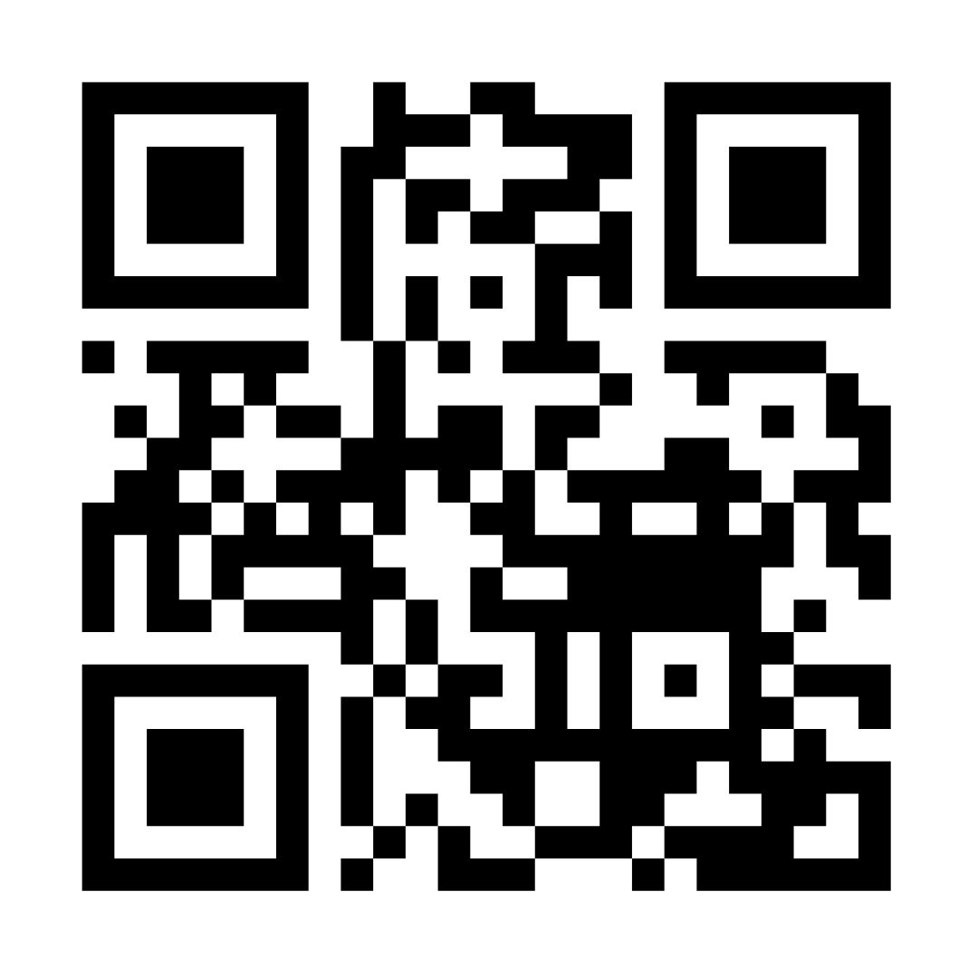
The Source Website – for young people in Suffolk
How we capture pupil’s voices…
Is a bespoke website which was designed with young people in Suffolk, and is aimed at 11-18 year olds (up to 25 with SEND)
Offers impartial information and advice for young people to make the right choices for them
The website covers four sections – ‘Future’, ‘Body’, ‘Mind’ and ‘Life’
www.thesource.me.uk
Notes:
The biggest way in which we capture and share the voices of young people is on our Source website.
The Source provides information, advice and sources of support to young people in Suffolk about the things that are important to them. The website was designed with young people and its unique selling point is that the information and advice that you find on The Source website has been co-produced with children and young people, via group work and projects that we do with with young people within schools, colleges, and with youth organisations. This is what makes our website a friendly and colourful place for young people, and those who support young people, to go for help about a whole range of topics not just about Mental Health. If you have not already seen the walk-through video of The Source website, please scan the QR code to go to our site to take a look at all the support and features the site offers young people.

Slide 5
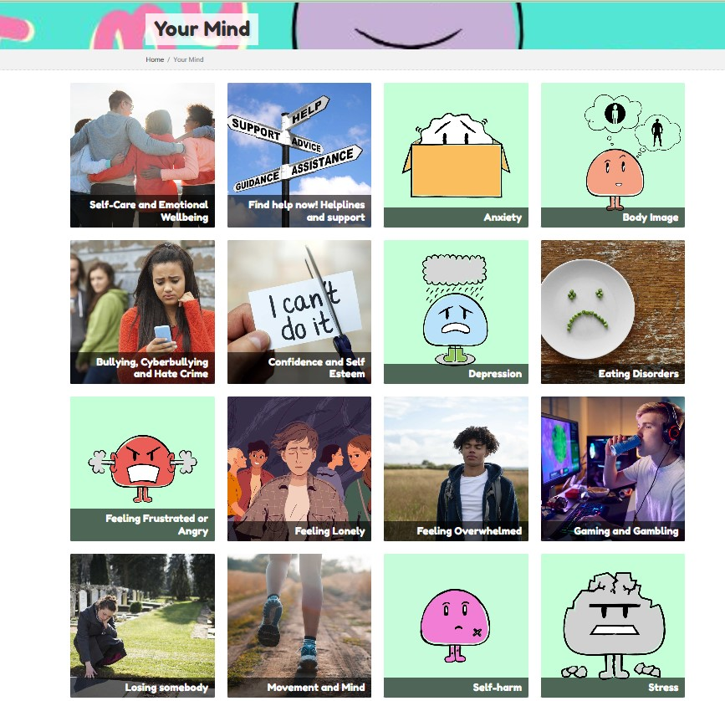
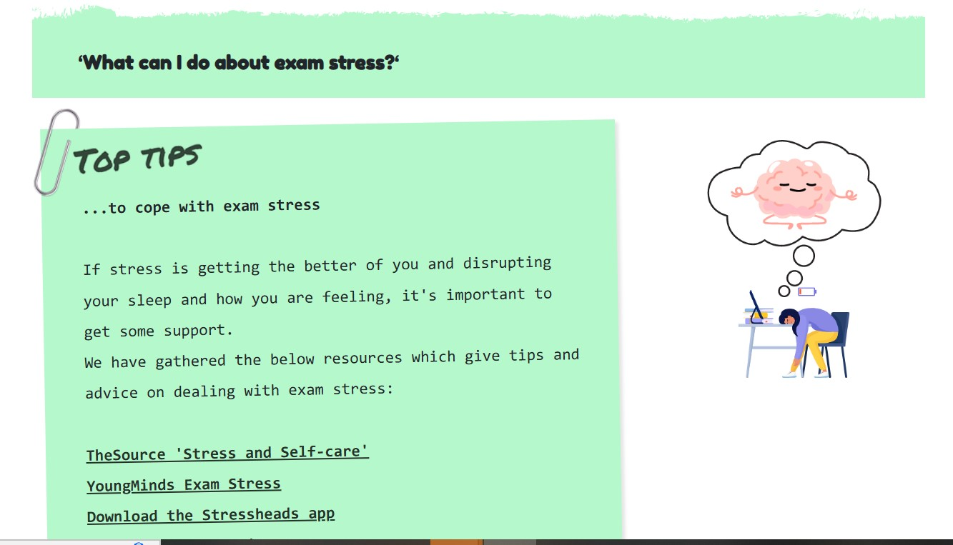
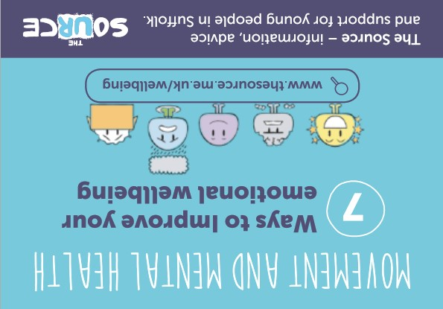
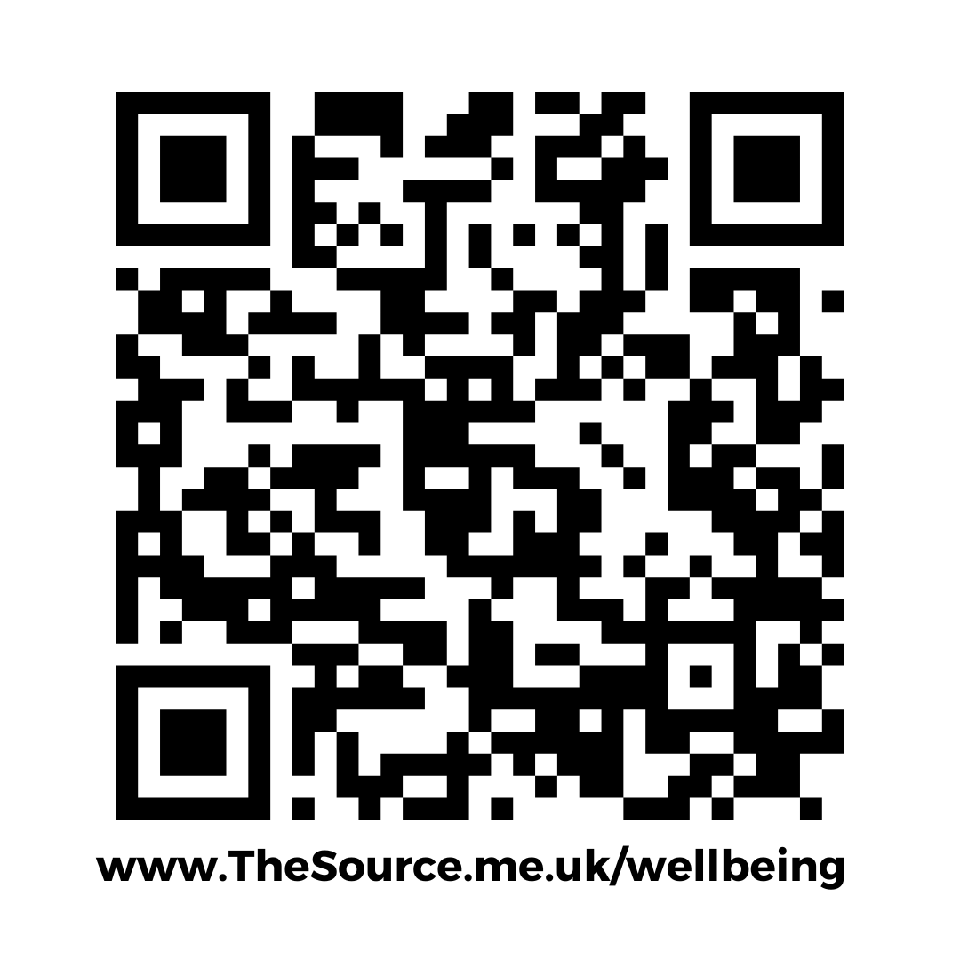
Co-producing emotional well-being information and advice with young people
How we capture pupil’s voices
The well-being advice pages on our website comes from young people’s voices. We have a series of co-produced emotional well-being z-cards available to schools which provides friendly tips and signposting to help young people know where they can find mental health support services in Suffolk.
Download our wellbeing resources at: www.thesource.me.uk/resources
Notes:
The Source website, has an extensive ‘Mind’ section to help young people manage their emotional health – if you haven’t seen this already scan the QR code which will take you to our Mind section.
This section includes advice on all the common mental health issues like stress (exam stress) anxiety, low-mood, self-harm, eating problems, suicidal thoughts. The advice provided on these pages has come from what young people have told us helps them. We have co-produced a series of emotional well-being z-cards and posters to help signpost young people to mental health support services. These resources can be digitally downloaded from The Source website ‘Resources’ page found from the Home tab, or you can request hard copies from us– you can contact us via The Source website to do this.

Slide 6
Year 10 students at Northgate High School told us they wanted to help support the mental health of their younger students in and out of school
What we have learned from pupil’s – Older students would like to help younger students
As a result, we helped them to co-produce a ‘We all have Mental Health’ presentation
which could be used with Year 7s in their PSHE lessons and in assemblies.
Their presentation included an introduction about what is emotional wellbeing, what can affect our emotional wellbeing, their school values for helping each other and signposting to mental health support in and out of school.
Notes:
This is an example of a co-production piece of work that we did last year with Year 10 students at Northgate High School, who had identified mental health support in and out of school for their younger students as being a big priority for them, and they felt they weren’t aware of what support was available to them when they were in Year 7.
The group of Year 10 students wanted to present information on mental health and wellbeing to Year 7s in their PSHE lessons. We worked with the students to co-produce a ‘We all have Mental Health’ presentation.
The presentation has been used by their staff and students and shown via the school’s social media channels to help the school raise awareness of mental health support to their students in and out of school.
This project helped the students involved to discuss and explore mental health support together. We have the presentation as a template which can be downloaded for other schools to create a version of the presentation for their pupils.

Slide 7
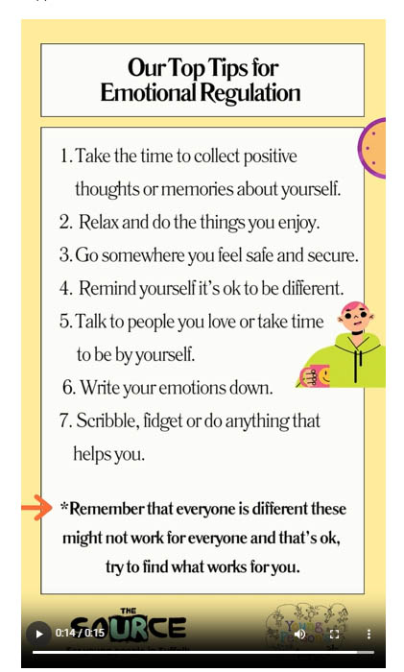
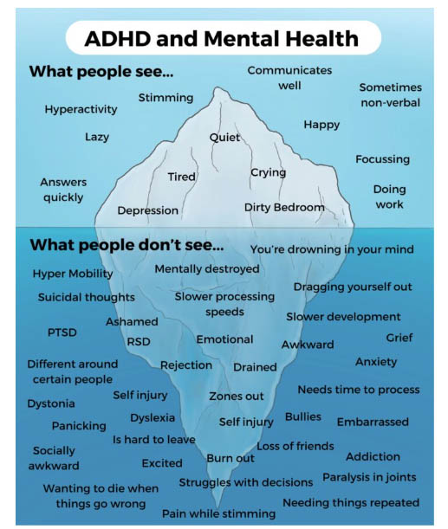
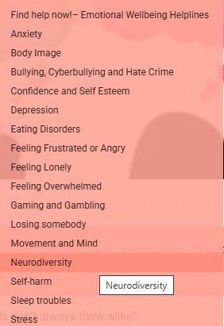
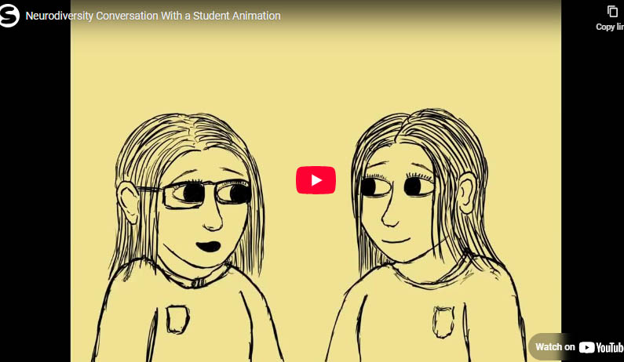
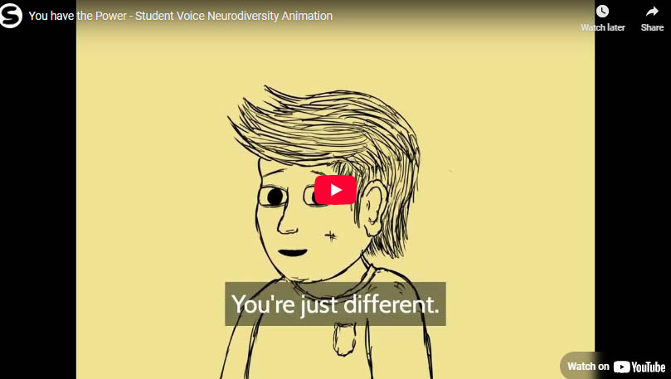
What we have learned from pupil’s – They would like more Neurodiversity awareness in school/college
Ice
Iceberg Poster
Illustrated video clips of young people talking about being a neurodivergent student.
www.thesource.me.uk/neurodiversity
Notes:
When we speak to pupils, particularly from our Young Person’s Network groups, these are children and young people with learning difficulties, or are awaiting diagnosis for ADHD or autism, it’s clear that a lot of pupils want to share their experiences about emotional well-being when we talk to them about their learning experiences.
In the last year within our young person’s SEND network groups within high schools and colleges, we have had lots of discussions with pupils about the challenges, stereotypes and misconceptions that students with neurological differences have experienced in school.
We do find that SEND and mental health tend to go hand in hand with the experiences that we hear from our young person’s network groups.
The pupil’s wanted to raise awareness about what it is like being a neurodivergent student – we explored with them - how they would like to be supported more in school, and what advice they would give to their peers.
As a result of this work, we created a Neurodiversity page on our Source website to provide information and advice about neurodiversity to raise more awareness and share the quotes and resources that we co-produced with the pupil’s. The resources created included voice clips that we captured of their conversations where we worked with them to turn their voices into illustrated video clips of themselves which have worked well in getting their points across anonymously. We captured their top tips for emotional regulation and created a poster with the students, who produced some Iceberg illustrations that talked about what people see and what they don’t see in relation to ADHD and Mental health. These resources are all available to download from the Neurodiversity page which can be found in our Mind section on The Source.

Slide 8
What we have learned from talking to primary school pupils about mental health
How could we help someone who is feeling sad?
“We should ask someone if they are okay if they look sad in the playground.”
What things make you feel nervous/anxious? “People staring at me makes me anxious. And answering questions in class because if I get the answer wrong the class laughs at you.”
“When I see people upset it makes me feel nervous.”
“I feel nervous when someone is hurt as I feel like I have to help even if they don’t like me.’ (a student rep)
What makes you relax? Pupils said…Crystals, candles, loud music, reading, sleeping, stretching, Minecraft (gaming), take a deep breath.
Pupils from our Young Person’s Network group at Beccles Primary School.
Notes:
When we plan for a group session we normally give the pupil’s a choice of topics that they have mentioned to us – and we often find that they would like to talk about how they are feeling given a choice of topics.
Here is some feedback we received from the pupils from our Beccles Primary school’s Young persons network group when we were talking about our feelings with them. And what things they said makes them feel sad, anxious or worried and what helps them to relax.
Feedback like this helps us identify trends in well-being issues and see how SEND children and young people’s mental health is being impacted within the school environment which we then feedback to the school and service providers to look at how we can improve support for them.
.

Slide 9
What we’ve learned from pupils – Sharing is caring
Pupils a lot of the time want to share their experiences about emotional well-being with us – particularly when they feel someone is unkind.
“People are mean to me.”
“I have a feeling of hate by people and how they perceive me it makes me angry.”
How can we be more kind to each other?
“Helping each other pick things up someone has dropped.”
“Reassurance is being kind, listening to each other is important.”
“Helping with schoolwork.”
“Drawing things to help them feel better.”
“Finger pulling, hot chocolate, and chair push techniques, our brain buddies’ exercisers that we use to help us feel less tense.”
“Compliments and praise, telling someone is good at something, and using kind words i.e. liking a friend’s hair. All these help us to be kind.”
Pupils from our Young Person’s Network group at Kyson Primary School
Notes:
The common theme we hear from pupils from our Young Person Network groups is that we have been hearing a lot lately is that they don’t like people being mean to them/feeling bullied.
This is a photo is from a group of pupils we have been working with at Kyson Primary school where we explored the topic of ‘How can we be more kind to each other?’ These are some of the quotes we captured from their voices.
We were talking to them about what brain buddy mindfulness activities they use in school. We got the pupils to try some alphabet yoga as a mindfulness activity they had not done before which they loved doing and they spelt out ‘Be Kind’ for us which we captured with the school.
The well-being feedback we have explored with our Kyson group is to go towards supporting the school to create a young person’s friendly version of their school’s neurodiversity guidance they have for parents and carers, so they have a version available that includes the pupils voices.

Slide 10
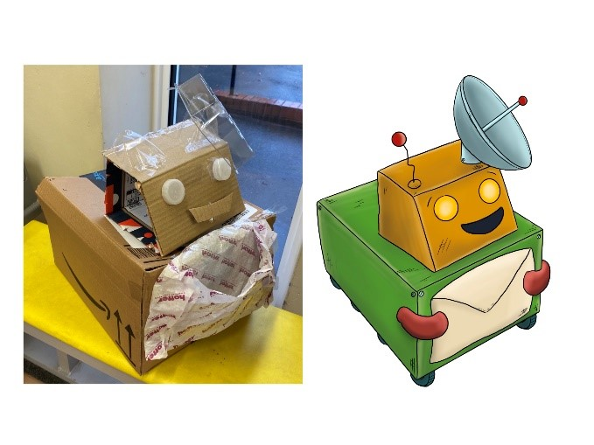
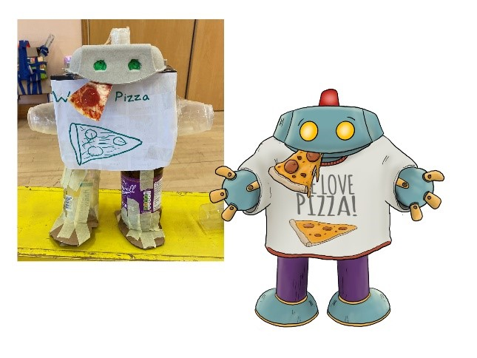
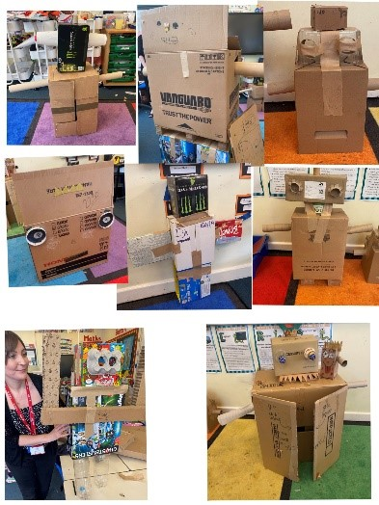
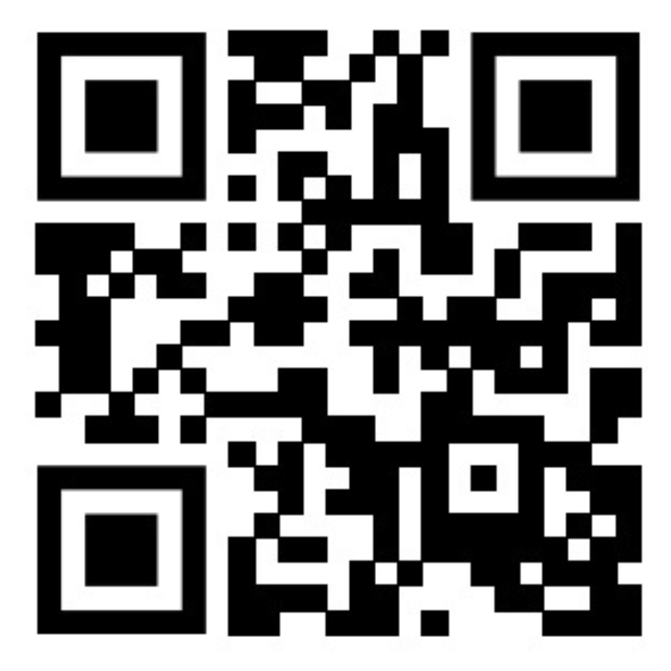
Jot the friendly Robot Wellbeing Workshop Feedback
‘Jot’ the friendly robot is a well-being campaign we created to support primary-school-aged children and SEND young people when they are feeling sad or worried.
As part of the campaign, we delivered Jot the robot well-being workshops in primary schools and with SEND schools where we used the Jot the robot character to teach children about emotional literacy while getting pupils working together to build their own robots out of recyclable items, whilst talking about their feelings. Top common things that pupils from the workshops said helped them when they felt sad was:
Talking to family –mainly referred to mum, included talking to siblings.
Playing video games
Pets
Music – playing and listening
Alone time
www.suffolk.gov.uk/jot
Notes:
Jot the friendly robot’, is an emotional wellbeing campaign that our team introduced over a year ago now in partnership with Suffolk and North East Essex ICB to help primary school aged children in Suffolk learn about emotional literacy and to support primary schools by providing them with well-being resources– at the time we found we had lots of well-being resources aimed at secondary school pupils but none aimed at primary school pupils.
The Jot the robot campaign gives 15 tips to children about the things they can do to help them feel better when they are feeling sad or worried.
The campaign consists animated videos of Jot giving his wellbeing tips which are available online, booklet and flash cards and poster resources which we send out to schools to help them with their whole school approach to wellbeing support for their pupils. Jot the friendly robot has proved helpful to schools and parents and carers who support children and young people with SEND or learning differences to learn about managing strong feelings.
Since the campaign was launched we rolled out workshops to 14 schools on request across east and west suffolk. The workshop included introducing the children to Jot and talking with them about things they could do when they feel sad or worried and then getting them to make their own robots out of recyclable items. Here is the feedback we captured from the pupils when we asked them about the things that helped when they felt sad.
What we found is for primary school aged children – talking to a friend when they felt sad was barely mentioned which tends to be the preferred thing young people tells us they would do. When we looked at the workshop feedback from primary school teachers about what well-being topics they would like to see for future workshops? The most common topic was about:
1. Friendships – how they change as we get older and respecting each other, then…
2. Gender identity
3. Bullying
The Jot workshops we found worked well in providing a fun and creative way to talk with the pupils as a group or individually about how they are feeling.
We have got all the resources available on the SCC Jot page to allow primary schools to host their own Jot the friendly robot building well-being workshop – scan the QR code to find this.

Slide 11
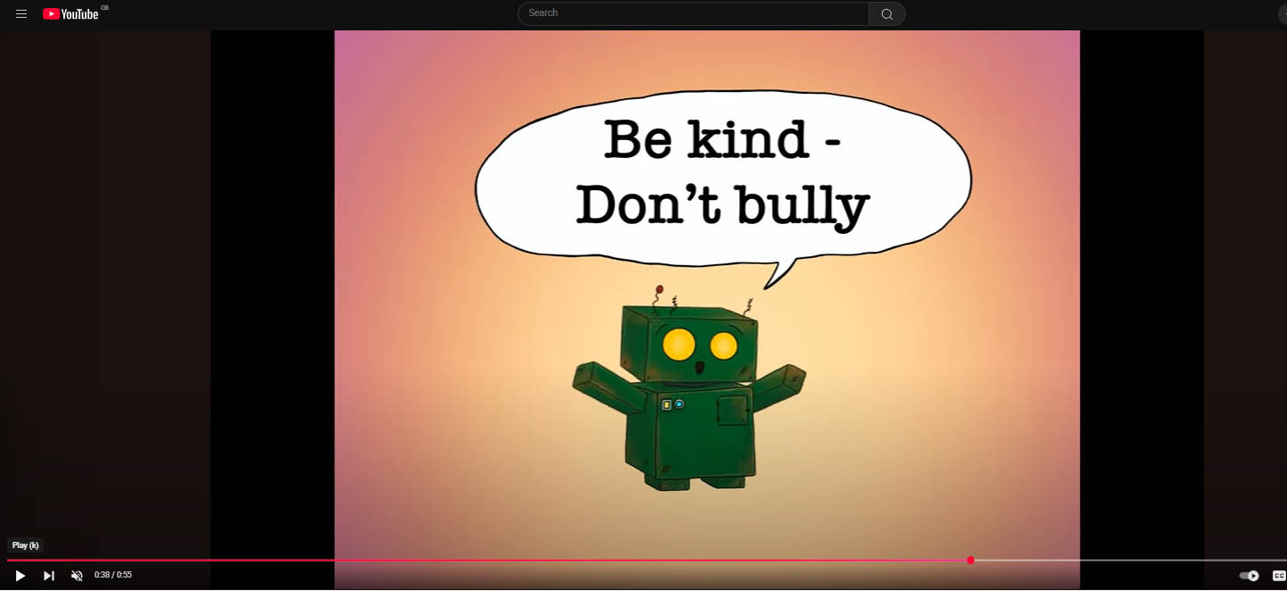
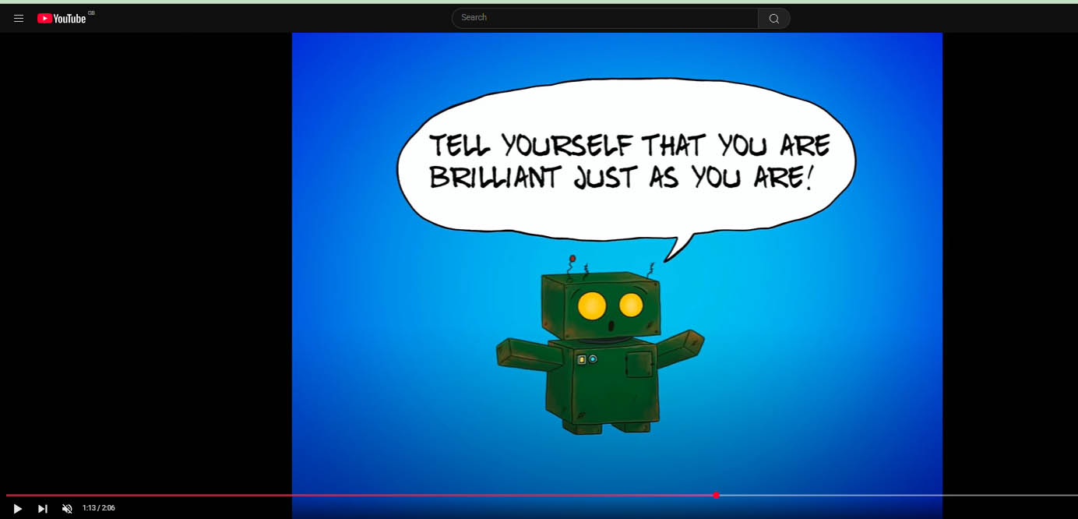
Resources to support pupils with unkind/bullying behaviour
Hearing from pupils about the common theme of unkind/bullying behaviour impacting their well-being, we have looked at resources we have available to help support pupils and schools with this issue.
We have created ‘Jot the Friendly Robot’s Well-being Tips’ animated videos with messages to children about being kind to others and ourselves.
– Jot well-being tip animation: ‘Offer to help someone’.
- Jot well-being tip animation: ‘3 things I like about myself’. (This was our highest reaching video on YouTube with over 58k views since October 2024.)
We have re-launched our ‘Stop the Hate’ anti-bullying Campaign’ to help pupils and schools know how to report hate crime.
www.suffolk.gov.uk/jot
www.thesource.me.uk/bullying
Notes:
Based on feedback from pupil’s and schools, one common theme we are hearing is about unkind behaviour impacting pupil’s mental health. So to help support anti-bullying in schools we have created our ‘Jot the friendly Robot’ well-being animations to promote the message of being kind to yourself and to others to children – our 3 things I like about myself jot animation is our highest reaching video which resonated with lots of people on our Source YouTube channel.
To help support high schools and colleges we have re-launched our ‘Stop the Hate’ ant-bullying campaign to help pupils know how to report hate crime.

Slide 12
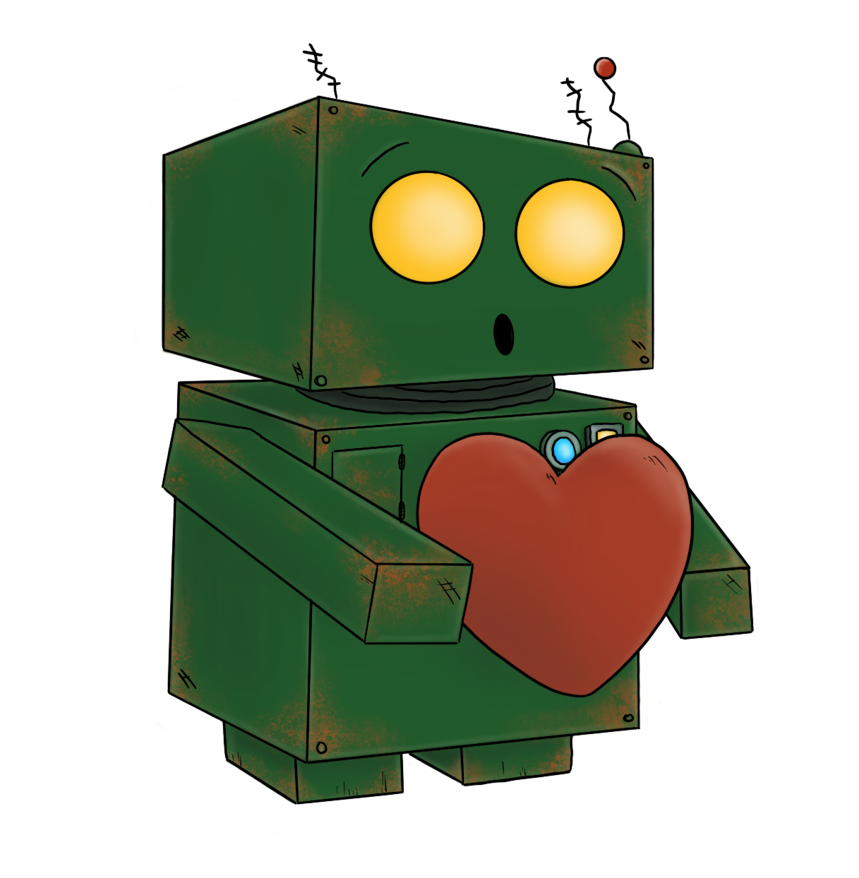
CYP Engagement Hub Contact Details…
Please like and share our social media:
Facebook: @thesourcewebsite
Instagram: @ehub_
YouTube:
@thesourcesuffolk
Email: thesource@suffolk.gov.uk
Notes:
Finally If you would like to get in touch with us, you can do so via our Source website or social media channels.
Please do follow us to stay updated with our well-being news and campaigns on The Source. Any questions?

