Slide 1
Supporting Children with Anxiety
JA
Tony Whitehead
SEMH Specialist Teacher
Jane Albery
C&I Specialist Teacher

Slide 2
Who are we?
JA
Suffolk County Council
Inclusion Service
Specialist Teachers

Slide 3
Aims Plan
JA
To gain an understanding of how SES supports early intervention
Some theory
To gain an understanding of anxiety in children and young people.
Some strategies
To become familiar with the types of strategies SES recommend to schools to support anxious children and young people.
Some signposting

Slide 4
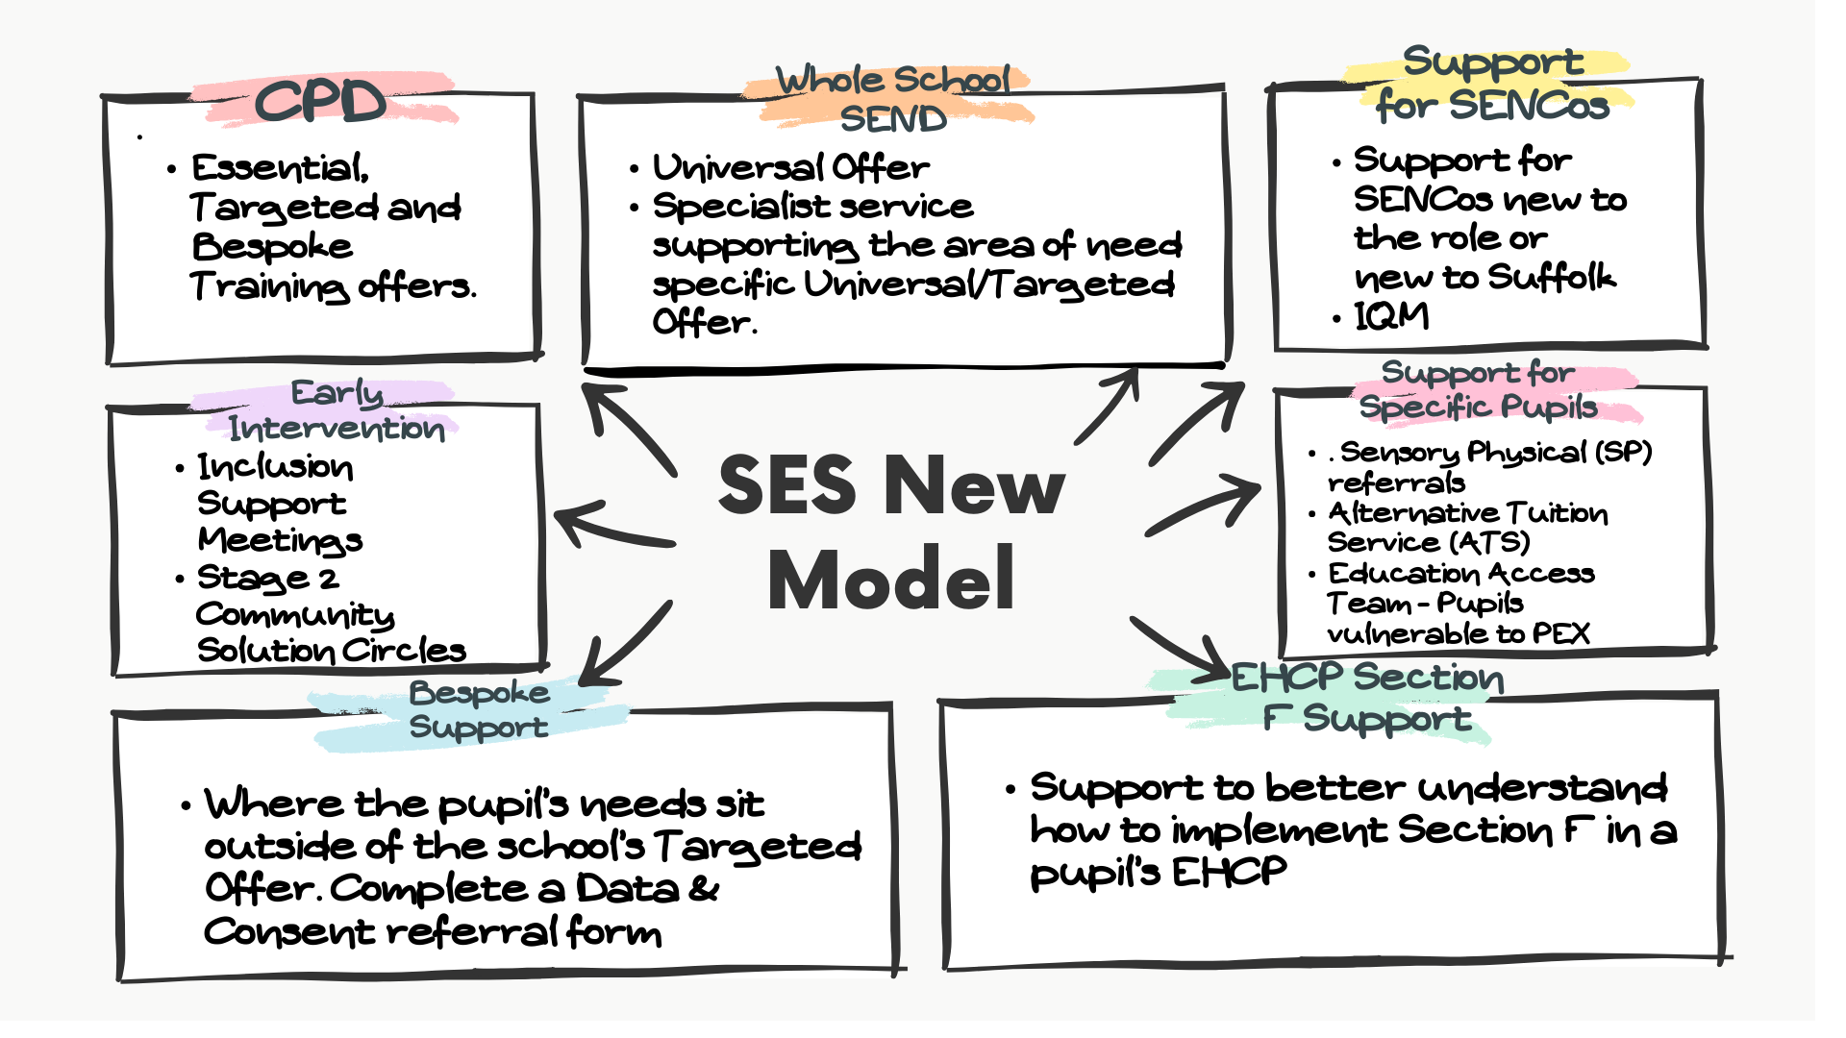
Our New Model
TW

Slide 5
Whole School Approach to supporting mental health
TW

Slide 6
Things that make a difference
TW
Our language and communication
Routines, consistency and scripts
Motivation and reward
The environment and visual supports
Relationships, connection and sense of safety
Use of PACE

Slide 7
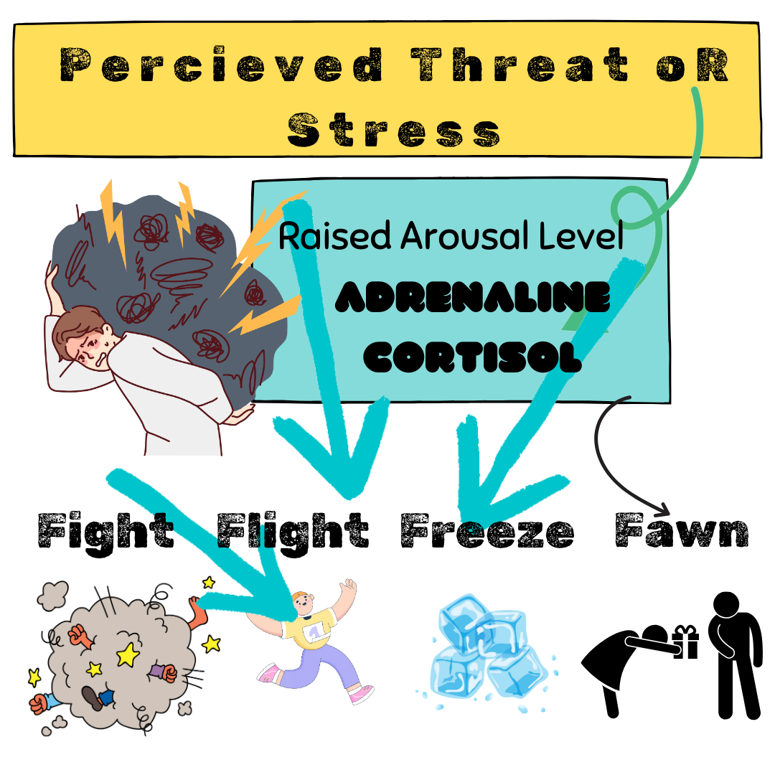
Anxiety is a natural response to
JA

Slide 8
Why are children anxious?
JA
Social side of things is difficult for some children who spend all their energy at school managing this- it’s exhausting. Think of ‘Social Energy’.
Language skills
Experiences - ACEs, trauma, attachment
Sensory issues
Environmental factors; within the family, school, wider community
Neurodivergence, health and disability
Genetic predisposition to some children being anxious

Slide 9
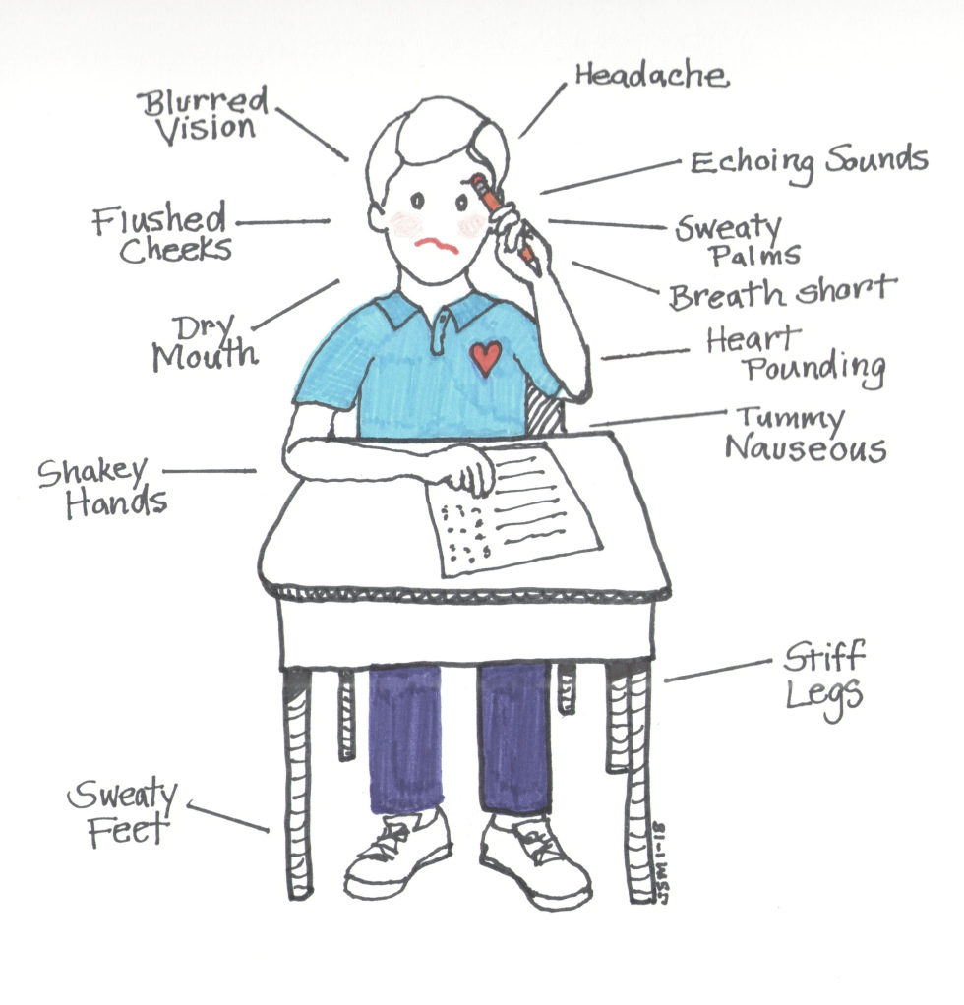
Some Signs Of Anxiety
TW
Tired, on edge or restless.
Unable to concentrate or make decisions.
Feel sick, dizzy, tummy aches, headaches or sweaty.
Poor or increased appetite.
Isolated from peers.
Constant worrying or having negative thoughts.
Repeatedly check things or need reassurance from others.
Heightened emotions e.g. anger, often uncontrollable.
Avoid situations or put off doing things.
Trouble sleeping.
Need to control situations.
Frequent toileting.
Dry mouth.
Pins and needles.

Slide 10
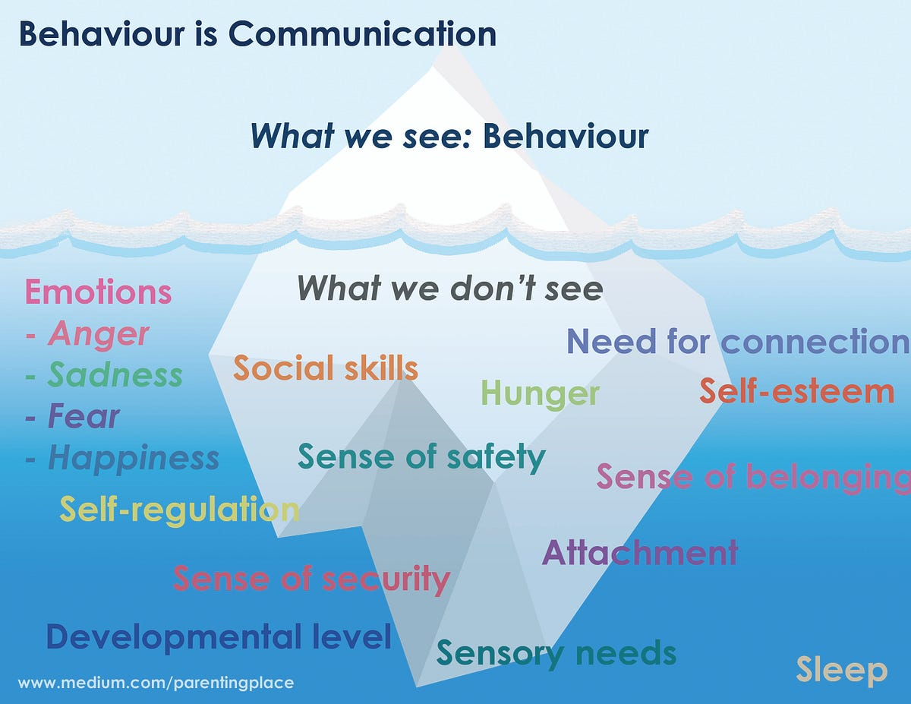
The ‘anxiety’ iceberg
TW

Slide 11
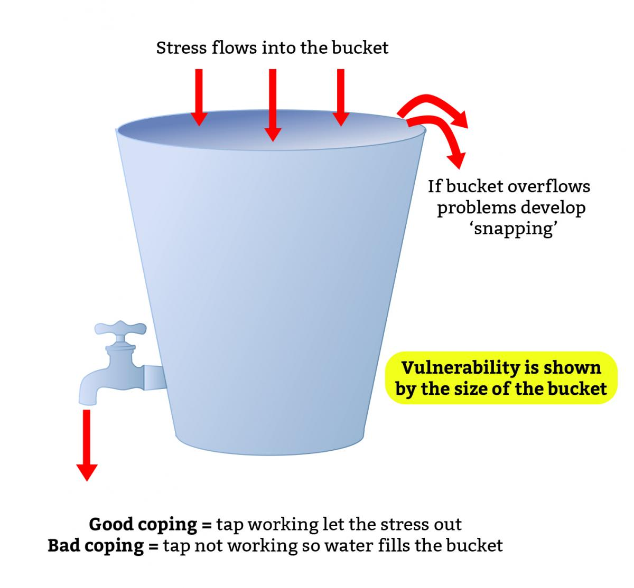
Stress Bucket
TW

Slide 12
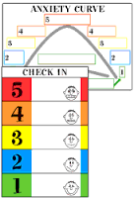
Anxiety
JA
Everyone has anxiety- it is normal- normalize it for children
What are the triggers?
Work on identifying the bodily sensations to anxiety
Use a hierarchy or scaling to help identify levels of anxiety.
Help child to generalise strategies for reducing anxiety to different situations

Slide 13
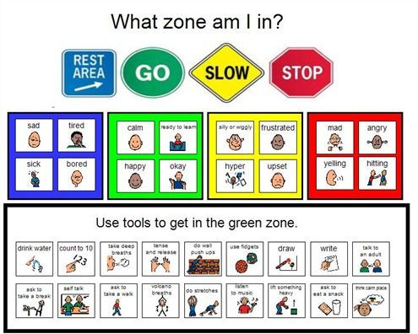
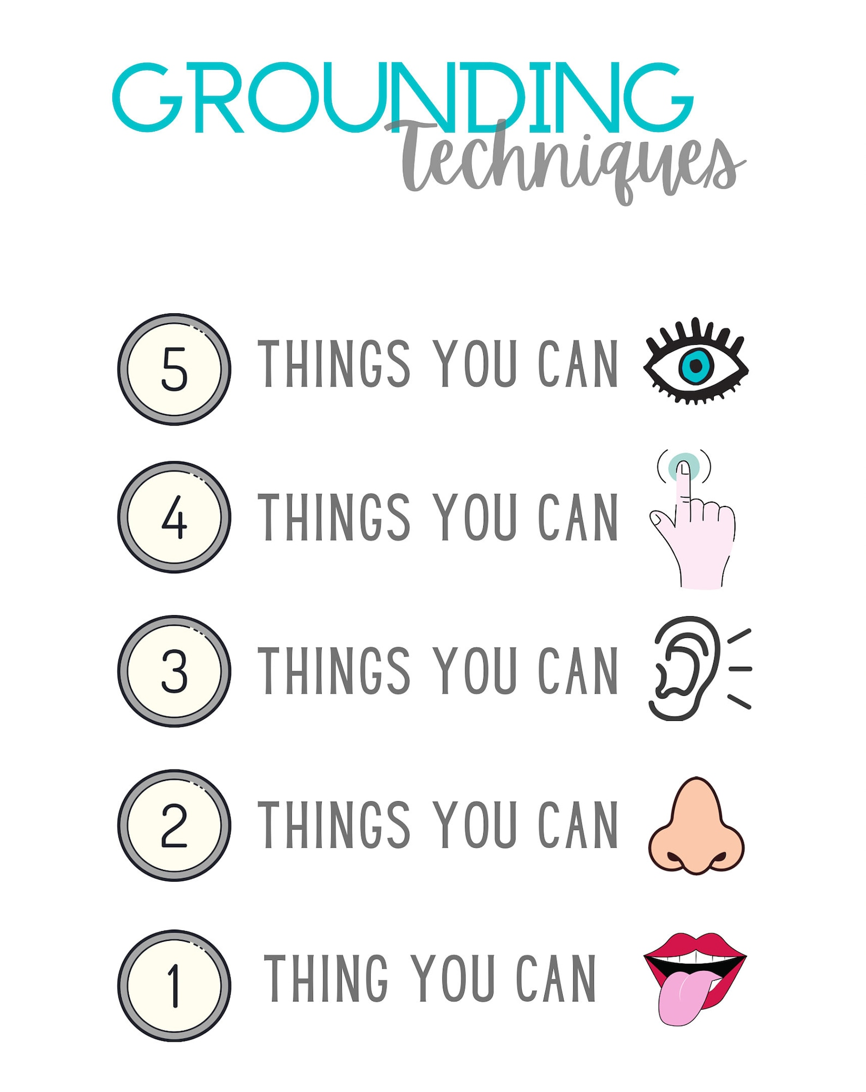
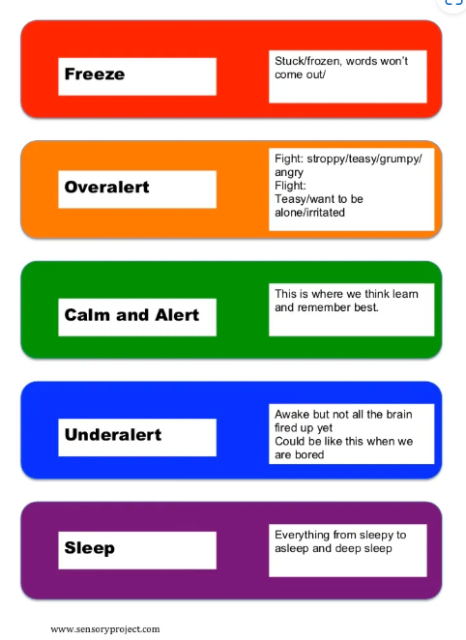
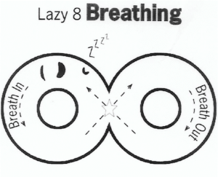
Visuals to support regulation
JA

Slide 14
Emotional Toolkit
JA
Develop an emotional toolkit-
Sensory breaks- toys, books, time out/chill out areas, safe space, physical activity
Breathing exercises- ‘rectangular breathing’ (with a longer outbreath) and ‘lazy eights’
Would opportunities for exercise after school help?
Give child allocated ‘worry time’
Find activities which make the child happy/give sense of well being

Slide 15
Emotional Toolkit cont’d.
TW
Find 10 things to improve your mood… visual menu
Diary of strategies- rate anxiety before and after.
Problem solving together.
Thought challenging – what do you think, feel and do? What could you have done instead? How might you have felt instead?
Develop an emotional language that holds relevance for the child.

Slide 16
Breathing & Grounding Exercises
TW
BREATHING EXERCISES
regular practice when not anxious
creates a physical response which activates the relaxation process
GROUNDING EXERCISES
bring us back to the
present moment
senses link to different
parts of the brain

Slide 17
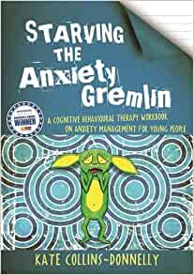
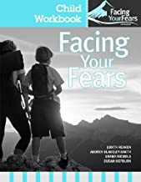
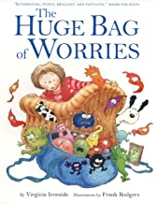
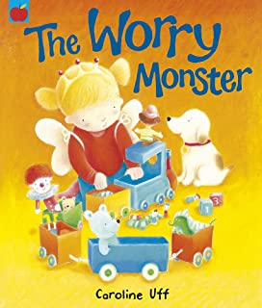
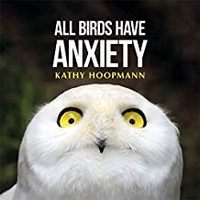
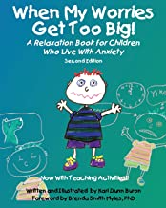
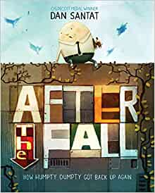
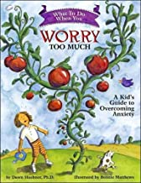
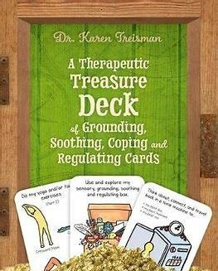
Starving the Anxiety Gremlin - by Katie Collins-Donnelly
Facing your fears - by Judith A Reaven
The Huge Big Bag of Worries – by Virginia Ironside
Worry Monster – by Caroline Huff
All Birds Have Anxiety – by Kathy Hoopman
When My Worries Get Too Big – by Kari Dunn Burton
What to Do When You Worry Too Much – by Dawn Huebner
Hey Warrior – Karen Young
After the Fall – Dan Santat The Essential Guide to Mindfulness with children and young people’ by Tina Rae, Jody Walshe and Jo Wood ‘Help! I’ve got an alarm bell going off in my head!’ How panic, anxiety and stress affect your body by K.L. Aspden
Useful Books

Slide 18
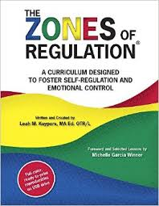
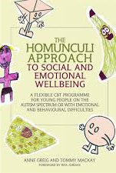
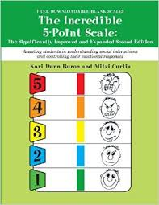
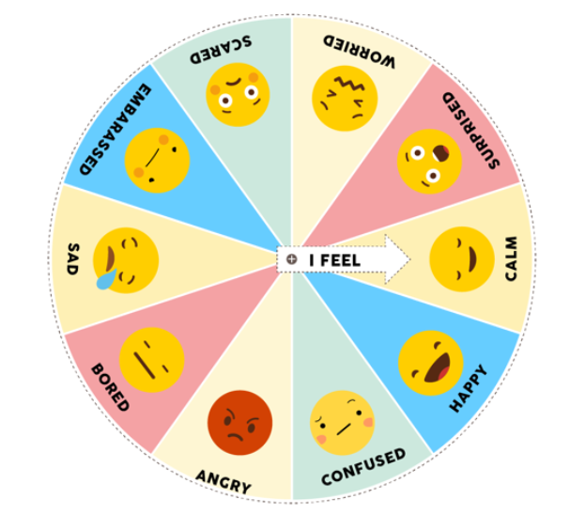
Useful books- cont’d
Incredible 5 Point scale
When my worries get too big
Zones of Regulation
Modified CBT- The Homunculi Approach to Social and Emotional well being
Overcoming Your Child's Fears and Worries: A Self-help Guide Using Cognitive Behavioural Techniques Cathy Creswell
Worry Eaters
www.minded.org.uk
Modified CBT programmes
Anxiety-in-Autism-Guide-021219.pdf (city.ac.uk)
Make a calming scrapbook
or PowerPoint?
Any others?

Slide 19
https://infolink.suffolk.gov.uk/kb5/suffolk/infolink/advice.page?id=Nh2oJw7Qq4I
https://youngminds.org.uk/
https://www.mind.org.uk/
https://www.nhs.uk/conditions/anxiety-disorders-in-children/
https://www.heysigmund.com/anxiety-in-teens/
https://www.nhsinform.scot/illnesses-and-conditions/mental-health/mental-health-self-help-guides/anxiety-self-help-guide
https://www.mcgill.ca/counselling/files/counselling/anxiety_moodjuice_self_help_guide.pdf
https://www.kooth.com/
https://www.thesource.me.uk/health/chathealth-your-school-nursing-text-service/
Service details | Norfolk and Suffolk NHS (nsft.nhs.uk)
https://www.suffolk.gov.uk/children-families-and-learning/pts/
Useful Websites

Slide 20
Thank you for listening
Any Questions

