Slide 1
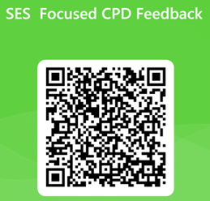
Welcome: 1st slide
We will start shortly.....
Please complete the short evaluation at the end of this training. Relevant content will only be shared, upon completion of the evaluation (returned within 1 week of the training session).
Thank you.
SES Focused CPD School Feedback
Notes:
January 2025 FOCUSED MASTER PPT (HOUSE STYLE) –This slide should be included in all Bespoke Focused presentations that are tailored to schools, as the first slide
Teachers- please display this slide as a prompt, whilst people are joining. Please ask delegates to add their names into the chat pane AND forward the names to the SES CPD mailbox after the training has finished, so a PDF copy of the PPT can be sent out to the attendees, along with the evaluation link.

Slide 2
The Importance of Pupil Voice
Emma Nicholson SEMH
Samantha Wilkins SLCN
Louise Taylor-Hilton SLCN
Notes:
Training Title Slide: This slide should be included as Slide 2 in all presentations, as shown.
Please amend training title and add presenter and service names.
Send PPT to Nickie Roberts (SES BSC) for accessibility, layout and house style checks. If any changes are made to previously checked PPTs, please re-send to Nickie, so she can re-check accessibility etc.
PPTs should be sent to Nickie at least 1 week before training is due to be delivered, so Nickie has time in her diary to carry out the checks alongside her other commitments.

Slide 3
Slide 2: Who are we?
Who are we?
Suffolk County Council
Inclusion Services
Specialist Teachers
Notes:
Who are we Slide: This slide should be included as Slide 3 in all presentations, as shown.
Slide to remain as shown – No changes to be made.

Slide 4
SES
Notes:
SES sits within the CYP Directorate in Inclusion Services.
SES comprises of 7 different specialist services. Each either have a Head of Service or Service Lead and is comprised of specialist teachers and in the S/P teams, also intervenors, specialist LSA’s. A BSO is linked to each service although BSO’s largely work across SES. More details on this on next slide. HoS to go into more detail about their service further along…

Slide 5
Access to SES
Mainstream school-based specialist support service*
Referrals accepted only from mainstream schools with parental permission
Referrals can be made for pupil support or school support
4 different referral forms – bespoke, Section F, school, and sensory service
*This includes specialist units attached to mainstream schools
**The Sensory/ Physical services also accept referrals from Health

Slide 6
How we work with schools
Pupil support (Bespoke or Section F)
School support
Support to new SENCos/ new to Suffolk SENCos
Inclusion Quality Mark (IQM)/ Suffolk Inclusion Toolkit
Training
Inclusion Support Meetings (ISMs)
Solution Circles
Notes:
To note, S/P services are a little different in that they are statutory services and so their referral pathway is different. Referrals can come via the same route as specialist services but can also come via health. They work with CYP 0-25 and work in or out of the school environment.
The following information is not applicable for our S/P services…
Request for support…
Pupil support – WEO of WSI and S/P, SES services are mainstream school-based and can support CYP from Reception up to Year 11 for bespoke or Section F support – expand detail re bespoke/ Sec F.
School support – SES also offer whole school level support focused in and around a school's inclusion or one of the SEND areas of need
Support for new to SENCo/ new to Suffolk and IQM/ SIT can all be requested via the school referral form – KD to expand?
A weekly Resource Allocation Panel (RAP) whereby each HoS/ Lead Teacher is present and robust, professional discussions are held about referrals received that week and if accepted for SES support a specialist teacher/s are allocated. These are then processed by our BSO team and the referring school are informed of the outcome, at which point the specialist teacher/s allocated contact the school to arrange an initial meeting/ discussion. The entire process from receiving the referral to the specialist teacher being allocated is approx. 2-3 weeks, if not quicker.
Training/ ISM’s and Solution Circles - expand

Slide 7
Agreed Learning Objectives
1
To understand the role/importance of pupil voice
2
To know strategies for capturing pupil voice
3
Case studies showing impact of pupil voice
Notes:
Agreed Learning Objectives Slide: This slide should be included as slide 4 in all presentations and should include LO’s discussed by HoS with School at point of CPD interest/purchase.
Please DO NOT alter layout, font size and background colour on this slide.
Text can be changed to reflect specific training aims/plan.
SCC logo should remain as shown in bottom right-hand corner of all slides unless this would impact on legibility/layout.

Slide 8
Pupil Voice – universal approaches
Notes:
Children and young people need to be provided with meaningful opportunities to share their experiences, views and hopes about their school. Pupils need to know that it is safe and that it is important for them to express their views on what happens at school. They need to know that what they say is valued and will be listened to and considered.
At universal level, schools are quite adept at capturing pupil voice through a variety of means that are embedded throughout their every everyday provision:
School councils
Class circle times
Assemblies
A ‘suggestion box’ placed in the entrance hall or in each classroom,
House team

Slide 9
Why capture pupil voice?
Improved learning and engagement
Early identification of needs
Enhanced social inclusion
Empowers and agency
Improved school climate and relationships
Better decision making
Increased advocacy and support
Personal development and skills
Motivating for the student to embrace support they have agreed
Notes:
https://www.mentallyhealthyschools.org.uk/whole-school-approach/pupil-voice
Empowerment and Agency:
Students feel heard and valued when their voices are actively sought and considered, fostering a sense of ownership and engagement in their learning.
Improved Learning and Engagement:
When students feel their opinions matter, they are more likely to actively participate in class discussions and activities, leading to better learning outcomes.
Early Identification of Issues:
Pupil voice can help identify potential mental health concerns, learning difficulties, or social issues early on, allowing for timely support and intervention.
Enhanced Social Inclusion:
By listening to students' experiences, schools can identify and address any barriers to inclusivity and participation, creating a more equitable and supportive environment for all.
Improved School Climate and Relationships:
When students feel their voices are valued, it can lead to improved relationships between students and teachers, as well as a more positive and collaborative school culture.
Better Decision-Making:
Student input can provide valuable insights into the effectiveness of school policies and practices, helping to inform decisions and improve outcomes.
Increased Advocacy and Support:
Students can advocate for themselves and their peers, leading to a more empathetic and supportive community.
Personal Development and Skills:
Participating in pupil voice initiatives can help students develop valuable communication, leadership, and problem-solving skills.

Slide 10
When?
Needs to be planned in session – no surprises for the pupil
Allow ‘enough’ time – this could be more than one session
Proactive not reactive
Prepare the pupil in advance
Give the pupil an element of choice
Protect that time
Notes:
Intentional capturing throughout the year – class votes; decision making, school councils, PHSE sessions etc…. Should be integral to and universal to all.
When we start to observe difficulties or concerns with a pupil, capturing pupil voice on an individual level becomes important to explore the school experience from their perspective.
Choice – when would be best? Consider what they could potentially be missing –is it their favourite lesson? Consider alternatives.

Slide 11
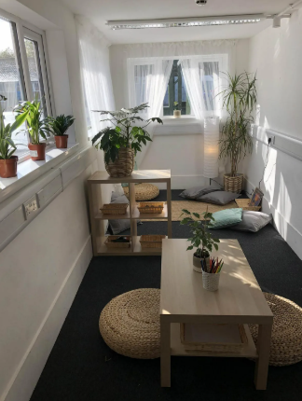
Where?
Safe space chosen by the pupil
Indoors or outdoors
Reduce potential interruptions e.g. sign on the door
Notes:
In a safe space – indoors or outdoors

Slide 12
Who?
Trusted safe adult
Is that adult equipped to be able to capture pupil voice?
Objective comments
Confirming what’s been said is accurate
Checking understanding
Avoiding assumptions
Validate their thoughts and feelings
Notes:
A "safe adult" in a school provides a crucial sense of security and support for pupils, fostering a positive learning environment and promoting their overall well-being. These adults can be teachers, school staff, or designated individuals who create a safe space where children can share their concerns, feel valued, and thrive academically and personally.

Slide 13
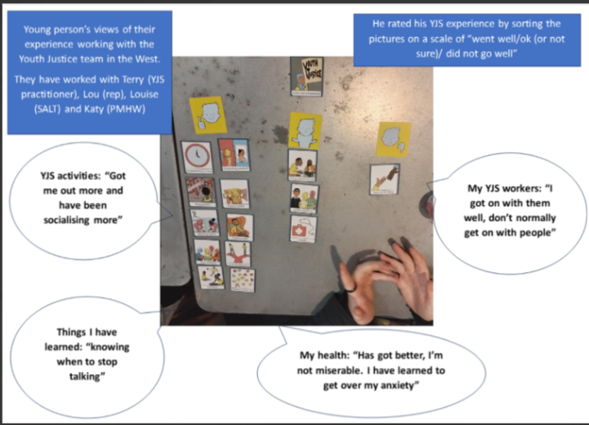
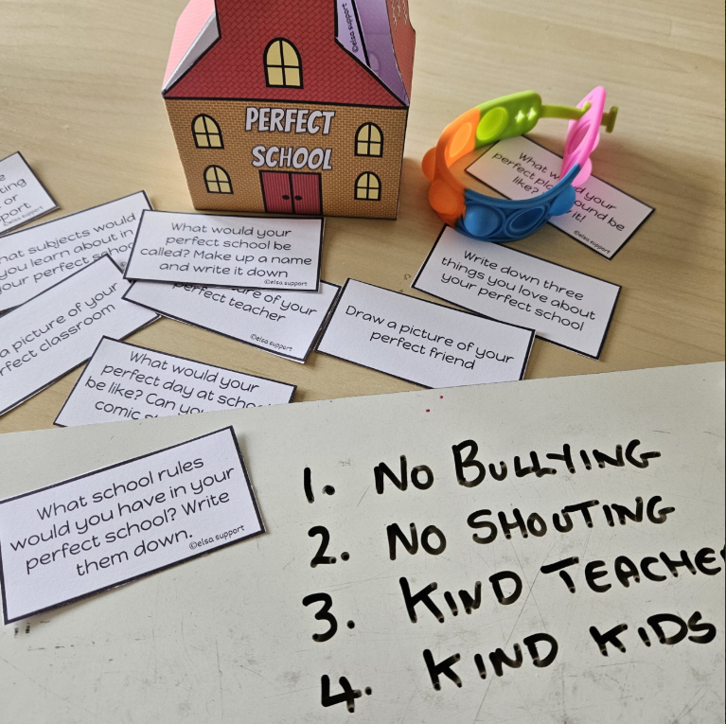
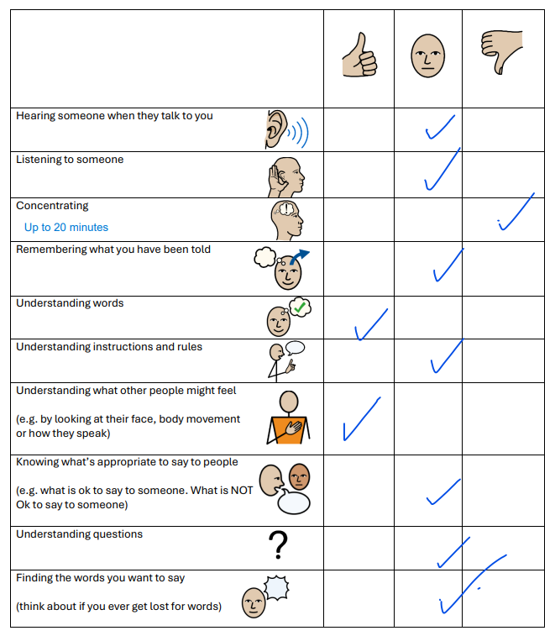
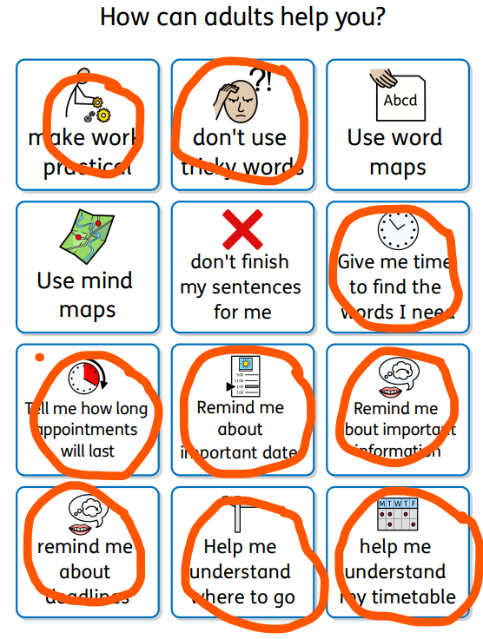
How?
Choice boards
Talking mats
Questionnaire
RAG rating – timetable/environment
Ideal School/Ideal worker projects
Landscape of fear
Treasure Deck of Cards
Walk and Talk
Notes:
Make it low threat
Not just one session – capture over several sessions.
Talking mats
Choice boards
Treasure Deck of cards
Self-Rating scales
Walk and talk
Landscape of fear

Slide 14
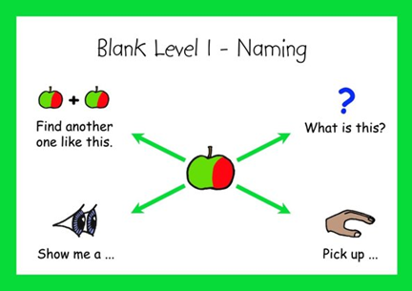
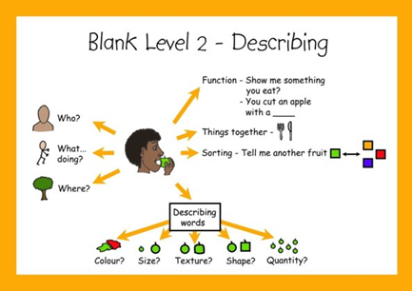
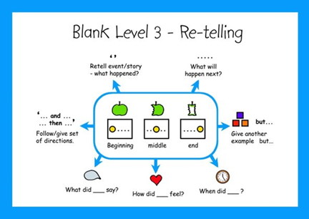
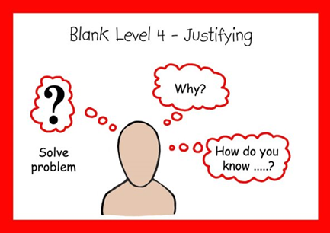
Further consideration
Visuals support understanding
Objects, photos, pictures, words
Open questions
Blanks levels of questions
Pauses
Repeating back
Notes:
Make it low threat
Not just one session – capture over several sessions.
Talking mats
Choice boards
Treasure Deck of cards
Self-Rating scales
Walk and talk
Landscape of fear

Slide 15
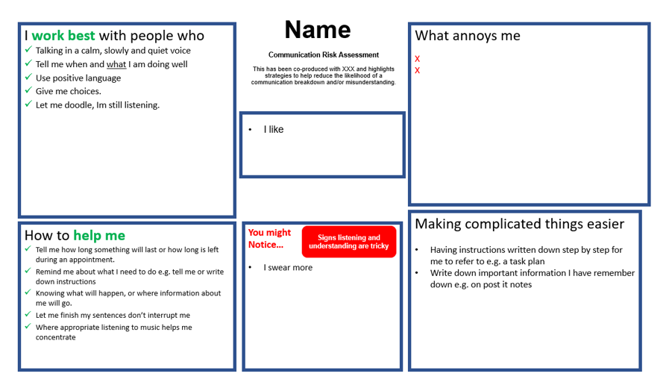
What to do next?
Manage expectations – what is possible vs impossible
Bespoke plan for child – more motivated to accept support
Create a one-page profile that showcases the pupil voice
Talk about what will happen with the information they have shared
Jointly agree next steps and when these will happen.
Reflect and review
Affirmation their voice has been heard.
’
Notes:
What do schools so with this information?
Not a tick a box exercise?
many pupil voice exercises are tokenistic or not truly collaborative. You won’t see the same benefits if your rationale is not authentic, so it’s well worth the extra effort to question your purpose before designing your strategy.
Tell the young person where the information will go and why we want to ask e.g. report
Time frame
Next steps; jointly agree what we will do as a result e.g. share strategies they find helpful with staff
Reflect and review; come back to it
Purpose……

Slide 16
Examples
Repeating the process using a different approach (if unsuccessful)
Getting in touch with other professionals/onward referrals
Another more targeted conversation/ pupil voice activity
Feeding back to others and advocating for the child
Implementing strategies / changes / agreed support
Revisit next steps with child
Notes:
What does unsuccessful look like?
What do schools so with this information?
Not a tick a box exercise?
many pupil voice exercises are tokenistic or not truly collaborative. You won’t see the same benefits if your rationale is not authentic, so it’s well worth the extra effort to question your purpose before designing your strategy.
Tell the young person where the information will go and why we want to ask e.g. report
Time frame
Next steps; jointly agree what we will do as a result e.g. share strategies they find helpful with staff
Reflect and review; come back to it
Purpose……

Slide 17
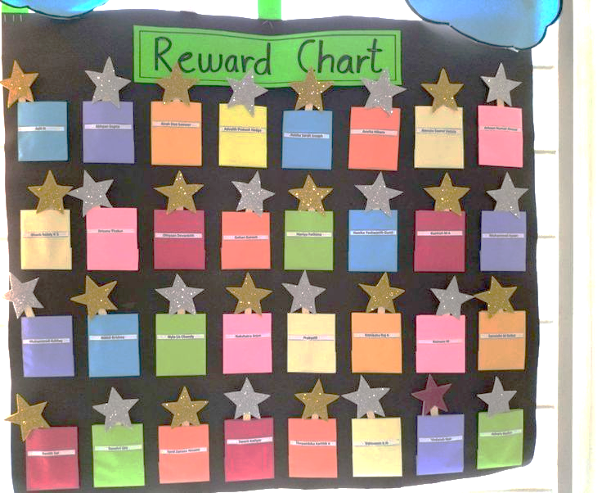
Impact of Pupil Voice
Impact of Pupil Voice 1
Case Study 1
School had shared that pupil frequently became dysregulated
School shared that pupil became more dysregulated in successful lessons
There were no ‘known triggers’
SES Teacher carried out observation and captured pupil voice
Discussion regarding the school/class reward process.
Notes:
SES teacher noted that pupil did not respond to the class process of accepting a spotlight and physically walking to the display board and putting a token on the reward board.
SES teacher noted that in fact, when he physically shook his head when his name was mentioned
Teacher reminded pupil “You haven’t put your name on the board for XYZ this lesson”
Afterwards, SES teacher “I noticed that you didn’t put your name on the board to celebrate your success – pupil explained that he didn’t like physically leaving his workstation and walking across the classroom as others ‘watched him’ – asked him what he would want… he decided that the teacher could put the tokens discretely on his desk.
The impact was almost immediate – he still earned his tokens, teacher still acknowledged his success, it was more discrete.

Slide 18
Impact of Pupil Voice
Impact of Pupil Voice 2
Case Study 2
School shared that there was a ‘challenging’ cohort
SES teacher carried out cohort observation
SES teacher captured a ‘group’ pupil voice alongside the class teacher
Pupils were able to respond reflectively about their school experience.
Class teacher then used the technique for future class decision making.

Slide 19
Impact of Pupil Voice
Impact of Pupil Voice 3
Case Study 3
Pupil in year 10 coming to school but not going into lessons. Rudeness to staff and not following instructions. Frequent suspensions, at risk of PEX
Met pupil. Explained who I was, why I was there. Explained what I would do with the information they shared and who would see it. Asked them where they would like to go to share views. Chose a room off the library with the door propped open.
Number line to rate aspects of school /10
Talked about what was going well – eg 8 or more /10
Gradually pupil talked about other aspects of school and gave additional information and a number rating

Slide 20
Impact of Pupil Voice
Impact of Pupil Voice 4
Case Study 3
Pupil feedback;
don’t know how to manage anger or calm down. Said where they would feel comfortable and supported.
Cannot tell the time and relies on their phone for digital clock. Cannot read or spell well
Can’t catch up on the work in class as they are out on AP some days each week
Would go into class if they could just watch and listen but not be asked questions. Didn’t understand some of the words.
Outcome; views shared with key school staff and home. One page profile updated for staff
School implemented a ‘soft start’ in chosen area
Reading mentor and intervention put in place.
Counselling avenues explored by school for anger management
Pupil screened for language needs
Pupil to be given role coaching sport with support of PE lead

Slide 21
Summary
When harnessed well, pupil voice is a powerful tool.
Consider the pupils language/learning needs
Coproduction child first approach
Pupil voice is a process over time.
Consider – who, where, when, how, what next

Slide 22
Useful Websites/resources
https://www.mentallyhealthyschools.org.uk/whole-school-approach/pupil-voice/
Talking Mats | Improving communication, improving lives
Home - Speech and Language UK: Changing young lives
Ages and stages - Speech and Language UK: Changing young lives
Visual supports - Speech and Language UK
https://edpsy.org.uk/blog/2020/drawing-the-ideal-safe-school-an-optimistic-approach-to-returning-to-school/
Resources:
Karen Treisman Treasure Deck of Cards – 3 sets.

Slide 23
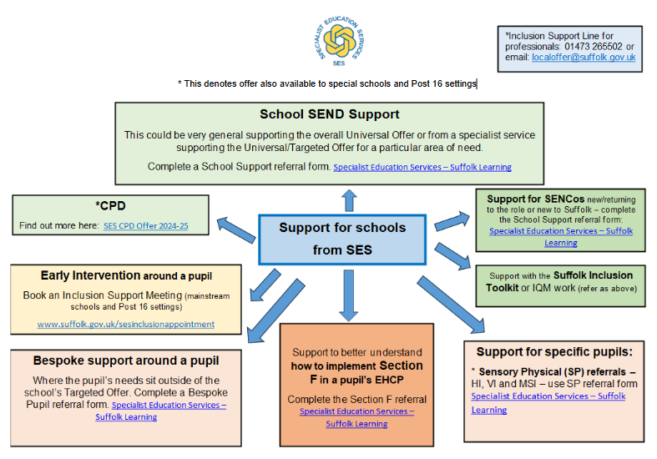
SES on a Page
https://suffolklearning.com/inclusion/specialist-education-services/
Notes:
https://suffolklearning.com/inclusion/specialist-education-services – link to the SES offer and referral forms
Brief overview of accessing service???
PUT IN APPENDIX!

Slide 24
Further Training
Book SES CPD here!
​Further SES training is available,
please email for more details:
SESCPD@suffolk.gov.uk
or
sally.blackman@suffolk.gov.uk
SES Deputy Head Teacher
Thank you
Our CPD Menu is available here:
https://suffolklearning.com/wp-content/uploads/2024/09/SES-CPD-Offer-24-25.pdf
Book SES CPD here:
For Essential (free) CPD: SES CPD 2024-25 Essential Booking Form (office.com)
For Targeted (low cost) CPD: SES CPD 2024-2025 Targeted Booking Form (office.com)
If would like to discuss bespoke training for your school via our traded offer, this is available through Schools Choice. Please contact Sally Blackman to discuss your requirements

Slide 25
Reminder
We value and encourage your feedback.
Please now complete the short evaluation below. Relevant content will only be shared after this training, upon completion of the evaluation (returned within 1 week of the training session).
Thank you.
SES Focused CPD School Feedback
Notes:
Reminder Prompt: This slide should be left visible at the end of the presentation as it shows the FOCUSED evaluation link/QR code for attendees to complete
Teachers, please display this slide at the end of the presentation, as a prompt AND forward the names in the chat pane to the SES CPD mailbox afterwards so a PDF copy of the PPT can be sent out to the attendees, along with the evaluation link.

