Slide 1
9th May 2024
Sophie Boettcher
Mental Health &Wellbeing:
Addressing the most important issues

Slide 2
Discussion points:
What are the main causes of poor staff wellbeing?
What are the gaps in regards to support?
What would you like to see change?

Slide 3
The experiences of education staff in the UK
81%
Of all education staff experienced mental health symptoms due to their work
71% feel that inspections negatively impact the mental health and wellbeing of staff
95% Of Headteachers and 78% of school teachers reported feeling stressed

Slide 4
19th April 2024
Sophie Boettcher
Education Support
An introduction

Slide 5
112,000 supported through EAP
4,178 people suppported by our helpline
564 grants awarded

Slide 6
How we work

Slide 7
How we work

Slide 8
Helpline
Free and confidential
Open 24/7
Staffed by qualified counsellors
08000 562 561

Slide 9
Helpline
“The helpline counsellor gave me permission to feel what I was feeling. Get in touch as soon as you feel things aren’t right. The call really helped me.”
- Teacher

Slide 10
Online resources
educationsupport.org.uk/resources

Slide 11
Grants
Available to everyone in education
Financial help with essential costs:
food
rent/mortgage
utility costs
essential household items
travel to work costs
www.educationsupport.org.uk/grants

Slide 12
School and FE leaders’ service
Professional supervision provides a safe and confidential space to talk
Support leaders to feel more in control
Fully funded for leaders in England
www.educationsupport.org.uk/leaders

Slide 13
“It was completely life-changing. Each session enabled such food for thought and tools for self-care. It is impossible to say how grateful I am.”
- Headteacher

Slide 14
How we work

Slide 15
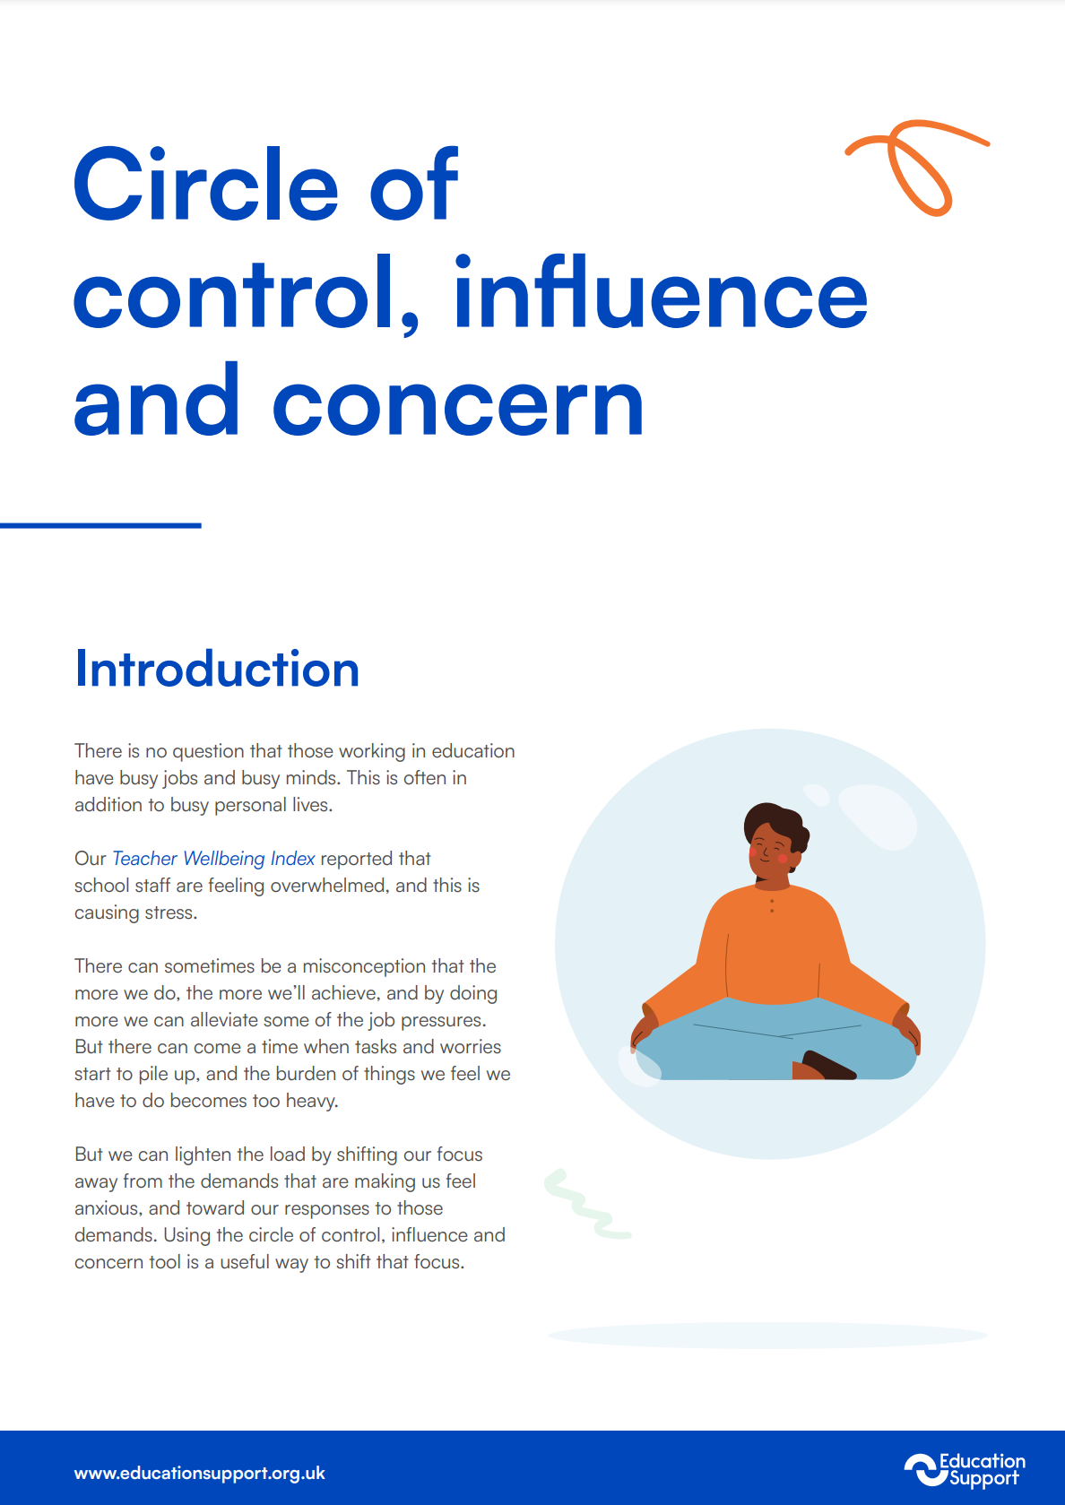
Resources for Schools

Slide 16
What is an Employee Assistance Programme?
Impartial and confidential support service
24 hour phoneline, 365 days a year
Access to practical resources on a dedicated website
Assistance with personal or work issues
Fast track support by BACP accredited counsellors
Information and guidance for financial and legal queries

Slide 17
How we work

Slide 18
Building evidence and influencing

Slide 19
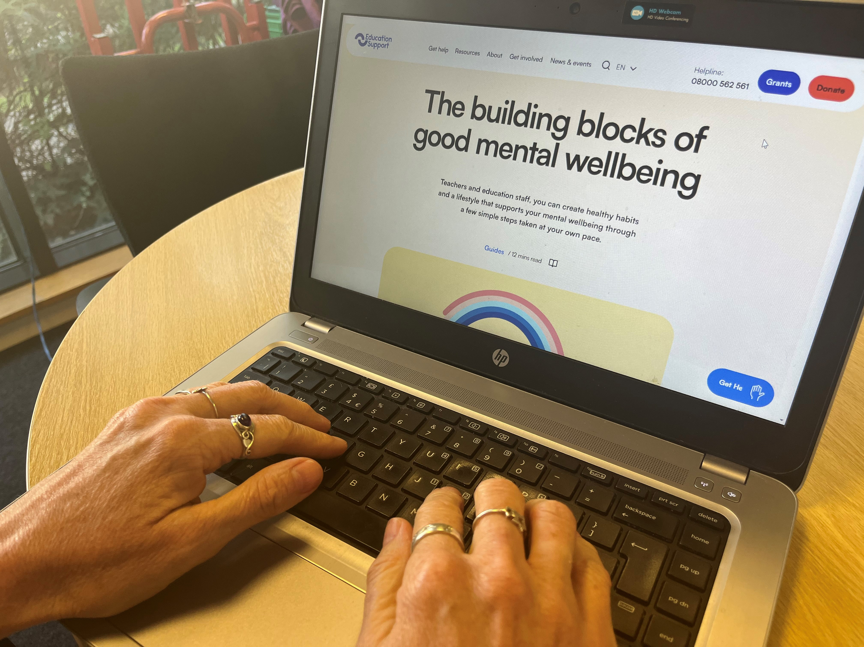
There’s more…
Our website has a wealth of free resources, all the latest news as well as wellbeing events you are welcome to join.
Sign up for our newsletter!
educationsupport.org.uk/subscribe

Slide 20
Get Involved
As a charity, our services are funded by the generous support of our donors.
Help us be there for teachers and education staff whenever they need support.
educationsupport.org/donate

Slide 21
Thank you
Any questions?
educationsupport.org.uk @edsupportuk

