Slide 1
MULTISCHOOLS COUNCIL COMES TO SUFFOLK
MSC started in Essex over a decade ago with just 4 schools.
It now has 500 schools in Essex and Southend and is beginning to work with Hertfordshire, Norfolk and now with us.

Slide 2
What is The Multi Schools Council?
The Multi Schools Council works to break down perceptions towards children with SEND and mental health difficulties and provide opportunities to empower them.
What does it do?
Each term children and young people from different education settings come together to talk about what’s important to them and learn about each other.
Why should we get involved?
The Multi Schools Council provides young people with an opportunity to improve their confidence and develop their skills, by having a voice in shaping the support and services that they receive.

Slide 4
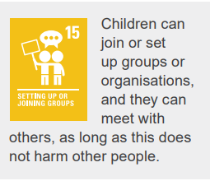
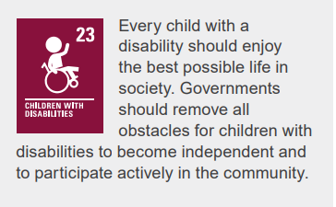

Slide 5
Why MSC Matters
1 in 6 children aged 5–16 has a mental health condition (NHS Digital, 2023)
SEND pupils are more likely to face exclusion and poor mental health
Shifting from intervention to connection
Self-Determination Theory (Deci & Ryan)
Three Basic Psychological Needs: Autonomy: control over one’s actions Competence: feeling capable Relatedness: feeling connected Meeting these needs improves wellbeing, engagement, and outcomes

Slide 6
Why Relatedness Matters - “I feel connected and valued.”
Being with peers is affirming and normalizing
Peer networks offer empathy, company, and advocacy
Belonging is a protective factor for mental health
Why Competence Matters - “I feel capable and effective.”
Having a voice increases self-worth
Learning to self-advocate and cope with challenge
A sense of achievement contributes to positive sense of self
Why Autonomy Matters - “I feel I have choice and control.”
Builds confidence and strong sense of self
Fosters a sense of control and choice
Being an active participant in one’s own life

Slide 7
Suffolk Schools Involved:
North
Red Oak Primary
Westwood Primary
West
Glemsford Primary
St Mary’s Primary
Great Heath Primary
Ipswich
Northgate High
St Matthews CEVP
Bury St Edmunds
Sybil Andrews Academy
Westgate Primary
Stowmarket High

Slide 8
The goal is for a centrally funded, national network for children and young people with SEND and mental health challenges.

Slide 9
Not Just Meetings
The MSC:
hosts community events to promote positive attitudes to SEND and mental health.
works with schools offering awareness sessions such as how to better understand autism.
delivers assemblies on topics such as mental health.
supports children and young people with community projects.
supports LAs on their journeys to improvement.
has written books about SEND from a first-person perspective.

Slide 11
What difference will it make?
To see the sorts of projects that children and young people
with additional needs have already been involved in, visit
https://thesource.me.uk/engagement-hub/the-young-persons-network-send/
How do I find out more?
visit the Multischools Council website https://www.multischoolscouncil.org.uk/
Watch our video
for an informal chat email us msc@suffolk.gov.uk
or scan the QR code or follow the link https://forms.office.com/e/769HG8yLGJ and we will contact you.

Slide 12
The Multi Schools Council recorded a song explaining why their work matters.

