Slide 2
The School Nursing Service offers a free and confidential service to support Children and Young Peoples Emotional, Physical and Sexual Health needs in Suffolk.

Slide 3
The Universal School Nursing service is available to all children and young people in Suffolk.
The Universal school Nursing service offers:
Screening for Reception aged children, which includes vision and hearing testing.
Reception and Year 6 National Child Measurement Programme
A drop-in service in high schools which is accessible to all students.

Slide 4
Drop In’s
The School Nursing Service offers a drop in service in high schools and sixth forms in Suffolk.
Drop in’s are run by trained nurses who are available to give advice and support around emotional health, physical health and Sexual Health needs.
Drop in’s are confidential and no appointment is necessary. We will not share information with anyone else unless we have consent of the young person or safeguarding concerns.

Slide 5
What Can We Help With?
Stress
Chlamydia Testing
(15 years +)
Bullying
Puberty
Drugs Smoking
Vaping
Emotional Wellbeing
C-Card Scheme
Sleep
Emergency Contraception
Healthy Lifestyles
Worries
Self-Harm

Slide 6
The School Nursing Service also offers Targeted support through referral to our service. School Nursing can offer targeted support for sexual, emotional and physical health concerns.
Physical Health
sleep difficulties
day and night-time wetting (urinary incontinence or Enuresis Service)
healthy eating and weight management
soiling (faecal incontinence and / or constipation)
tobacco, alcohol, drugs, substance misuse.
Puberty
Emotional Health
self-harm
self-esteem
low mood
anxiety
panic attacks
relationship difficulties
behavioural difficulties
stress
changes in eating
bereavement
anger management
Sexual Health
healthy relationships
contraception
sexually transmitted infections
sexual identity

Slide 7
How to Refer? Referrals for Targeted support can be completed via our referral portal on our School Nurse website. Please read the “information for referrers” before completing a referral, which is available on our website.

Slide 8
SEND
The School Nursing service supports children and young people from 5-25years who have SEND within mainstream, specialist and home education provisions.
Within each School Nursing locality, we have SEND Community Staff Nurses and SEND Healthy Child practitioners who offer support to CYP and their families through direct work, advice, guidance and signposting to promote their physical, emotional and sexual health needs.
Referrals to the School Nursing service for children and young people with SEND needs should be submitted via the School Nurse website.

Slide 9
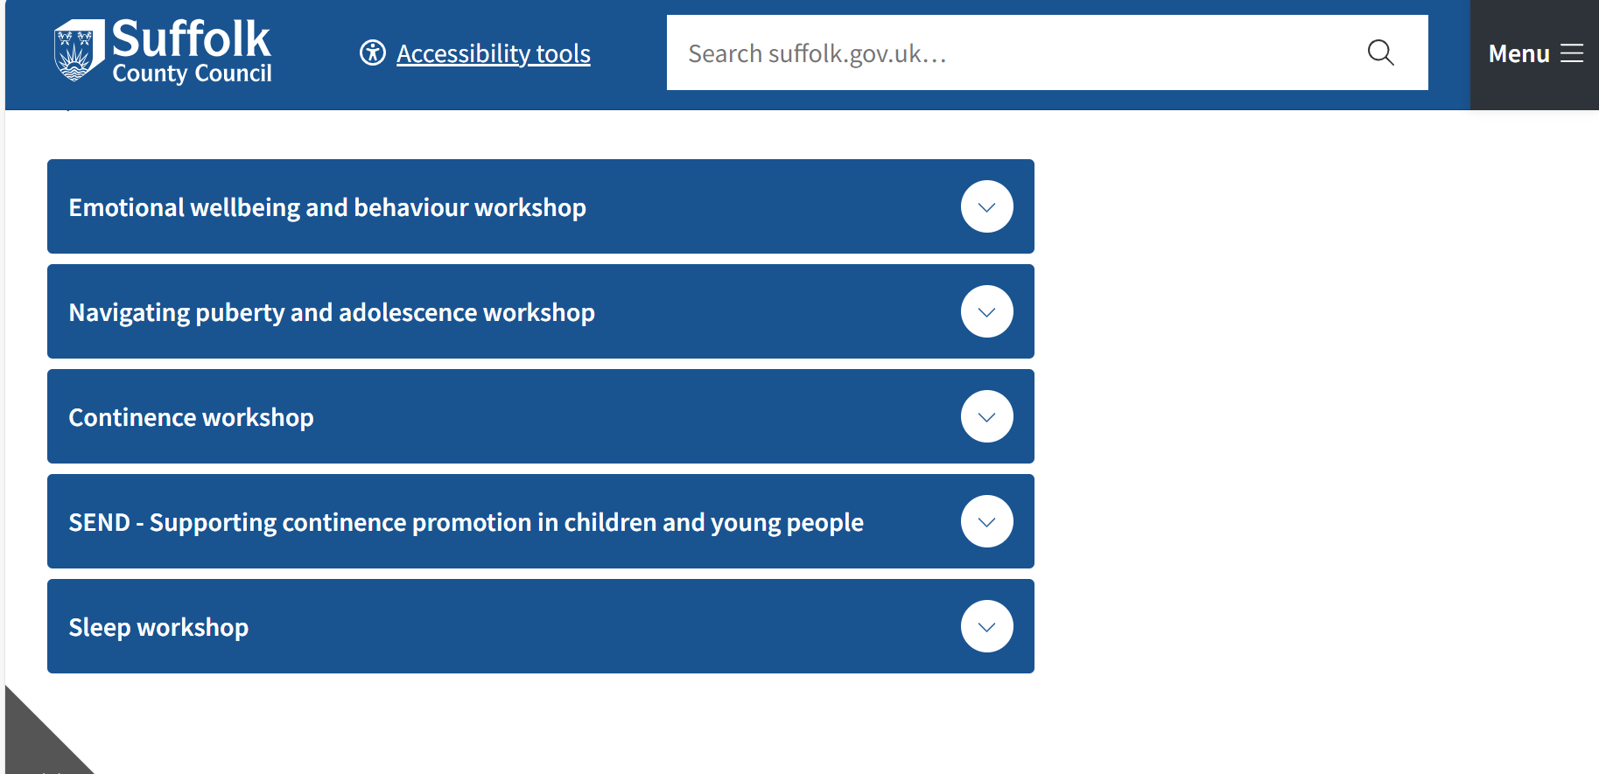
We also have a range of pre-recorded workshops on our website which can be accessed by parents/carers.

Slide 10
Contact us…
Email:
childrenshealth@suffolk.gov.uk
Health Business Centre:
0345 6078866
@scc_schoolnursing

