Slide 1


Mental Health Lead Network
Tuesday 27th January 2026
Considering the theme of: Belonging

Slide 2

LGBTQ+ Young people's experiences of school inclusion
Exploring the Real and the Ideal
Natalie Dowle

Slide 3

Why is this research important?
In 2024, 8% of people aged 16-24 years identified as ‘LGB’ (according to ONS, 2024).
In 2021 Census, 0.5% of adults in England & Wales identified as ‘Transgender’ (according to ONS, 2023).
LGBTQ+ Mental Health: What research statistics tell us:
Issue
LGBTQ+ CYP are 1.5 times more likely than non-LGBTQ+ peers to experience depression and anxiety ^{[1]}
Bisexual pupils report the highest mental health problems - linked to biphobia, invisibility, and lack of role models ^{[2, 3]}
LGBTQ+ community at increased risk of self-harm, suicidal ideation and attempts, and substance misuse. Sexual minority CYP are 2-3 times more at risk of suicide, with increased suicidal ideation/planning ^{[1, 2, 4, 5]}
Among transgender youth aged 11-19, 45% have attempted suicide ^{[6]}
Statistically, LGBTQ+ people have a reduced lifespan compared to non-LGBTQ+ people ^{[1, 4, 5]}

Slide 4
LGBTQ+ Mental Health: What school-based research tells us:
Issue | Impact on Young People
Exclusionary practices and invisibility in the curriculum | Learning barriers and reduced wellbeing ^{[7, 4, 8, 3]}
Peer bullying and derogatory language are common (e.g., “that’s so gay”) | Isolation and distress ^{[9, 10, 11, 12]}
Victimisation of gender diverse young people | Mental ill-health, anxiety, social withdrawal, risky behaviours ^{[13, 14, 15, 5, 16, 17]}
Unsafe communal spaces (toilets, changing rooms) | Identity concealment - reduced confidence and aspirations ^{[18, 19, 20, 16, 21]}
Being singled out (e.g., separate changing area for P.E.) | Avoidance of lessons or school entirely ^{[22]}

Slide 5
Rationale
Previous research has a negative focus (e.g., exploring LGBTQ+ exclusion, positioning LGBTQ+ people as ‘victims’)
Some previous LGBTQ+ research has positive focus, but doesn’t specifically explore ‘inclusion’
Previous UK educational psychology research on inclusion predominantly has SEND focus
Some previous research explores LGBTQ+ young people’s views on ideal school, but is non-UK based

Slide 6
Rationale
Therefore, this research is original as it explores both:
Real school experiences (both positive and negative)
AND…
Ideal school inclusion (from perspective of UK-based LGBTQ+ young people)

Slide 7
Research questions
What are LGBTQ+ young people’s real experiences of LGBTQ+ inclusion in school?
What are LGBTQ+ young people’s views on what makes an ideal LGBTQ+ inclusive school?
Methodology
Semi-structured interviews:
10 LGBTQ+ YP
Aged 16-24
Retrospective views
Analysis:
Reflexive Thematic Analysis (RTA)

Slide 8
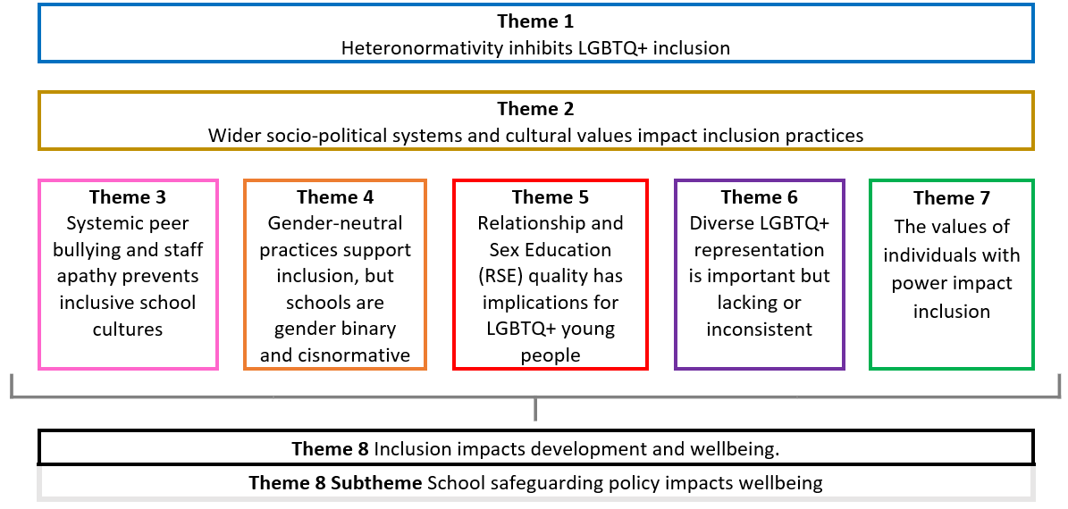
Findings​

Slide 9
Theme 1 (Real) Heteronormativity inhibits LGBTQ+ inclusion
Definition of Heteronormativity: “the assumption that the world and everything in it is, and should be, based on a heterosexual model” (Atkinson & DePalma, 2010, in Price & Tayler, 2015, p.126)
Real
Many heteronormative practices
Limited/reactive education on LGBTQ+ issues
History curriculum is heteronormative
Resources/pastoral support inadequate
Schools are improving? It’s hard to define how

Slide 10
Theme 1 (Ideal) Heteronormativity inhibits LGBTQ+ inclusion
Definition of Heteronormativity: “the assumption that the world and everything in it is, and should be, based on a heterosexual model” (Atkinson & DePalma, 2010, in Price & Tayler, 2015, p.126)
Ideal
Heteronormativity is eradicated
Diverse identities are naturally integrated
Use inclusive language, resources, and events that celebrate diversity across school

Slide 11
Theme 2 (Real) Wider socio-political systems and cultural values impact inclusion practices
Real
Schools not to entirely to blame for not being LGBTQ+ inclusive
External influence:
-hegemonic processes/finance driven government agendas
-rigid/outdated processes
-prioritisation of academic grades
-approach to COVID-19
-motives of religious-affiliated groups
-values of parents

Slide 12
Theme 2 (Ideal) Wider socio-political systems and cultural values impact inclusion practices
Ideal
School systems openly celebrate difference
A culture of everyone being their authentic selves

Slide 13
Theme 3 (Real) Systemic peer bullying and staff apathy prevents inclusive school cultures
Real
Culture of overt and subtle phobia
Staff inadequately deal with bullying
Bullying occurs within the LGBTQ+ community
Anti-bullying re-education strategies are positive, but inconsistent

Slide 14
Theme 3 (Ideal) Systemic peer bullying and staff apathy prevents inclusive school cultures
Ideal
A culture that promotes respect for difference, supporting mutually beneficial peer relationships
Use of zero-tolerance bullying policies/practices, and re-education of harmful views, rather than use of punitive measures

Slide 15
Theme 4 (Real) Gender-neutral practices support inclusion, but schools are gender binary and cisnormative
Definition of Cisnormativity: “the idea that cisgender people (people whose gender matches the body they were born with) are normal or right and that all other people are not” (Cambridge English Dictionary, 2024)
Real
Uniforms have gender-binary elements but leniency supports inclusion
Segregation on presumed genders
Pronoun education lacking and performative (‘box-ticking’)
Changing rooms are gender binary, inadequate and uncomfortable for females and gender diverse pupils
Toilet options are varied. Often gender-neutral options remove resources from others (e.g., from disabled people)

Slide 16
Acknowledgement of political changes
UK Supreme Court Ruling (April 2025):
The legal definition of "woman" under the Equality Act 2010 refers specifically to biological sex
This impacts women's spaces and transgender rights
Still awaiting governmental school guidance
Education and Human Rights Commission (EHRC) interim guidance states schools: must not permit transgender girls to use biological girls’ facilities, or transgender boys to use biological boys’ facilities

Slide 17
Acknowledgement of political changes
Reflections
Schools are worried about what the Supreme Court Ruling means
Schools must provide single-sex spaces and also provide spaces that include gender diverse people
Separate facilities for gender diverse pupils may cause stigma and lead to discrimination
Ultimately, schools have duty of care to safeguard all pupils

