Slide 1

Supervision in schools A presentation for the Mental Health Leads Network 20.11.25
Kay Breton Senior Educational Psychologist
Natalie Dowle Educational Psychologist

Slide 2
Use of Clinical Supervision in a Secondary School
Supporting a SENCO to reflect on professional practice
Dr Natalie Dowle
Notes:
---

Slide 3

The purpose of clinical supervision is to provide a safe and confidential environment for staff to reflect on and discuss their work and their personal and professional responses to their work. The focus is on supporting staff in their personal and professional development and in reflecting on their own practice. (Care Quality Commission, 2013)
Definition of Clinical Supervision

Slide 4
Following reflections from my own clinical supervision… Key discussion points: - Specific concern around SENCO wellbeing, and the impact that working practices might have on individual wellbeing - Additional concern around retention of staff Exploring what we can do to help… Piloting a new approach: - Provide a safe and confidential space to explore ways to improve SENCO wellbeing (whilst collaboratively problem-solving to support more efficient/less stressful working practices) How this also helps us? EPs get to work more closely with SENCOs in our localities to: - Continue building on positive working relationships - Increase our understanding of specific school contexts
Case Study Background

Slide 5

Clinical supervision is…
a semi-structured space that has set agenda
AND
has flexibility to explore that agenda in a meaningful way, which:
Helps supervisee actively engage in reflective practice
Helps supervisee learn and develop
Helps supervisee consider ethics related to their professional role

Slide 6

Clinical Supervision sessions might also provide:
A space for therapeutic thinking:
- focus on impact of wellbeing on professional practice, and;
- the impact of professional practice on wellbeing
2) A space where specific problems can be explored:
possible solutions can be realised
collaborative process facilitated by the supervisor

Slide 7
Structure and Implementation

Slide 8

Clinical Supervision Session 1:
Time Frame (70 minutes)
1) Contracting - 5 minutes 2) Checking expectations - 5 minutes 3) Wellbeing 'Check in’ - 40 minutes 4) Collaborative problem solving - 15 minutes 5) Evaluation - 5 minutes

Slide 9
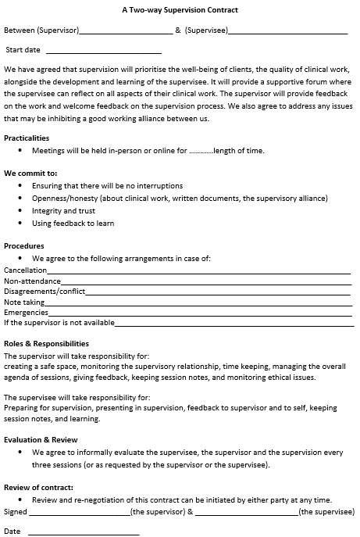
A standardised approach - at the beginning - used to contract and; - check expectations *Emphasis is on all parties being responsible for ensuring appropriate conduct (and this also helps to reduce any perceived power imbalances).
Contracting and
Checking Expectations
(10 minutes)

Slide 10

Mostly discussion based (but helpful visual prompts can be used)
Wellbeing Check in: (40 minutes)

Slide 11
Collaborative problem-solving can take place in a structured way. In this case: there was explicit discussion around the SENCO’s own goals. SENCO was encouraged to create an ‘I Statement’ goal (no longer that 10 words): I provided some prompts:
How can I approach caseload effectively whilst maintaining my wellbeing?
How can I share caseload pressures whilst keeping oversight?
Collaborative Problem-solving (15 minutes)

Slide 12
Measuring Impact

Slide 13
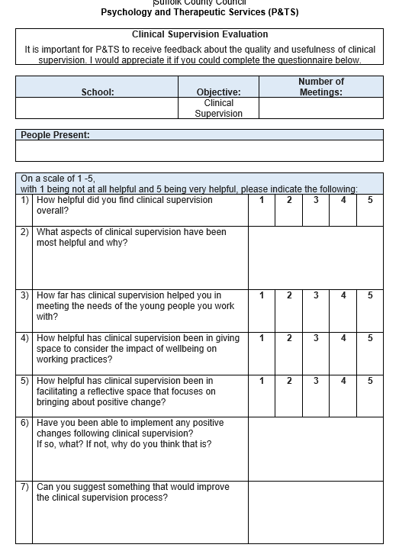
Key takeaways from verbal feedback (positive impacts): 1) Increased emotional resiliency 2) Increased confidence in decision-making 3) Clearer consideration of ethics 4) Clearer goals related to work/life balance 5) New practical strategies to try In the next clinical supervision an evaluation form will be used:
Evaluation (5 minutes at end)

Slide 14

Clinical supervision can be an enjoyable process for all parties: - a chance to reflect on working practices - in a safe non-judgmental space - all parties confident to share ideas, and; - create positive change
Final Reflections

Slide 15
The Psychology and Therapeutic Service can offer, for example:
1:1 supervision for individual members of staff, i.e., headteacher/teaching staff.
Group supervision for staff members, i.e., pastoral support teams.
ELSA and trauma aware ELSA supervision.
Trauma informed schools UK (TISUK) supervision.
Supervision related to individual events/circumstances, i.e., critical incidents.
Our clinical supervisors' experience enables them to support a broad range of professionals inside and outside of the education sector.
Please email the Psychology and Therapeutic Services team at psychology&therapeuticservices@suffolk.gov.uk to discuss your supervision needs further.
Supervision - Suffolk County Council
– Click on this link to arrive at our service webpage outlining our supervision offer.
Other things to note:
Critical incident related supervisory support is available on an as-needed basis and is commissioned separately so that it is free at the point of delivery to schools. Critical incidents are any incident or incidents which are sudden, unexpected, significantly disruptive, traumatic, or associated with bereavement and loss.
Other supervision is accessed mostly via our traded offer and so is purchasable as part of a package. Trading ‘windows’ are advertised via the Headlines bulletin as soon as Educational Psychologist capacity is available.

