Slide 1
The Role of the Mental Health Lead
The purpose of this network meeting is to help shape a shared view of the role of
MH Leads in Suffolk Education settings.
Wellbeing in Education - Suffolk County Council
@SuffolkPTS
Oct. 2022

Slide 2
Transforming children and young people's mental health provision
(www.gov.uk)
“We want every school and college to have a designated lead in mental health by 2025. The designated lead will be a trained member of staff who is responsible for the school’s approach to mental health”.
This designated lead will:
oversee the help the school gives to pupils with mental health problems
help staff to spot pupils who show signs of mental health problems
offer advice to staff about mental health
refer children to specialist services if they need to
Transforming children and young people’s mental health provision: a green paper - GOV.UK (www.gov.uk) (longer version)

Slide 3
The Green Paper was put out for consultation. Feedback was received and then a Government response to the feedback was produced – which is where the below came from. Transforming children and young people’s mental health provision: a green paper - GOV.UK (www.gov.uk)
“We agree that the focus of the lead should be strategic, putting whole school/college approaches in place, ensuring a coordinated approach. This would encompass the roles that existing practice suggests leads cover:
Oversight of the whole school / college approach to mental health and wellbeing, including how it is reflected in the design of behaviour policies, curriculum and pastoral support, how staff are supported with their own mental wellbeing and how pupils and parents are engaged;
Supporting the identification of at-risk children and children exhibiting signs of mental ill health;
Knowledge of the local mental health services and working with clear links into children and young people’s mental health services to refer children and young people into NHS services where it is appropriate to do so;
Coordination of the mental health needs of young people within the school or college and oversight of the delivery of interventions where these are being delivered in the educational setting;
Support to staff in contact with children with mental health needs to help raise awareness, and give all staff the confidence to work with young people; and
Overseeing the outcome”
government-response-to-consultation-on-transforming-children-and-young-peoples-mental-health.pdf

Slide 4
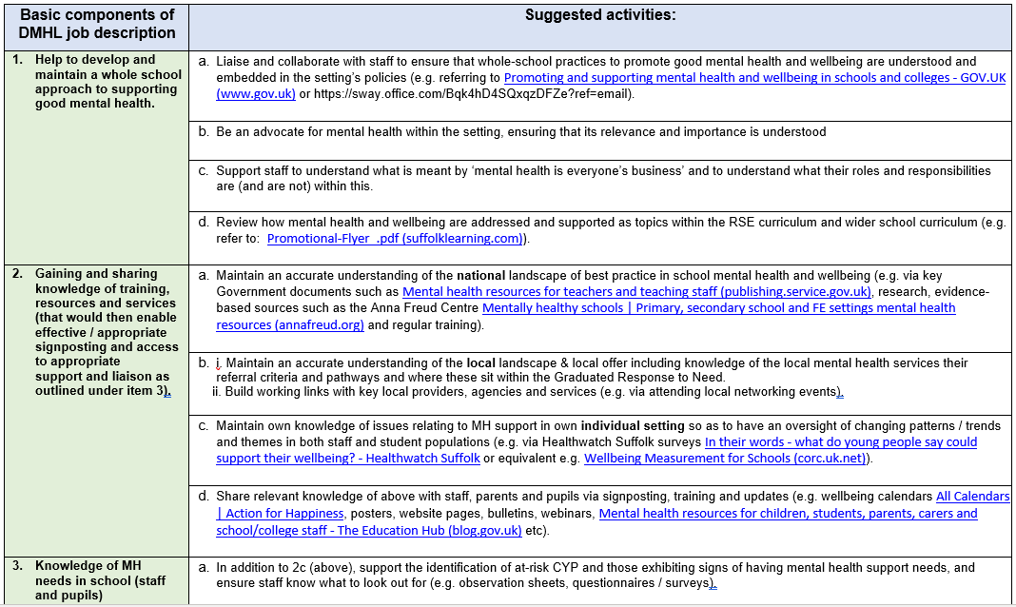
This is what we began working on together as a group during the network meeting: a draft MHL job description for Suffolk settings that could then be bespoked / amended to suit individual setting circumstances (continues over into next slide).
Once finalised, this document will be uploaded separately as a ‘stand alone’ document on our MHL webpage for you to use.

Slide 5
Basic components of DMHL job description | Suggested activities | One thing I can do towards this before the end of term is… | This is who I need to help me with this | This is the time I will need
Helping to develop and maintain a whole school approach to supporting good MH. | a, b, c, d….
Gaining and sharing knowledge of resources and services | a, b, c, d …
Knowledge of MH needs in school | a, b, c, d…
Matching needs to provision | a, b, c, d, e, f…
Building and maintaining key relationships | a, b, c…
Idea: You could use the DMHL job description as a planning tool to help devise a set of goals per term, targeting just a couple of areas at a time?

Slide 6
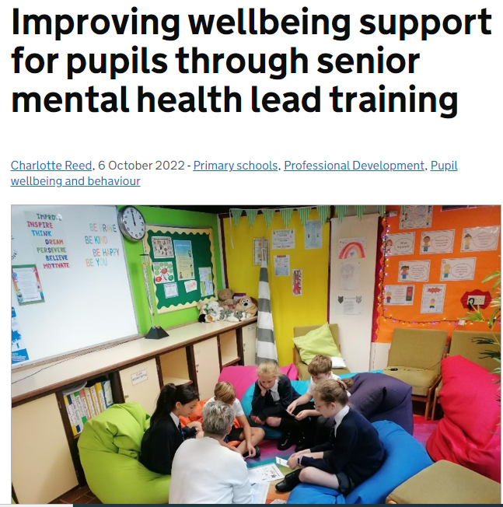
Improving wellbeing support for pupils through senior mental health lead training - Teaching (blog.gov.uk)
This is a brief and helpful example of how one MH lead began to make some changes in school via 'positive and possible' next steps - She captures eight ways that were “quick and relatively simple fixes” that she incorporated into the school’s mental health strategic plan.
Notes:
Just sharing for interest

Slide 7
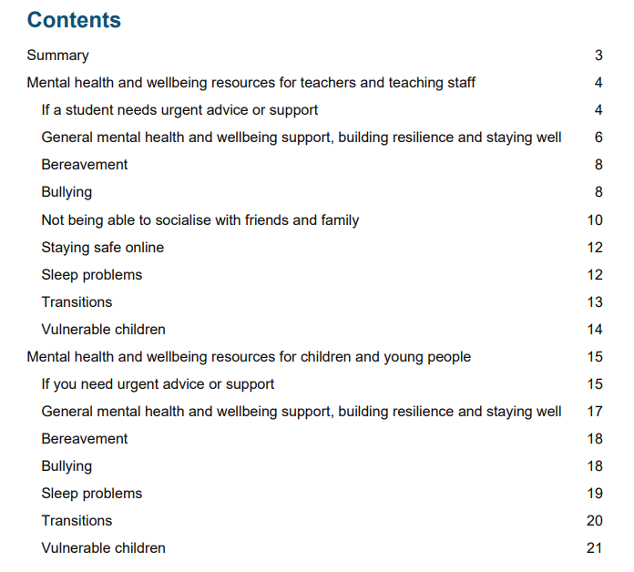
Mental health resources for teachers and teaching staff (publishing.service.gov.uk)
Produced in June 2021 – Gives descriptive summaries of recommended websites and links to them for staff and pupils on the following topics:
Building resilience
Bereavement
Bullying
Socialising
Staying safe online
Sleep
Transitions
Note that although this document was originally produced to address needs arising from Covid lockdowns etc. the guidance is still applicable and helpful.
Notes:
Again sharing for interest / reference

Slide 8
Mental health resources for children, students, parents, carers and school/college staff - The Education Hub (blog.gov.uk)
Lists some useful links and sources of mental health support so that children and young people, parents, carers, and school and college staff can get the advice and help they need.
Notes:
Again sharing for interest / reference

Slide 9
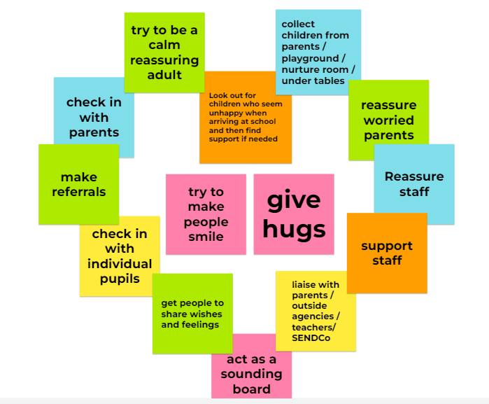
A day in the life of a DMHL
The comments on the post-it notes are what the MH Leads shared with us during the session.
We are happy to build upon these in the future.
Thank you everyone ☺

