Slide 1


Published December 2023
My Health, Our Future (Phase 7)
My Health, Our Future (Phase 7)
Children and young people’s wellbeing in Suffolk (2022/23)

Slide 2





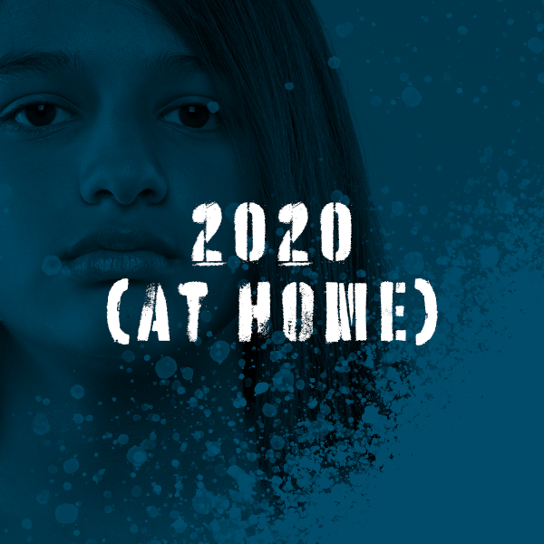
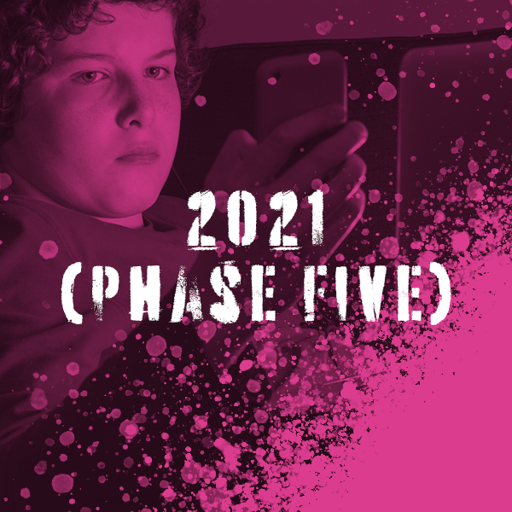



Introduction
My Health, Our Future (MHoF) is a unique research programme exploring the physical and mental wellbeing of children and young people in Suffolk.
Since 2017, over 50,000 survey responses have been collected through the MHoF surveys that address crucial topics relating to bullying, self-harm, body image, social media, anxiety, and other pertinent areas of interest. Due to the strong links between mental health and physical health, we have also extended the focus of this year’s survey to include questions about physical health.
This presentation will showcase a few key findings from MHoF 7 which will officially be published in December 2023 alongside responses from the co-production for MHoF 8.

Slide 3

School Reports
Each participating school or college receives a free bespoke report on their students’ needs. We offer to meet with schools to assist in interpreting these results.
The creation of individual school reports has been instrumental in the programme's success, enhancing both school engagement and survey impact.
These reports summarise the data to ensure anonymity of students while aiding schools to identify key years, issues, or demographic groups for targeted focus.
This year we are refining how we deliver information to school by offering more concise summaries and providing practical tips on addressing specific challenges.
These tips will be informed by what schools have previously done in response to their results, as well as information and support from professionals in the relevant fields.

Slide 4
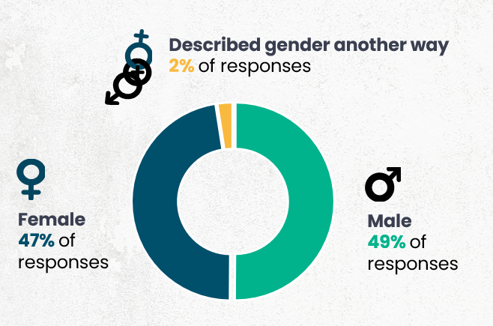
Demographic summary
13,084 responses were recorded.
The majority were from students in Years 7, 8 and 9. There were also a small number of responses from university students and young people not in mainstream education.
73% (9,606) of responses were from ‘White – English / Welsh / Scottish / Northern Irish / British’ young people. This was followed by ‘White – Any other background’ (5%/ 598) and ‘Polish’ (3%/ 331) young people.
31% (4,048) identified with one or more ‘additional support needs’ in the survey, such as receiving free school meals (12%/1,364).
13% (1,763) of responses were from students who identified as LGBT*Q+.
4

Slide 5
Wellbeing (SWEMWBS data)
The chart below shows how the average wellbeing score of young people in Suffolk has changed over time. Scores range between 7 and 35.
12,959 students responded to the SWEMWBS questions.
National SWEMWBS data
NHS research in 2020 reported the average SWEMWBS score for young people in England (aged 11 to 16) as 24.6.
SWEMWBS was developed by the Universities of Warwick, Edinburgh and Leeds in conjunction with NHS Health Scotland (©University of Warwick, 2006, all rights reserved).

Slide 6
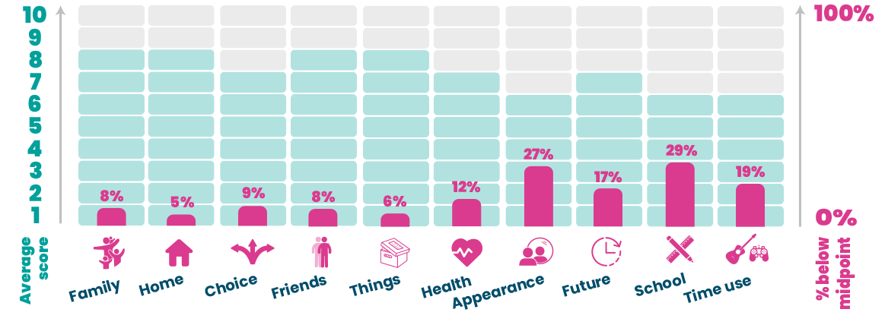
Happiness
The graphic below shows the average GCI score for each aspect of life, and the percentage of students scoring below the midpoint on the 0-10 scale. Higher percentages of scores below the midpoint, and lower average scores overall indicate higher levels of unhappiness.
13,084 students responded to these questions.
6

Slide 7
What can help?
What would be helpful? | % | Count
Access to counsellors/ someone to talk to. | 34% | 4,155
Guest speakers with knowledge about mental health. | 26% | 3,161
More awareness of mental health among staff and students. | 44% | 5,312
More information about support options and where to access them. | 38% | 4,543
More frequent access to lessons on mental health. | 31% | 3,797
More time to discuss mental health. | 34% | 4,143
An after school or breakfast club that provides healthy food. | 25% | 2,954
School lunches to offer healthier food options. | 34% | 4,053
More after school activities (sports, music, art, dance). | 45% | 5,371
We asked: ‘Would you find any of these helpful in your school or college?’
The response choices were taken from students’ answers to the MHoF (phase six) survey regarding what could be improved in 2022. 12,137 students responded to the question.
The most favoured response choices were an increase in after school/college activities like sports, dance, arts, and music (45%), and greater awareness of mental health among staff or students (44%).
Other popular choices included inviting speakers into school/college with expertise in mental health (26%) and breakfast clubs providing nutritious foods (25%).
7

