Slide 1
Inclusion Facilitation (IF) Service www.Suffolk.gov.uk/if
Imogen Howarth​
Deputy Principal Educational Psychologist
and Senior IF Line Manager
Maia Gooding​
Experienced Senior IF
Kelly Francis​
Experienced Senior IF
Katie Thornton​
Senior IF
Lucy Wells​
Senior IF
Rebecca Griffiths
Senior Educational Psychologist and IF Line Manager
Rebecca Sleightholme​
Experienced IF
Jodie Young​
Experienced IF​
Emily Smith​
Experienced IF​
Imogen Bunn​
IF
Zoe Bennett​
IF​
Liza Wright​
IF
Promoting the Inclusion of Children and Young People
Notes:
Welcome – Promoting the Inclusion of Children and Young people

Slide 2
Check in – 5 mins
1. Choose a Haribo that represents how you are feeling today.
2. If you feel comfortable,
share with the group around you why you chose
a particular Haribo.
3. We wonder if your choice will change throughout the day or in different situations?
Notes:
ES: Model this (can be about colour as well as shape, etc.) Can be interpreted differently …
Example of activity we can do with CYP (can be buttons/stones/shells/other items).

Slide 3
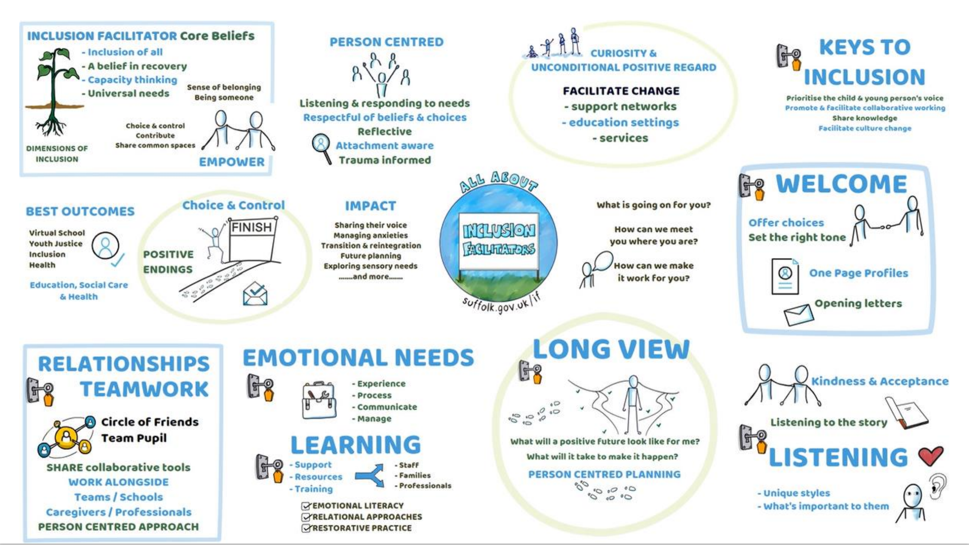
Inclusion Facilitator Role
We spend time with children and young people, getting to know them, building rapport through shared interests and meeting them where they are now.
This approach is considered using
The Keys to Inclusion;
Offering Choice and Control
Listening, acknowledging and validating their feelings and emotions
Building a trusting relationship to help plan for a positive future
Understanding what is important to the young person and what could help.
Notes:
We spend time with children and young people, getting to know them, building rapport through shared interests and meeting them where they are now.
This approach is considered using The Keys to Inclusion;
Welcome and Listening
The Long View
Meeting Emotional Needs
Teamwork, Relationships and collaborative problem solving
Endings
We offer our young people choice and control, listening whilst acknowledging and validating their feelings and emotions. We build a trusting relationships to help create a more positive plan for the future and we understand what is important to young people.
We work with a range of young people and would like to share a quick overview of the types of interventions that we provide.

Slide 4
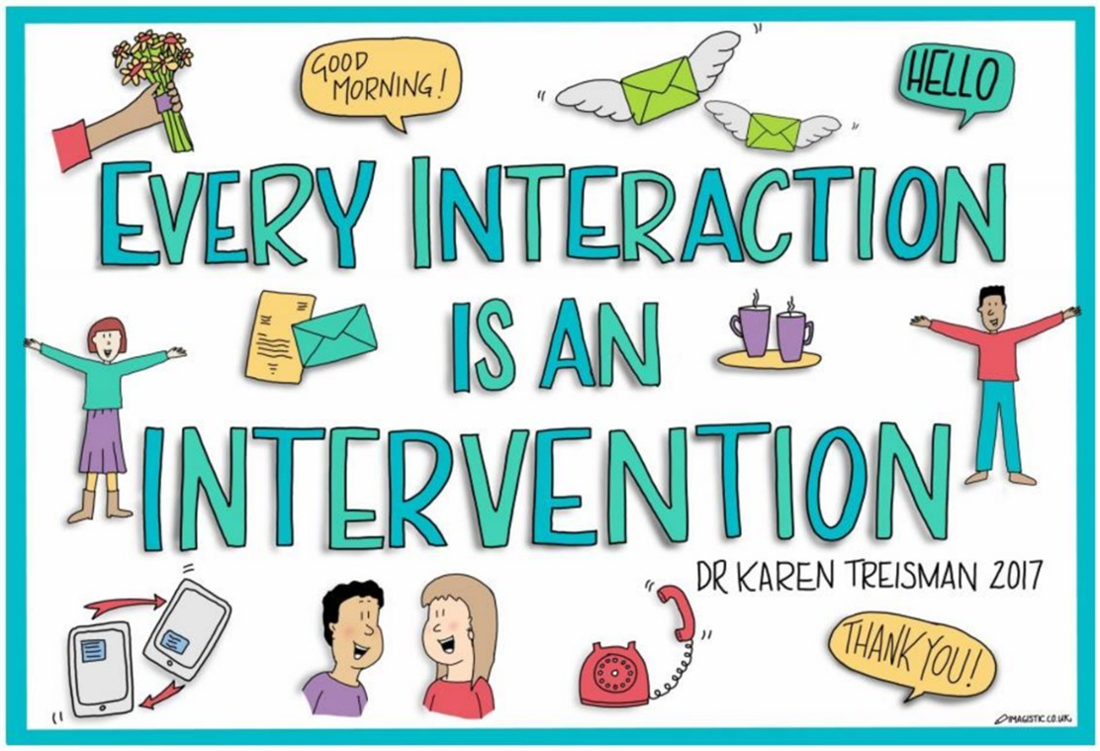
Interventions
PATH/Mini-PATH and MAP
Team Pupil
Sensory Profile
One Page Profiles
Emotional Literacy
Emotional Based School Non-Attendance
Reintegration Support
Transition Support
Staff Training
Notes:
ES: List of the interventions that we offer. Here all morning – can answer Qs. Focus today on Person-centred approaches that support CYP to share their voice

Slide 5
Pupil Voice
We strive to encapsulate the Dimensions of Inclusion across all the work that we do as Inclusion Facilitators.
Belonging
Contribution
Choice and Control
Being Someone
Sharing Ordinary Places
As Inclusion Facilitators, we strive to begin all of our work with Children and Young People (CYP) with a warm welcome.
We highly value taking the time in getting to know people and what is important to them to build trusting relationships.
What do people say about it?
"It felt like you really got to know me"
"You took time to listen"
"Your visit made her feel really energised and you pitched it just right. A very positive first visit"
Notes:
We begin by sending our OPP (could be video OPP) and opening letter – introduce ourselves. Meet them (CYP) where they are at, at their pace. Provide options to work in a way that feels comfortable for them…
So - How do we gather CYP voice…

Slide 6
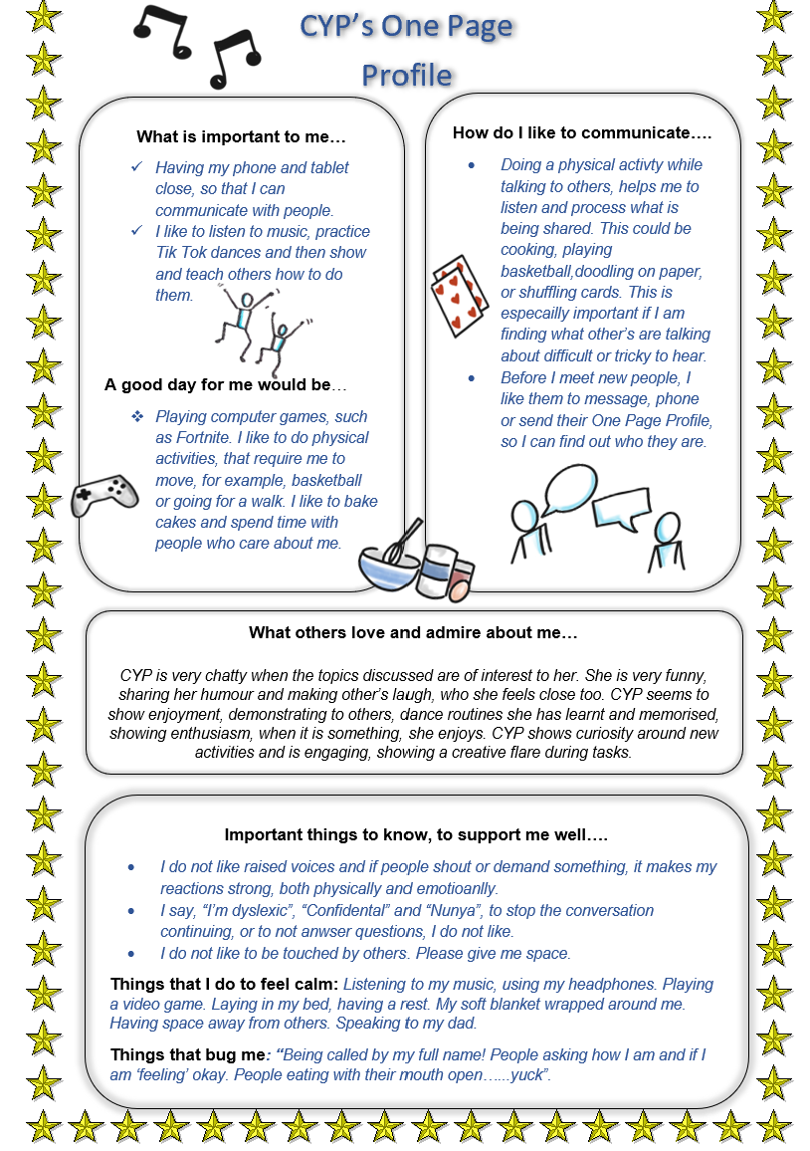
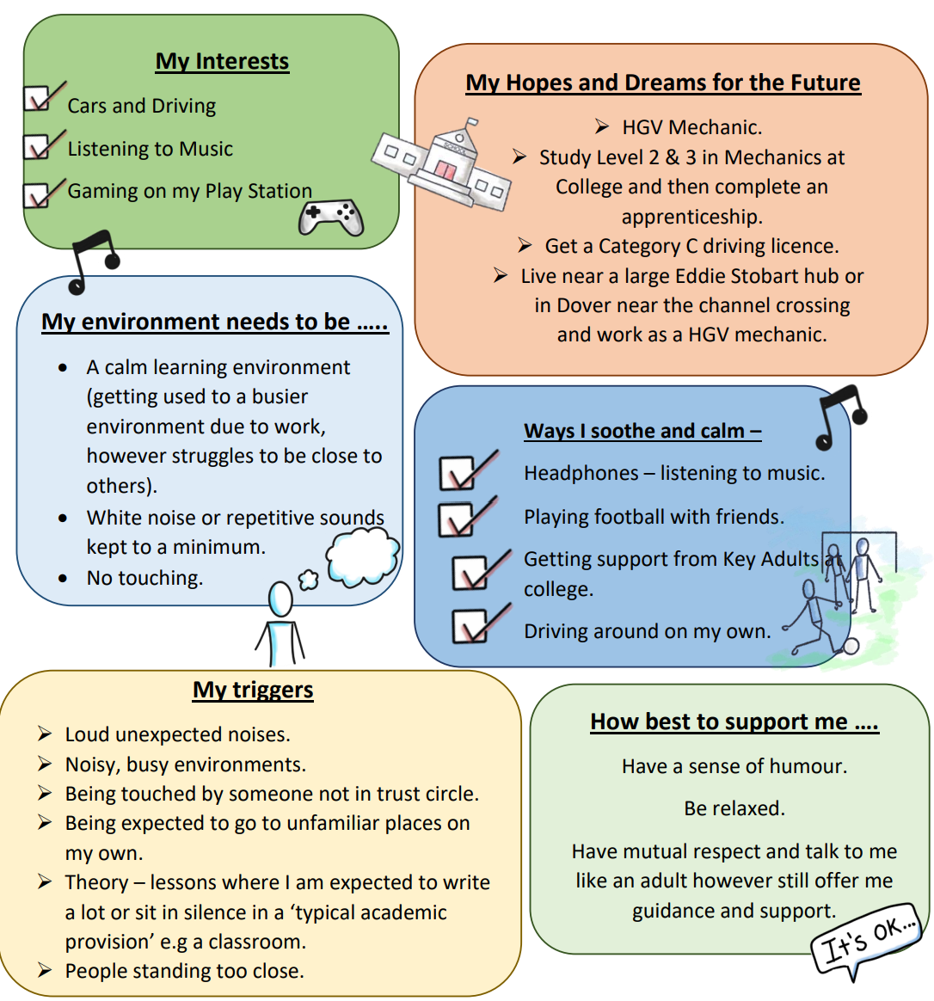
“This captures exactly what staff need to know”
One Page Profiles
“It means we are all on the ‘same page’…”
“For the record you are the ONLY person who has ever managed to complete a One Page Profile with him, which is nothing short of miraculous!”
“It’s so easy to access, having it on one page means we can put it all into place”
Notes:
ES: How can a One Page Profile help a CYP?
Ensures their voice is heard​.
Provides a clear detailed plan of how to support the young person.
An effective communication tool for young people to share what is important to, and for them.​
The process of creating a One Page Profile with a young person helps the individual and their family feel listened to.
*So effective we’ve adapted our sensory profile reports to include a One Page plan , informed by the CYP where possible, that encompasses all the key strategies and needs of the CYP.

Slide 7
How would you co-create a One Page Profile with a CYP?
Strengths and Interests
What people like and admire about me
Hopes and Dreams for the future
How best to support me
Online Support Series: Creating a One Page Profile
Notes:
(allow 5 mins – so finishing with 15min left)
How would you co-create a One Page Profile with a CYP? [not for but with them]
You have five minutes to discuss with the people around you or on your tables, how you would fill in a one-page profile with a child and young person?
Think about the types of questions you could ask?
What tasks/games could you play to get information from a young person who is more reluctant to tell you their hopes and dreams?
Is there something you already do that helps to gather information about a young person without sitting and asking the basic questions?
Maybe consider how you would do a OPP without doing a OPP ensuring that you’re still capturing the young persons voice?
Please could you share some of your ideas (5 mins)
We’ve included our OSS link which talks you through the process?

Slide 8
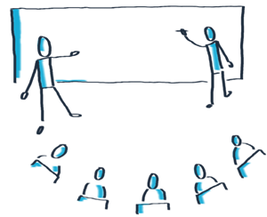
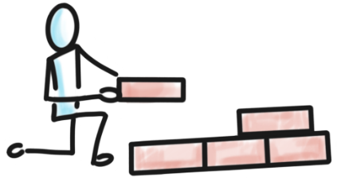
1
2
3
4
5
6
8
7
7. Building Blocks
8. Reflections
Notes:
ES: Brief overview of PATH process – focus on purpose (why a PATH)
E.g. showcase support network, bringing together, valuing CYP views – they’re at the centre (when often their experience might be others making decisions for them or speaking for them, although with best intentions, can leave them feeling they lack autonomy/control, sense of helplessness, when we want them to instead have a sense of belonging, contribution and choice & control).
Also great for transition/planning – informing what support may be required
Coming up with manageable next steps
And so on…

Slide 9
Mini-PATH
PATH | Mini-PATH
Group session with important people invited by the CYP, contributions are live in-session Completed in one in-person session (approx. 2 hours) Typically includes a process facilitator and graphic facilitator Large, wall-sized graphic (to accommodate larger group of attendees) | 1:1 between facilitator and CYP (possibly a ‘key’ adult in attendance, chosen by the CYP) Views can be gathered from other important people using a form, before the Mini-PATH session Can be broken down into multiple sessions Facilitator takes on graphicing role as well (can include CYP in this too!) Typically, smaller in scale (A2/3 paper) and can be delivered virtually
Mini-PATH Foundation Training
The training covers the importance of person-centred planning and provides you with the skills and confidence to facilitate Mini-PATH for children and young people with whom you work with.
This virtual training consists of three sessions over four weeks.
Our training is offered TERMLY.
*This training is best done in pairs*

Slide 10
IMPACT: Some examples
What did people say about PATHs?
“Such a positive experience”
“Makes it all seem more achievable with it all drawn out for everyone to see.”
“Brought us all together to see your vision”
“A truly great experience for everyone”
“Relieved that I have everything written down and a solid plan”
“This has helped me so much”
“I feel I’ve got control”
What have people said about OPPs?
“That’s me!”
“It has been so helpful; we don’t have to keep repeating ourselves.”
“I liked seeing your pictures, it helped me to know what you were going to be like.”
“Happy… as it gives a clear picture of his needs and strengths”.
Notes:
ES: Link here takes to impact pages – in process of updating webpages, so more will be added
These are some examples of what pupils/others have shared and how this has facilitated change / furthered our understanding of the CYP
(Read a couple)

Slide 11
Notes:
CYP feedback following Mini-PATH process – only a handful (read a couple)

Slide 12
Check Out Activity – 2 mins
Notes:
ES – (maybe link with presentation/ MH network day in some way, as no time to do pledges/take-aways) e.g., “what will it take for you to be able to apply something you’ve learnt from today, e.g., what do you need to start a OPP?”

Slide 13
Our One Page Profiles
For more information…
About our Service
Free Resources
Impact Pages
Thank you
for listening!
IF@suffolk.gov.uk

