Slide 1
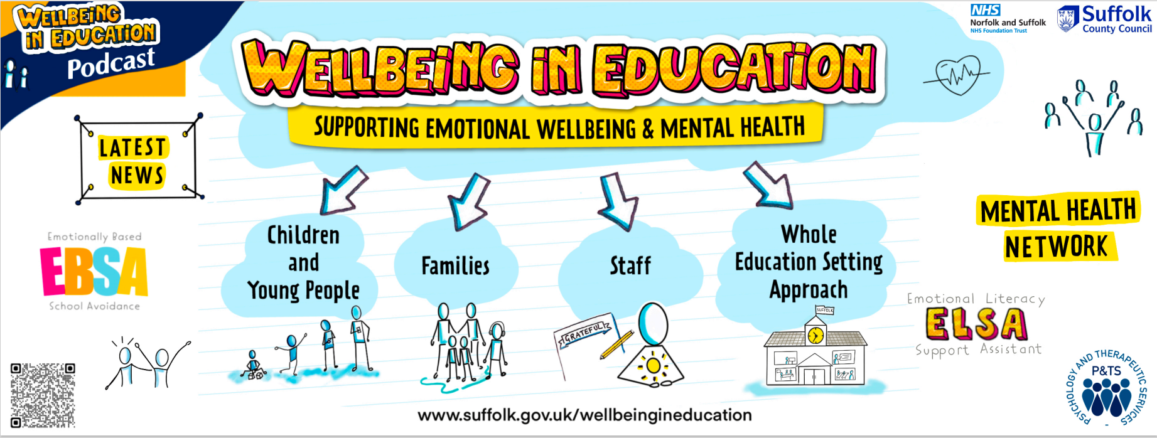
Welcome!
Mental Health Lead Network Event
9th May 2024

Slide 2
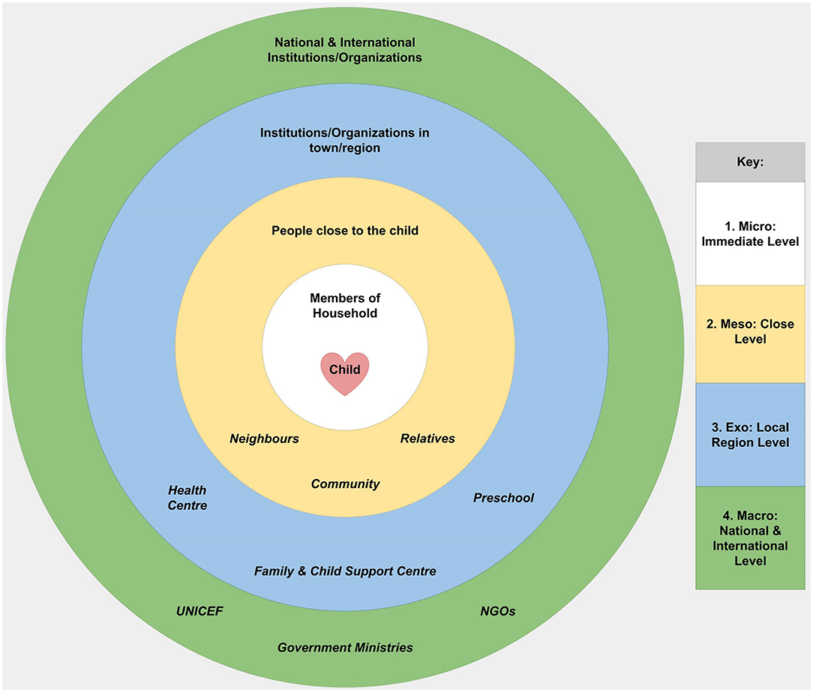
Anxiety can be considered / viewed / addressed from lots of different angles
Within communities around schools (awareness of how a sense of community builds a sense of safety) – addressed, for example, via building links with local organisations / businesses, families, the creation of local initiatives to forge positive connections, as well as awareness of the impact of our physical environments on our wellbeing and safety.
Within whole school systems (awareness of the importance of whole school approaches) – addressed, for example via staff wellbeing support or the explicit use of relational policies NEW Education Setting Guidance 2023 - Part 1 (suffolk.gov.uk)
Within explicit or implicit messages from key adults around the child (awareness of the impact of parental and teacher behaviour) – addressed, for example via teaching emotional regulation techniques to adults so that they are better at co-regulating and containing anxiety (and promoting a sense of calm) Wellbeing Check (suffolk.gov.uk) and https://www.suffolk.gov.uk/asset-library/ebsa-self-regulation-for-cyp.pdf
Within key relationships around the child (awareness of a sense of safety via strength of connection) – addressed via, for example, peer support and the strengthening of friendships https://www.suffolk.gov.uk/asset-library/promoting-feelings-of-safety-ebsa-support.pdf and https://www.suffolk.gov.uk/asset-library/ebsa-maintaining-connections.pdf
Within child (awareness of physiology, sensitivity, predisposition, temperament) – addressed via, for example, breathing techniques (e.g. see slide 3 of slides about anxiety intervention for CYP (suffolk.gov.uk))

Slide 3
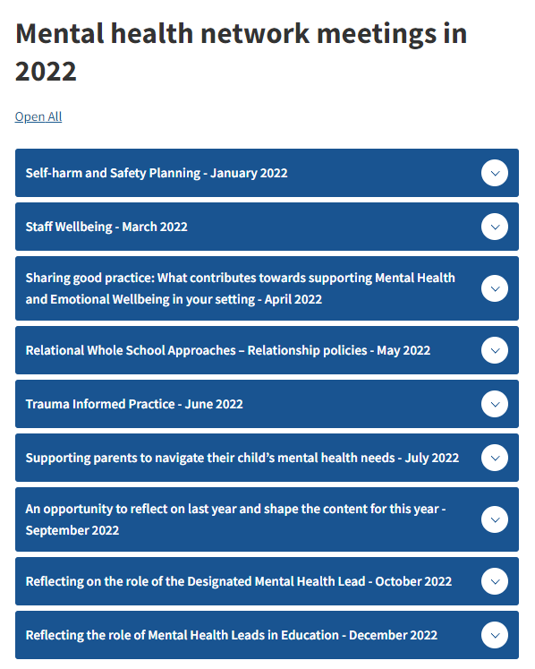
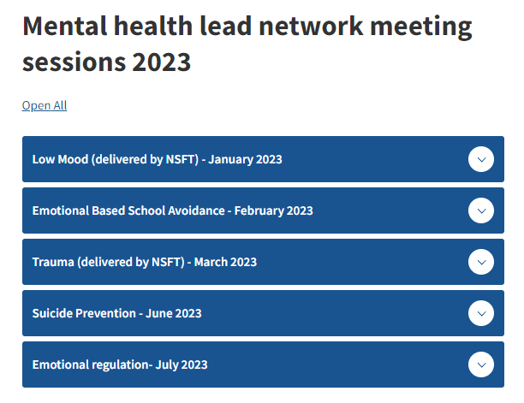
Suffolk education mental health lead network - Suffolk County Council

Slide 4
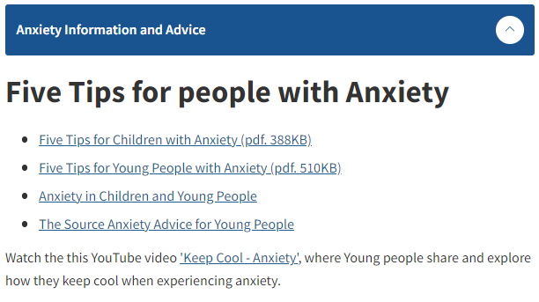
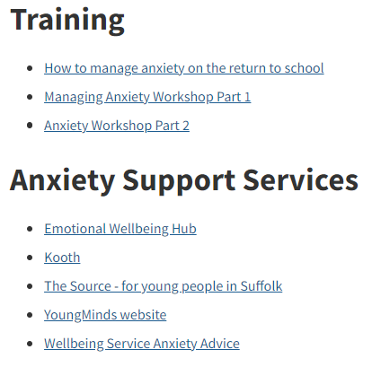
Children and young people's wellbeing - Suffolk County Council

Slide 5
EBSA (Emotionally Based School Avoidance) - Suffolk County Council

Slide 6
MHF-wear-it-green-day-2023-anxiety-booklet.pdf (mentalhealth.org.uk)
This is an easily accessible, virtual 11 page guide bringing together a range of national websites, services and on-line resources as a general up-to-date reference for secondary schools on anxiety, produced by the Mental Health Foundation. It was made in 2023 but most links and resources still available and relevant.
What is Anxiety? | Symptoms of Anxiety & Getting Help | YoungMinds Is the central page on anxiety put together for young people. It includes one or two short video clips featuring young people talking about their experiences and some ‘top tips from bloggers’. It also signposts young people to other sources of information, advice and support
I want some more general information / documents / pamphlets / websites on the topic of anxiety for CYP
Anxiety – The Source Information, Advice and sources of support for young people in Suffolk
Anxiety : Mentally Healthy Schools Information, Advice and sources of support – aimed at teachers / school staff supporting CYP.
The Mix – Anxiety
The Mix is a great source of information for young people from age 11 to 25.
On this page are a range of guides, videos, blogs and pieces of ‘expert advice’ all on the topic of anxiety.
There are also offers of 1:1 chat (facilities and counselling)
Managing anxiety in primary school - CBeebies – BBC and What is anxiety? - BBC Newsround and What is anxiety?: A kids' guide to anxiety and stress - Own It – BBC some great child friendly material on anxiety and how to manage it.
Mental Health Awareness Week 2023 toolkit of resources : Mentally Healthy Schools although 2023, the theme of that year was anxiety and the resource links are still relevant (there are primary and secondary versions)

Slide 7
201609mental_health_toolkit_for_schools_and_colleges.pdf (corc.uk.net) is a link to a very comprehensive and well researched document produced by The Anna Freud Centre, giving information and links to a wide range of wellbeing measures for children (some free, some with costs attached). The link: Outcome & Experience Measures (corc.uk.net) takes you to a whole page of downloadable questionnaires for use with pupils on a range of social and emotional and wellbeing topics (the filter facility allows you to specify age range)
The strengths and difficulties questionnaire (SDQ) : Mentally Healthy Schools is a link to a freely available questionnaire which can be completed by children and young people themselves, by their parents or by their teachers. There are shorter and longer versions available for a range of different age groups and across a range of different languages all located here: https://www.sdqinfo.org/py/sdqinfo/b0.py
I want ideas, questionnaires or activities to help me as an adult gain child / pupil views and perspectives related to mental health
Secondary - Emotionally Healthy Schools This page contains links to a range of tools and resources for assessing children and young people of secondary school age (11-16) including the Adolescent Well-Being Scale.
SPECTRUM database | EEF (educationendowmentfoundation.org.uk) This link takes you to a page where a range of researched wellbeing measures for children are listed (many for use to probe individual profiles rather than to gain a picture at a whole school level) along with links to the research behind them. The search facility allows you to specify the Key Stage you are interested in. Accessing the various questionnaires from this site is however a little more time consuming.
Measurement-tools-understanding-needs (annafreud.org) This document focuses on how to use measurement tools to understand pupils’ wellbeing so that you can provide them with the support they need. It includes a link to blf17_20-second-school-measuresbl-17-03-17b.pdf (corc.uk.net) which locates the following questionnaires: Short Warwick-Edinburgh Mental Wellbeing Scale, Trait Emotional Intelligence Questionnaire, Perceived Stress Scale, Student Resilience Survey.
Emotional Needs Survey lesson resources - Suffolk Mind includes lesson resources for key stages 3, 4 and 5 and Emotional Needs Survey - Suffolk Mind for one example of auditing mental health in pupils used by Suffolk Mind

Slide 8
Anxiety: guidance for staff in further education colleges : Mentally Healthy Schools
What schools and further education settings can do : Mentally Healthy Schools
This is a specific webinar for staff on anxiety: https://youtu.be/zhlO5ATM4Bg taken from this page: Expert advice and guidance videos: mental health in schools and colleges (annafreud.org)
I want some ideas for things we can do generally in the school day / school environment to minimise or reduce anxiety
How to help a teenager with anxiety at school as a teacher or mental health lead (worthit.org.uk)
Classroom wellbeing toolkit (annafreud.org) This evidence-based toolkit, created in partnership with the Early Intervention Foundation (EIF), will help secondary school staff take steps to improve students’ mental health and wellbeing through everyday practices.

Slide 9
School Anxiety and Refusal | Parent Guide to Support | YoungMinds written as a guide for parents who have a child who is reluctant to go to school; includes tips and stories from parents who have managed this as well as some expert advice and guidance.
Wellbeing advice to help you support your family - BBC Parents' Toolkit - BBC Bitesize hosts some links to supporting teenagers’ wellbeing for parents / carers with advice on (for example) anxiety, sleep, resilience building and LGBTQ+
www.youngminds.org.uk is an excellent source of information for young people and their parents / carers on anything related to mental health. This link goes directly to the parent page: Parents Mental Health Support | Advice for Your Child | YoungMinds and includes a parent helpline / webchat facility.
Parents and Carers | Advice and Guidance | Anna Freud Centre hosts podcasts on children’s mental health as well as tips for parental self care, conflict reduction and managing exclusion.
Anxiety self-help guide | NHS inform is an electronic guide that an adult or older child might use to aid self-knowledge and self-reflection on the topic of anxiety
I want some ideas for things that parent / carers can do to help with anxiety
https://www.mindedforfamilies.org.uk/young-people
Is a site for parents /carers who might be concerned about the mental health of their child or teenager or might just want some hints and tips on parenting. MindEd for Families has advice and information from trusted experts and will help you to understand what problems occur, what you can do to best support your family, and how to take care of yourself.
Five Tips for Families - Suffolk County Council is a link to our page of accessible tips on topics such as: sleep, anxiety, supporting pupils with ASD, positive self-talk, school avoidance
Online Workshops and Courses - Wellbeing Suffolk (wellbeingnands.co.uk)
This service offers a range of short on-line courses & workshops with both adults and children as the focus – some on mental health and some on physical health; they are all free and presented live by clinicians.
Psychology in Schools Team - NSFT Events | Eventbrite
Is a link to a rolling programme of free live webinars from Suffolk Clinical Psychologists specifically for parents on a range of mental health topics including emotional regulation, anxiety, social media, building resilience etc.
PACT | Parents And Carers Together | Suffolk
Their vision is to “reach all parents and carers across Suffolk who are caring for a child or young person with mental health issues”. They offer support (face to face meetups, online, and our outreach 1:1 service), training (including Youth Mental Health First Aid and parent guided CBT) and tools/resources to help both with a parent/carers wellbeing and via them, their child/young person too.

Slide 10
Free social work resources & tools for direct work with children and adults (socialworkerstoolbox.com) although designed for use by social workers, this site has a freely available wealth of information leaflets, activities and resources to use with children and families on topics such as: anxiety, emotional well-being, coping skills, resilience, bereavement etc.
Provide - Emotionally Healthy Schools a page of links to evidence-based quality interventions, both universal and targeted, matched to pupils’ specific needs on topics such as: exam stress support, relationships, sleep, bereavement, mindfulness. There is an equally impressive range also accessible at Mental Health Resources For Children and Young People | YoungMinds
Inclusion Facilitators Free Resources - Suffolk County Council and Children and young people's wellbeing - Suffolk County Council are links to ideas, advice, resources and strategies on our webpages
I want some ideas for things I can do in individual or small group work with a pupil to help teach them about anxiety management
Therapy worksheets, tools, and handouts | Therapist Aid as with the ‘socialworkertoolbox’ above, this site has a very wide range of freely available resources, articles, videos, worksheets, interactives to use on a plethora of wellbeing related topics.
Inspiring Stories and Resources - BBC Children in Need to find resources and stories to continue the conversation with your students about and managing their wellbeing. Mental health support and advice - BBC Children in Need hosts some guidance, activities and resources mostly suitable for KS3.
Mental health and wellbeing - BBC Bitesize also hosts a range of clips, articles and tips on mental health topics.
Resources for school staff - Suffolk Mind
There are a number of resources available to help you support the wellbeing of your students and that of your own
Secondary : Mentally Healthy Schools is a good ‘front door’ page from which you can follow a range of links to guide school practice around supporting pupil mental health.
There is also a resource link here: Resource library : Mentally Healthy Schools from which can be accessed pages of resources and guidance on over 40 mental health related topics.
On My Mind | Resources for Young People | Anna Freud Centre
‘aims to empower young people to make informed choices about their mental health and wellbeing’. Content is largely written by ‘young people for young people’. Includes links to information posters for school walls, and also resources such as: https://www.annafreud.org/media/15030/my-self-care-plan-secondary.pdf. Also gives advice to young people if they’re worried about the mental health of someone else.

Slide 11
https://www.nhs.uk/every-mind-matters/mental-wellbeing-tips/self-help-cbt-techniques/tackling-your-worries/#video is a 2 to 3 minute animated clip using an adult female voice over explaining one or two strategies for managing and containing worries.
https://www.nhs.uk/every-mind-matters/mental-wellbeing-tips/self-help-cbt-techniques/reframing-unhelpful-thoughts/ is a 1 to 2 minute animated clip explaining the concept of ‘unhelpful thoughts’ and some tips for reframing them, as one anxiety management strategy
Reframing unhelpful thoughts - Self-help CBT techniques - Every Mind Matters - NHS (www.nhs.uk) is the page of written guidance that accompanies the video including a link to a ‘Thought record’ exercise and proforma for capturing thoughts with a view to reframing (this reflects an approach similar to that used in Cognitive Behaviour Therapy)
Clear Fear is an app to help young people manage the symptoms of anxiety, developed by a clinician in collaboration with young people. The Clear Fear app uses evidence based Cognitive Behavioural Therapy (CBT). It is FREE to download from the Apple Store and Google Play. Home - Clear Fear App
I want some breathing techniques and signposts to meditations I could use or teach others to use
BBC - Headroom - Your Mental Health Toolkit
Includes stories to inspire or motivate as well as links to some online meditations to try or calming music to listen to
https://anxiety.ecrm-registration.nhs.uk/ is a link for signing up to an email programme to get expert advice and tips to help deal with anxiety
Relaxation techniques - Cumbria, Northumberland, Tyne and Wear NHS Foundation Trust (cntw.nhs.uk) a range of NHS endorsed visualisations to use or mediations to listen to

Slide 12
No Panic
Supports people struggling with panic attacks, phobias, obsessive compulsive disorder (OCD) and other anxiety-related issues - and provides support and information for their carers.
They offer a specialist youth helpline for people aged 13-20. The opening hours are 3pm - 6pm, Monday - Friday; 6pm - 8pm, Thursdays and Saturdays. 0330 606 1174 (Youth helpline)
sarah@nopanic.org.uk is the email contact.
The Mix
Offers online information as well as helpline support to under-25s about anything that’s troubling them.
Email support is available via their online contact form.
Free 1-2-1 webchat service and telephone helpline available.
Opening times: 4pm - 11pm, seven days a week
0808 808 4994
I want some contacts of organisations in Suffolk offering types of counselling support for children and young people
Home – Kooth is a website that has articles, discussion boards, on-line chats on mental health topics, as well as offering a free counselling service (for 11 to 25 year olds). The service is well used so sometimes the website buffers. It requires people to log-in but you can do so anonymously and without sharing any personal information
4YP works with 7-25 year-olds at the Ipswich town centre hub, in schools and out in the community.
4YP At School - 4YP - For Children & Young People Charity 4YP At School is a bespoke service, tailored to the individual needs of each school, which draws on 4YP’s expertise to supply counselling and/or youth work onsite services.
If you are interested in exploring how 4YP could assist your school, please contact at 01473 252607 or via email enquiries@4YP.org.uk
Mental Health Support For Children and Young People - YMCA (ymcatrinitygroup.org.uk) details the YMCA offer which includes counselling and therapeutic support for staff as well as individual pupils or groups.
https://www.teenagementalhealth.co.uk
For Mental Health Support in Ipswich & the surrounding areas Teenage Mental Health offer help both to parents and children.
“We can work with you and your child to ensure positive outcomes for all through specialist child therapy” (note however that beyond the first appointment, the service is not free.
Call: 01473 411324
Email: reception@teenagementalhealth.co.uk
Address: 31 Lower Brook Street, Ipswich IP4 1AQ
Childline 0800 11 11
If you’re under 19 you can confidentially call, chat online or email about any problem big or small.
Sign up for a free Childline locker (real name or email address not needed) to use their free 1-2-1 counsellor chat and email support service.
Can provide a BSL interpreter if you are deaf or hearing-impaired.
Hosts online message boards where you can share your experiences, have fun and get support from other young people in similar situations.
Opening times: 24/7

Slide 13
https://youtu.be/pJCpZBIedrw is a 2 minute animated YouTube clip produced by Mind with an English accented adult female voice over, with some ‘bite-size’ guidance on managing panic attacks.
Managing panic attacks
https://youtu.be/9YaS_4tXBNU is a 3 minute YouTube clip featuring a group of English men and women sharing what panic attacks feel like for them and how they’ve learned to manage them
Call 01952 680835 for a recorded breathing exercise to help you through a panic attack (available 24/7) – promoted by the No Panic service.
Panic Attacks | Signs and Symptoms | YoungMinds
Is the central page on panic attacks on the YoungMinds website, giving a lot of written guidance on self-care,
tips for managing panic attacks and how to help someone else having a panic attack.

Slide 14
Our Inclusion Facilitation Service...
Working within the Psychology and Therapeutic Services
Offering therapeutic support for CYP in any age or stage
Helping staff in educational settings embed best practice
Person-centred, tailored interventions that demonstrate real inclusive impact
Interventions can be one off or across many months, depending upon need
www.suffolk.gov.uk/IF
Visit our webpages for:
A ton of free training and resources
Impact highlights
Our One Page Profiles

Slide 15
