Slide 1
WELCOME
TO

Slide 2
My name is
..........................................
Me!
I come from
..........................................
I speak
..........................................

Slide 3
About me

Slide 4
About our school

Slide 5
Your class
YOU WILL NEED
Equipment (pens, bag, water, snacks etc)

Slide 6
Your teachers

Slide 7
Places to go in school
(safe spaces)

Slide 8
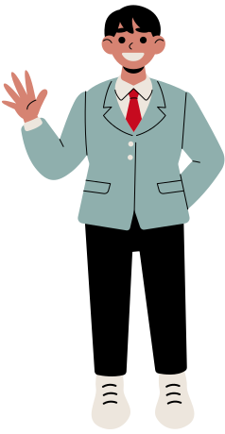
Uniform

Slide 9
School Day
8:00 AM
12:00 PM
3:30 PM
Arrive at school
Lunch Time
School ends

Slide 10
Your Buddy

