Slide 1
Discover Your Future 2021 Stress & Resilience
Virtual Work Inspiration Suffolk | April – July 2021

Slide 2
Employer Ambassador

Slide 3
Feedback on Keynote session: Laura’s story
What did you think about Laura’s story?
How did you score on the resilience quiz?

Slide 4
Stress & Resilience
Aims of the Session:
To help you find techniques to overcome new, challenging or stressful situations
To give you the tools to prepare and practice for a job/college/Apprenticeship interview
To increase your confidence and self esteem
By the end of this lesson you will have some tools to help them deal with stressful situations

Slide 5
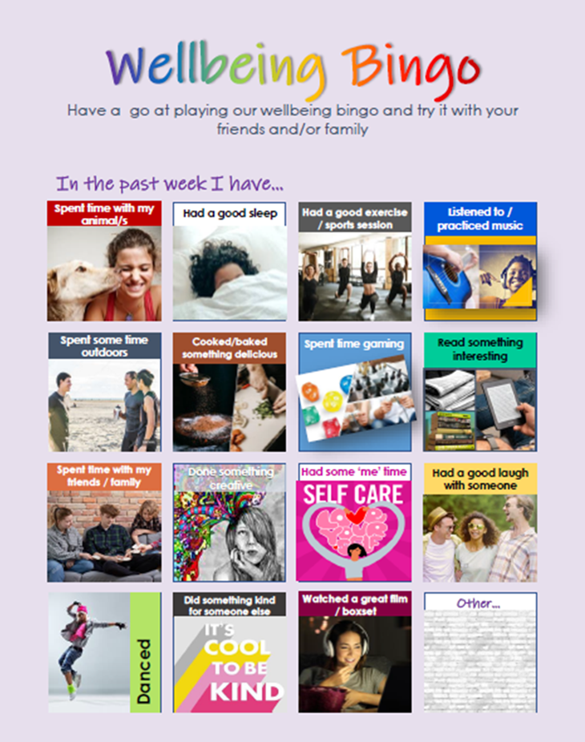

Slide 6
STRESS & RESILIENCE
What do we mean?
What is stress?
Being under pressure is a normal part of life. It can help you take action, feel more energised and get results. But if you often become overwhelmed by stress, these feelings could start to be a problem for you.
What makes you stressed?
How do you deal with it?
What is Resilience?
Learning how to cope with uncertainty or stress, how to make the most of the resources and connections you have around you, and how to adapt to changing situation.

Slide 7
Interviews
Interviews for college, work, apprenticeships are often very stressful.
We can get really nervous and not make the best impression.
Would any of the techniques work in this situation?

Slide 8
Resilience Techniques
Asking for help
Acceptance - no-one is perfect
Taking a break
Eating well
Getting enough sleep
Doing some exercise
Being prepared
Reflecting – what went well, what would you do differently
Perspective- what’s the worst that could happen? Or did happen?
Being kind to yourself

Slide 9
Time to reflect…
What have I learnt?
Add your thoughts to your workbook

