Slide 1
Discover Your Future 2021 Understanding the key skills Suffolk Employers need
Virtual Work Inspiration Suffolk | April – July 2021

Slide 2
AIMS of the session:
To help you understand key employability words or terminology.
To help you understand the skills and qualities needed for employment.
To help you identify your interests and how these can be used to support future career choices.

Slide 3
Hello to Employer Ambassador

Slide 4
Feedback on Keynote session
What did you think about the keynote session?
What were the main points you remember?

Slide 5
What skills do people need to succeed in work?

Slide 6
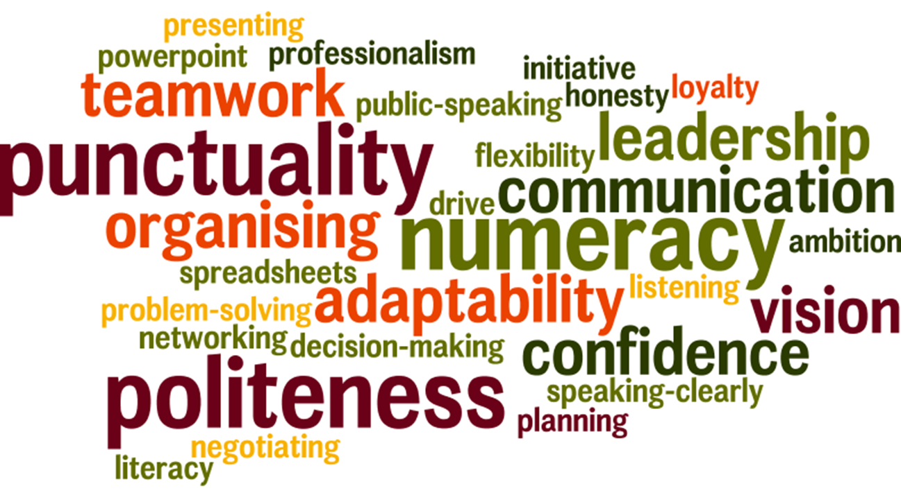
Key skills Suffolk employers need

Slide 7
Skills people need in their jobs…
In pairs or small groups ... think of a job title – e.g. Carpenter
What skill might a carpenter need? e.g., numeracy
And why? e.g., to be able to measure materials correctly!
Employer Ambassador to start this off with their job role and one skill they need…
How many job titles can you come up with as a class?
How many skills can you think of?

Slide 8
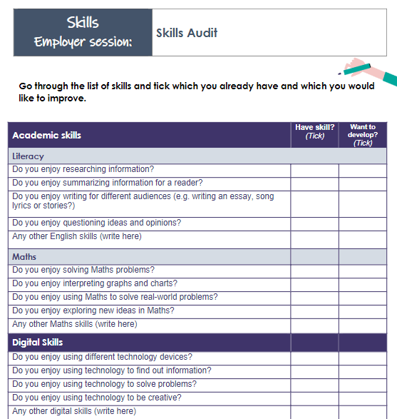
Your Skills Audit
Complete as much of the audit from your workbook as you can.
What evidence can you think of to show that you have these skills?
What areas do you need to develop?
How could you do this?

Slide 9
Summary
Businesses need people in many different roles with a huge range of skills if they are going to be successful.
Many employability skills are needed in most jobs – so you will need to develop these whatever route you take.
Make sure you start developing your skills now!

Slide 10
Reflection
What have you learnt today?
Add this to your workbook?
Don’t forget to thank your employer Ambassador

